Slide 1
Analytics 4.0 Overview

Slide 2
Summary of Changes
The following table references ONLY the new or enhanced capabilities within Analytics 4.0:
Category | Feature | Details/Comments
Call Centre Features | Agent Log-Off and State Control Silent Monitoring/ Whisper Coaching Queue Control Call Control Agent Break Reason Report Queued Callback Report “Bounced” rather than “Missed” | Supervisors can log out ACD Agents remotely via Analytics Supervisors can change an ACD Agent’s state – (Available, Unavailable with reason code (Meeting, Lunch, etc) via Analytics. Supervisors can initiate Silent Monitoring and Whisper coaching to an ACD agent via Analytics. Supervisors can receive Help requests (Silent monitoring) and Whisper coaching requests from agents within Analytics. Supervisors can pick up queued calls from a live queue via Analytics (Group Wallboards/ My Dashboard). Supervisors can move queued calls from one ACD queue to another via Analytics. Supervisors can make calls to ACD agents via the Agent Status Wallboard or My Dashboard. Supervisors can return calls via the Unreturned Missed/ Abandoned Call reports. Supervisors can assign Unreturned calls to an ACD callback queue. A new break reason summary report shows how many breaks of each reason/ the duration for each Agent. New metrics show queued callback stats – callback requested/ offered/ accepted/ missed etc. When a call is bounced to another Group, the call is shown as “Bounced” rather than “Missed” from the previous group.
Business Analytics | Consolidated Reporting | Multiple Customer tenants (Max. 1000) can now be grouped together in “Consolidated Reporting Groups”. Supervisors can now be elected as “CRG Supervisors” allowing them to view Analytics data across multiple tenants.

Slide 3
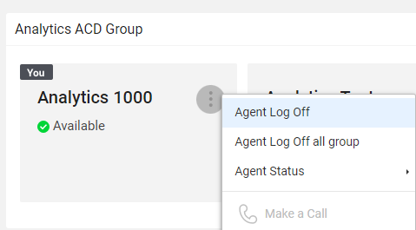
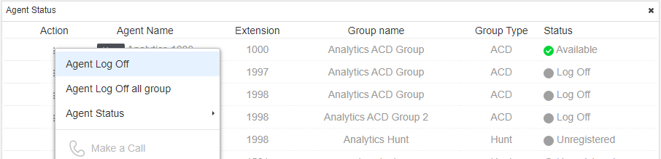
Agent Log-Off
ACD Supervisors can log target Agents out of ACD queues from within Analytics. This can be done via:
Agent Status Wallboard
My Dashboard (Agent Status Component)
Notes:
Can log out and change state, but not log in

Slide 4
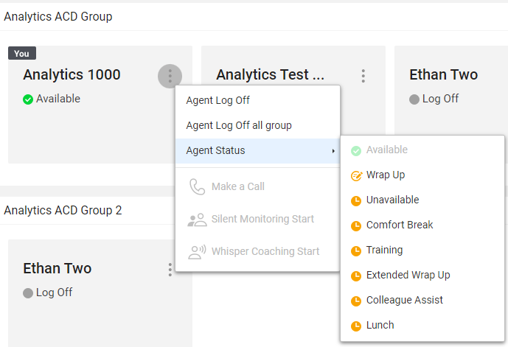
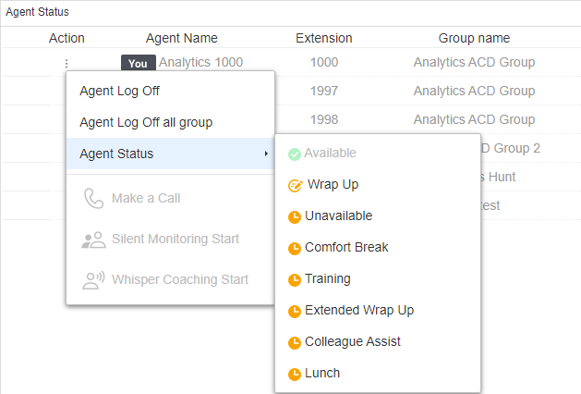
Agent State Control
ACD Supervisors can change Agent State to one of the “Reason Codes” set in the Customer Manager Portal. Agent State can be changed via:
Agent Status Wallboard
My Dashboard (Agent Status Component)

Slide 5
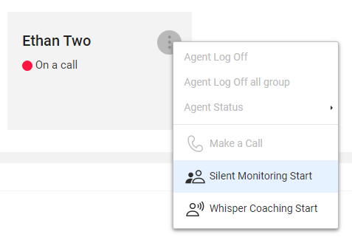
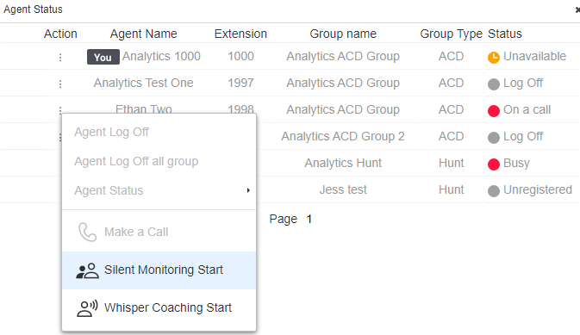
Silent Monitoring/ Whisper Coaching - 1
ACD Supervisors can initiate Silent Monitoring or Whisper Coaching via:
Agent Status Wallboard
Agent Call Summary Wallboard
My Dashboard (Agent Status Component)

Slide 6
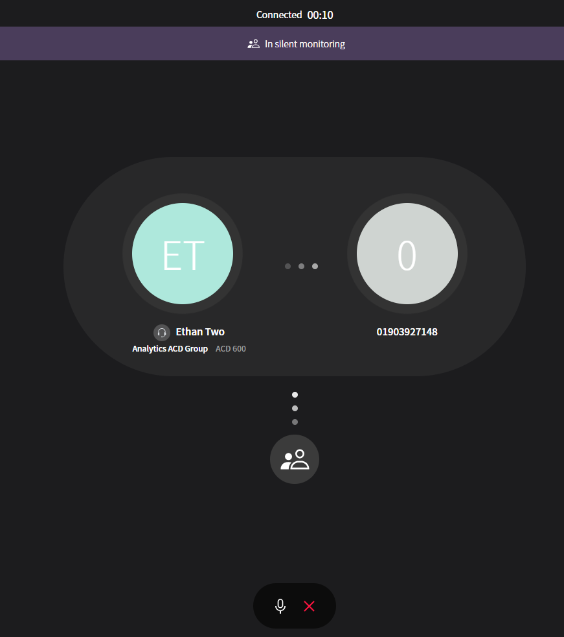
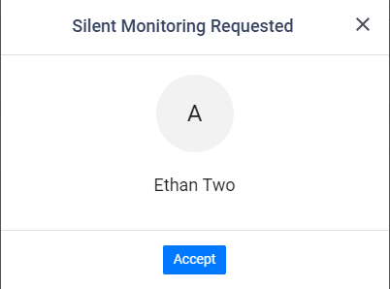
Silent Monitoring/ Whisper Coaching - 2
ACD Supervisors can receive and accept help requests and silent monitoring requests within the Analytics client, which will then initiate the call either via desk phone or iPECS ONE web client:
Notes:
iPECS ONE user must be logged in on the browser

Slide 7
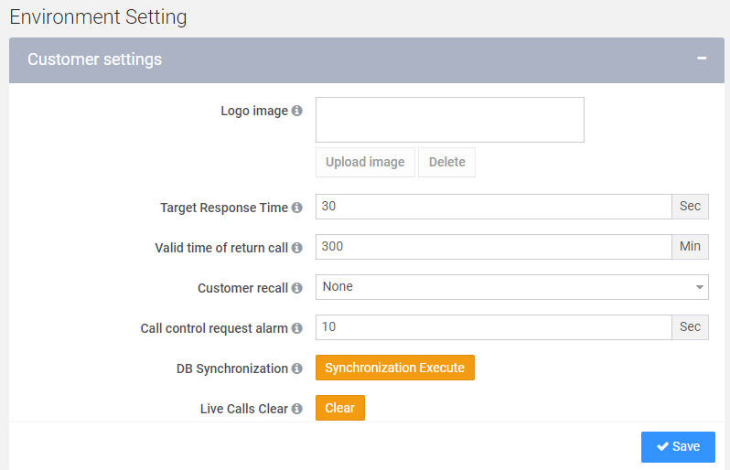
Silent Monitoring/ Whisper Coaching - 3
The amount of time the notification remains on screen can be adjusted via the Environment Settings within Analytics:
Notes:
Max 3600 seconds

Slide 8
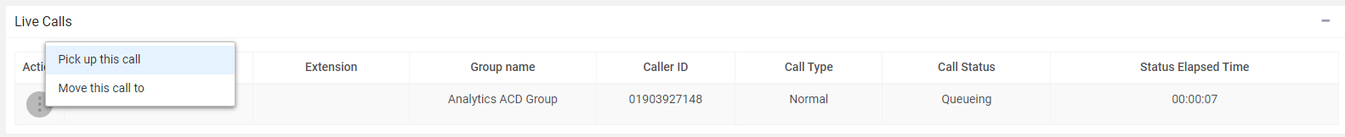
Queue Control - 1
ACD Supervisors can pick up and answer their group’s queueing calls (Normal or Callback).
This can be done via:
ACD Wallboard
My Dashboard (Live Calls Component)
Notes:
Counts as answered on group stats

Slide 9
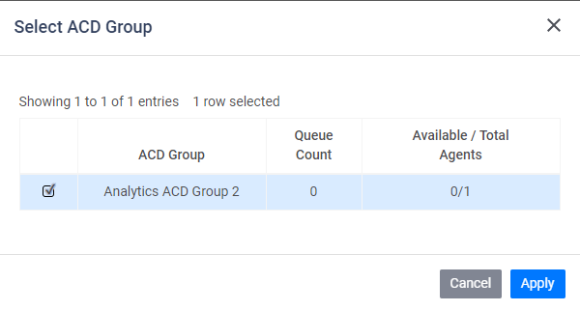
Queue Control - 2
ACD Supervisors can move queueing calls (Normal or Callback) to other ACD groups.
Counts as “Bounced” for the initial ACD group.
This can be done via:
ACD Wallboard
My Dashboard (Live Calls Component)
Notes:
Can only be moved to a group with queueing enabled Queue must have space to accommodate call

Slide 10
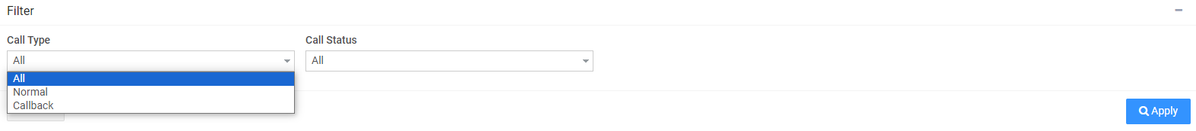
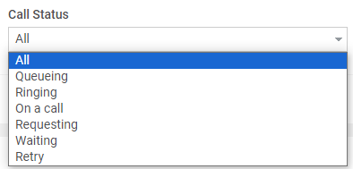
Queue Control - 3
Live calls can now be filtered by Call Type and Call Status:

Slide 11
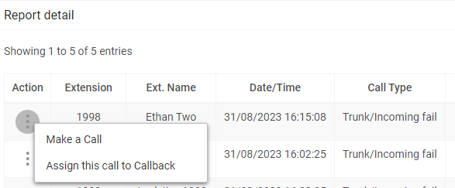
Call Control - 1
ACD Supervisors can now:
Return unreturned missed calls personally
Assign unreturned missed call Callbacks to an ACD queue
Notes:
Callback is only cleared if the call is assigned to the group it was missed by
Can only be assigned to an ACD group with “Callback” enabled

Slide 12
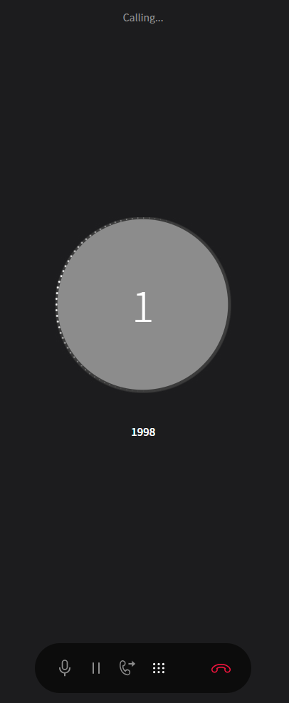
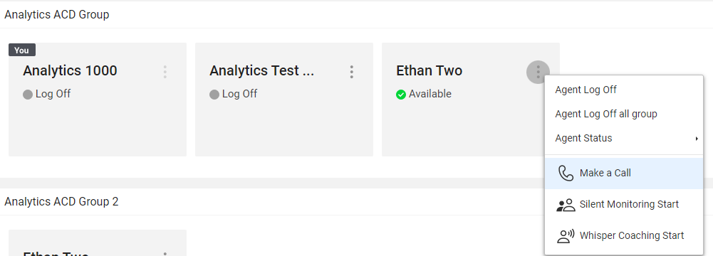
Call Control - 2
ACD Supervisors can initiate calls directly to ACD Agents from within Analytics.
The call is then made through iPECS ONE (if applicable) or the user’s desk phone.

Slide 13
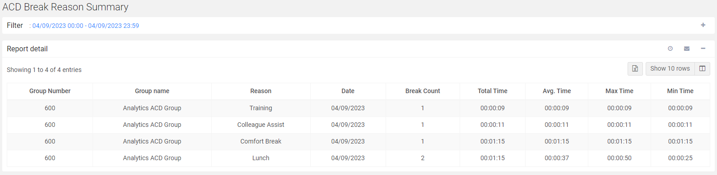
Agent Break Reason Report - 1
A new report shows statistics for how often each Break Reason is used per group.
A breakdown of when each Agent changed availability can still be found within he Availability History Report.

Slide 14
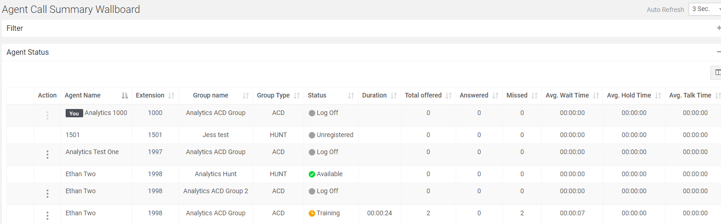
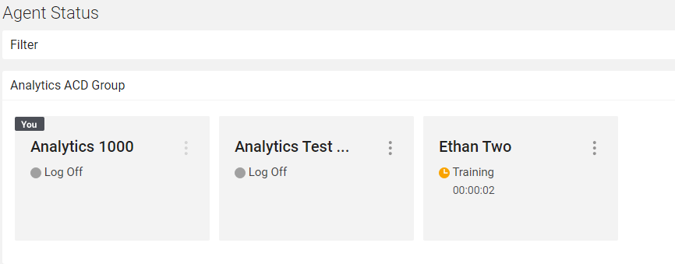
Agent Break Reason Report - 2
Agent Break Reasons are now shown on:
Agent Status
Agent Call Summary Wallboard:

Slide 15
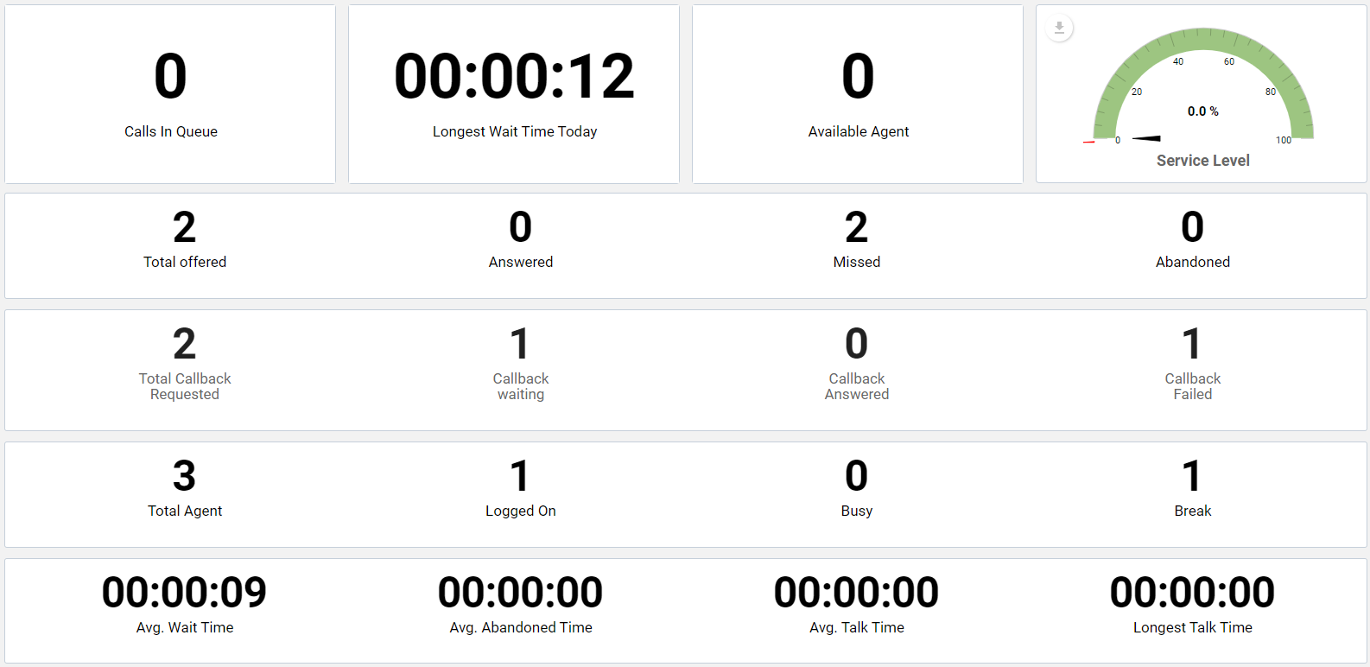
Queued Callback KPIs - 1
New KPIs have been added to Wallboards and Reports:
Notes:
Callback Requested – number of requested callback calls
Callback Waiting – number of waiting callback calls(from callback requested to completion(answered or failed) of callback)
Callback Failed – number of unanswered callback calls(It is updated after attempting defined retry times callback and failed).
Callback Answered – number of answered callback calls.

Slide 16
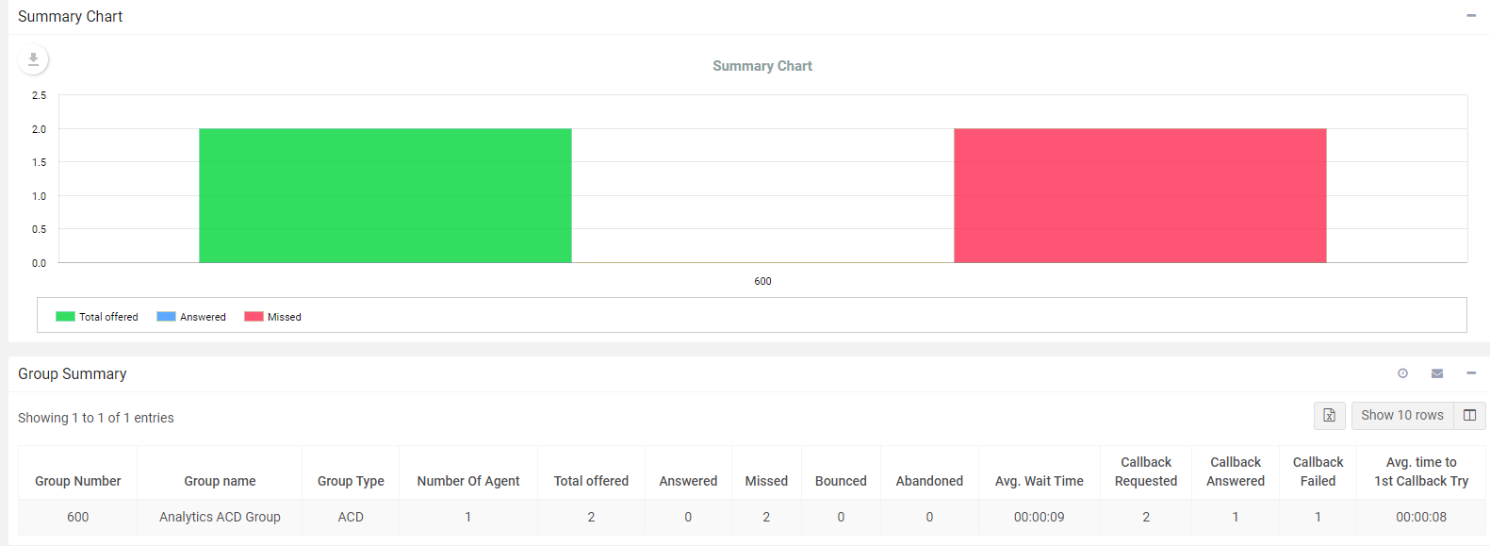
Queued Callback KPIs - 2
New KPIs have been added to Wallboards and Reports:
Notes:
Avg. time to 1st Callback Try - Average time from the callback requested to the 1st callback attempted.

Slide 17
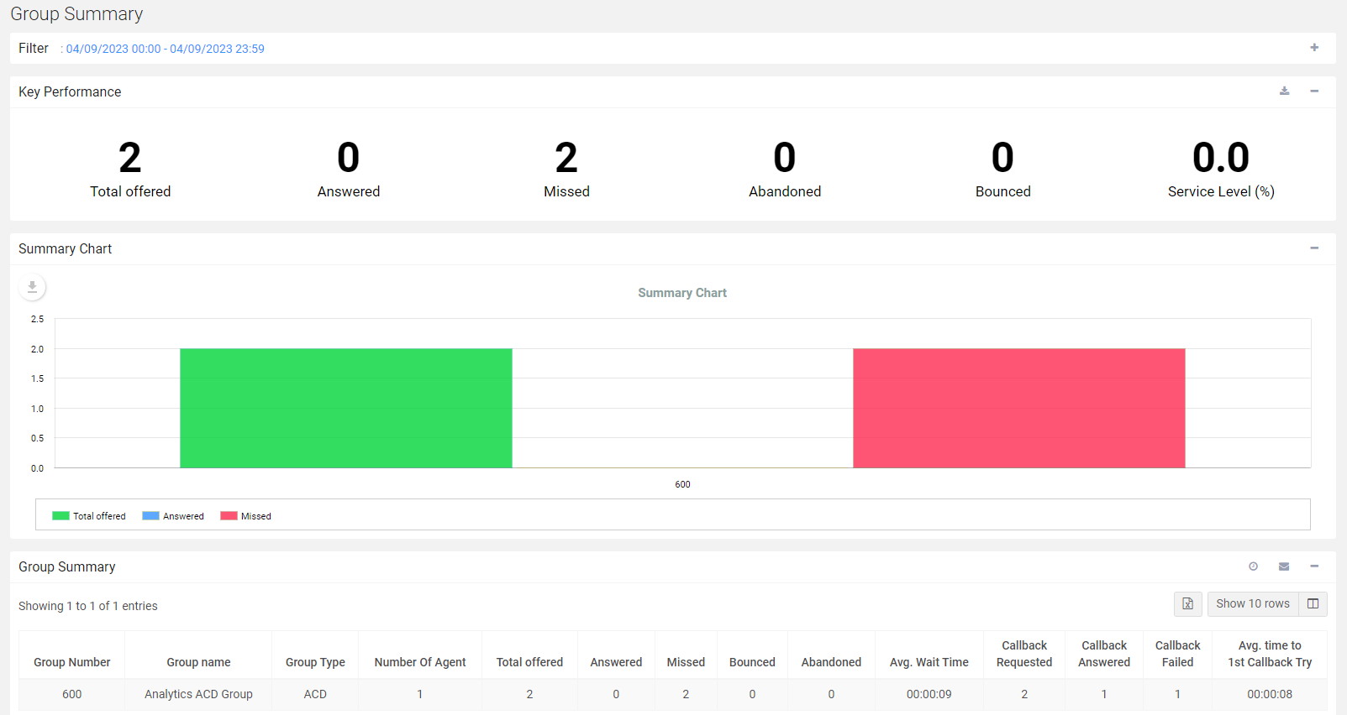
Bounced rather than Missed - 1
When a call to a group is bounced, it is now displayed as “Bounced” rather than “Missed” or “Abandoned”.
This behaviour is exhibited in the below scenarios:
When calls are forwarded on from one group to another
When a call is sent to the ACD Queue Timeout destination

Slide 18
Bounced rather than Missed - 2
This has been added to the below Wallboards and Reports:
Wallboards
Reports
Group Summary Wallboard
Extension Wallboard
Group Call Summary
Group Call Details
Company Call Summary
Extension Call Summary
Extension Call Details

Slide 19
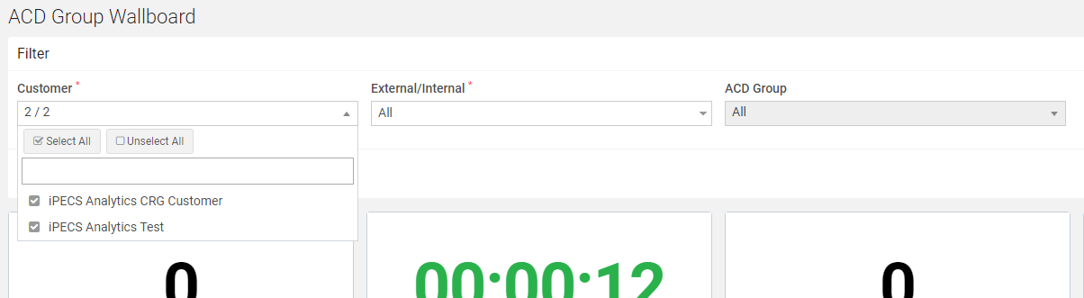
Consolidated Reporting Group - 1
Customers can now be grouped into “Consolidated Reporting Groups” (CRGs)
Supervisors can be elevated to become “CRG Supervisors”, granting them access to view other Customer Analytics Data.
Notes:
Can filter by customer in all menus (include My Dashboard) except below meus. Data Management, SETTINGS.

Slide 20
Consolidated Reporting Group - 2
Consolidated Reporting Groups are set up via an Analytics SP account.
If you require a CRG set up, please contact the Pragma Order and Provisioning team in order to arrange this.

