Slide 1
iPECS Cloud 6.0 Overview

Slide 2
Summary of Changes
The following table references ONLY the new or enhanced capabilities within iPECS Cloud 6.0:
Category | Feature | Details/Comments
Analytics Licensing | New ACD Call Control License | New ACD License version to allow the Call Control features in Analytics P4.
ACD | ACD Multi-Login Changes ACD Callback Configuration ACD Reason Codes ACD Agent Wrap-up Extension (iPECS ONE) | ACD Secondary Groups now set up within the Customer Manager portal. Callers can now request a Callback while waiting in an ACD queue. Reason codes can now be set in the Customer Manager for use within iPECS ONE and Analytics. ACD agents using iPECS ONE can be given the ability to extend their wrap-up timer.
iPECS ONE Features | Pickup Group Notification for iPECS ONE Users Sending Login information to Multiple Users iPECS ONE Microsoft Login iPECS ONE Teams Presence Settings | iPECS ONE Users in Pickup Groups can now have notifications enabled for waiting calls. Login information for iPECS ONE can now be sent to multiple users at once, rather than one by one. Users that have an AAD can now use Microsoft SSO to log in to iPECS ONE. iPECS ONE Users can sync their presence with their Microsoft Teams presence.
Customer Manager Features | Voicemail Schedules for Shared Lines Display Names on Voicemails Customer Based Call Recording Tone Call Recording Access History Report Shared Line Support for Hot Desk Users Phone Background Image Multi-Upload Site Limit Increase Multiple User Setup Enhancement | Shared lines can now have separate voicemail schedules. If a caller ID is registered in the company directory, the caller’s name will be shown in the voicemail list in the User portal. Call recording tone (ACR and ODR) can be set separately for each customer. A report can now be viewed to audit call recording access history. Hot Desk Users (Virtual Users) can be registered as Shared Line members. The Customer Manager can multi-upload phone background images to 1000i series phones. The limit for Customer Sites has been increased to 1000 per customer tenant. More options have been added when adding multiple users at once.

Slide 3
New ACD Call Control License - 1
A new ACD license is needed to enable the Analytics 4.0 Call Control features.
ACD User – CC licenses must be assigned to all ACD users to facilitate this.
There is an additional charge for this license which enables new features
Without a CC license, the following new Analytics ACD Supervisor features cannot be used:
Agent log off + State Change
Silent Monitoring/Whisper Coaching
Queue Control
Call Control
Notes:
There cannot be a mix of ACD User and ACD User – CC licenses on one tenant

Slide 4
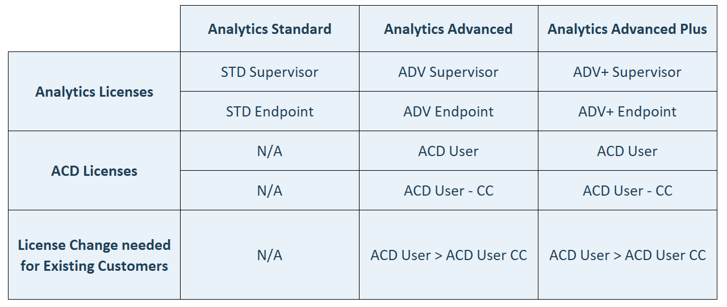
New ACD Call Control License – 2
Notes:
There cannot be a mix of ACD User and ACD User – CC licenses on one tenant

Slide 5
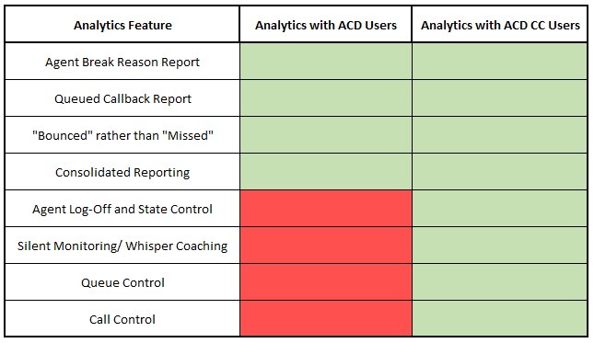
New ACD Call Control License – 3
Notes:
Listed in green are the features that are possible with each type of license

Slide 6
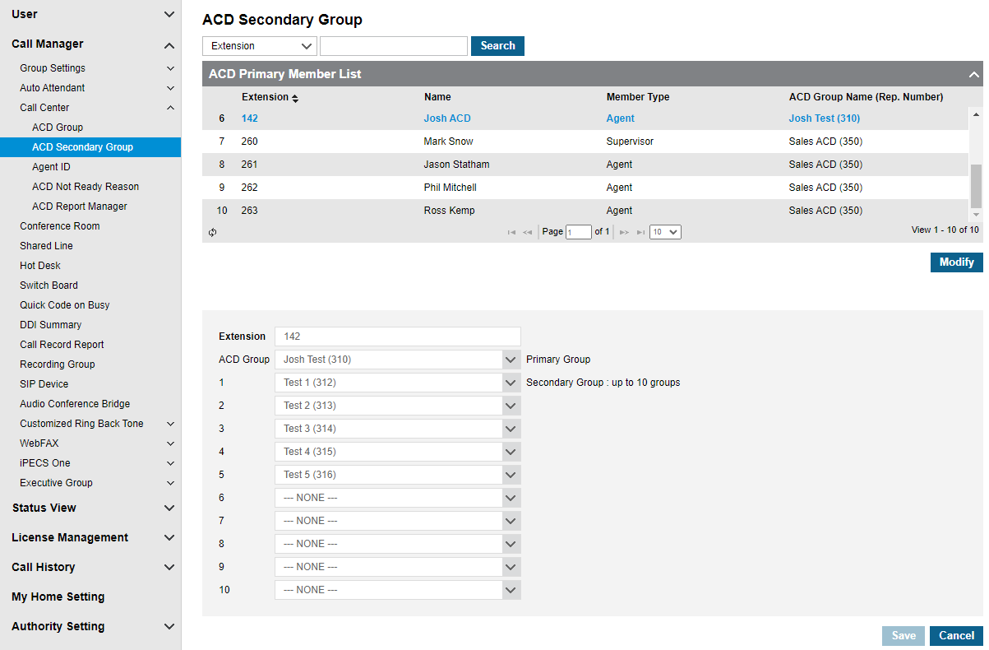
ACD Multi-Login Changes - 1
ACD Secondary groups are now set up and managed via the Customer Manager Portal.
Call Center > ACD Secondary Group
Notes:
Secondary groups will be defaulted at time of upgrade. So, they will need to be reconfigured in the customer manager upgrade post-upgrade.

Slide 7
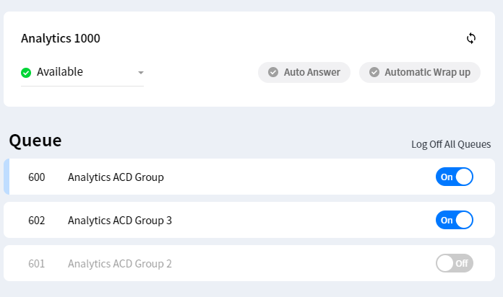
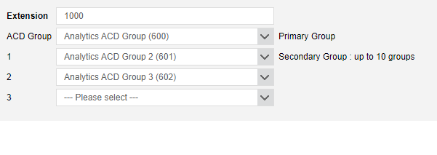
Secondary ACD Groups
In iPECS ONE P3, Secondary ACD groups were added/removed by the iPECS ONE user.
In iPECS ONE P4, Secondary ACD groups are added/removed within the Customer Manager Portal, and logged into/out of within the iPECS ONE client.

Slide 8
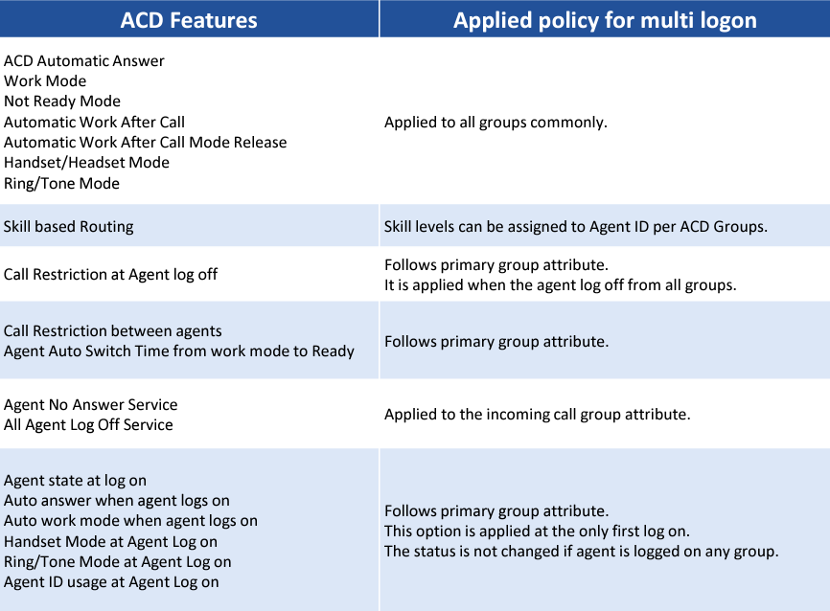
ACD Multi-Login Changes - 2

Slide 9
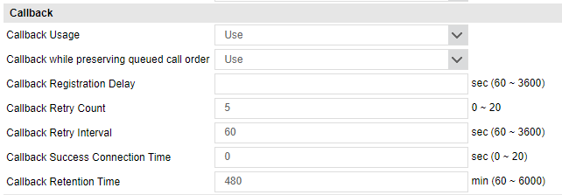
ACD Callback Configuration - 1
Callers can now register a “Callback” from within the ACD Group Queue.
Callback Calls will either retain their position in the queue, or be placed at the back (dependent on configuration.
Once a Callback Call reaches the front of a queue, an Agent will be allocated the call, and upon picking up the phone, a call will be made to the number presented by the original caller.
These calls now have representative stats within Analytics.
Notes:
Callback Usage – Dictates whether callbacks can be registered for the group
Callback while preserving queued call order – If this is set to “Use”, then Callbacks will retain their position in the queue
Callback Registration Delay – The delay before a callback joins the queue (if not set to retain PIQ)
Callback Retry Count – How many times a Callback will be attempted before it is dropped
Callback Retry Interval – The minimum interval between Callback attempts
Callback Success Connection Time – The minimum time that a Callback call must last to be considered a success
Callback Retention Time – The maximum amount of time a Callback can remain in a queue

Slide 10
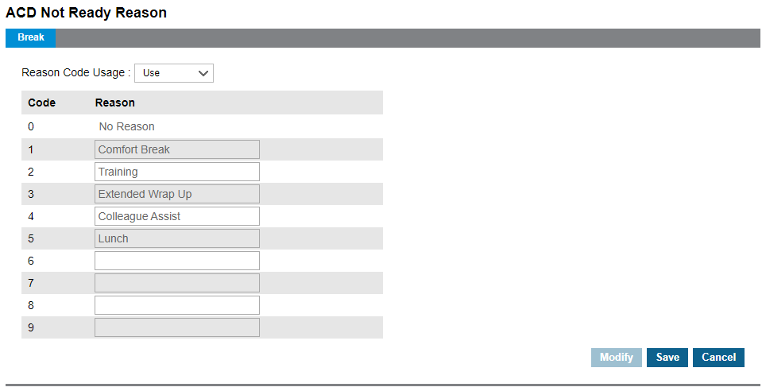
ACD Reason Codes
When an ACD Agent becomes unavailable, they can now provide a reason using codes set up via the Customer Manager Portal.
These reason codes are automatically synced to iPECS ONE and Analytics
Notes:
Max 16 Characters

Slide 11
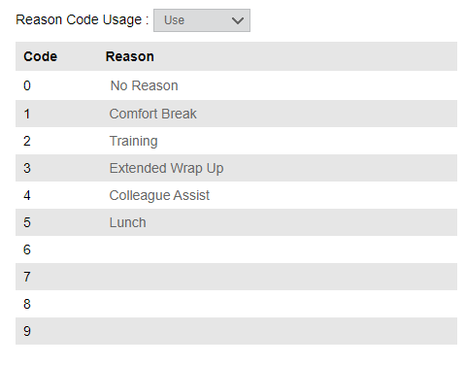
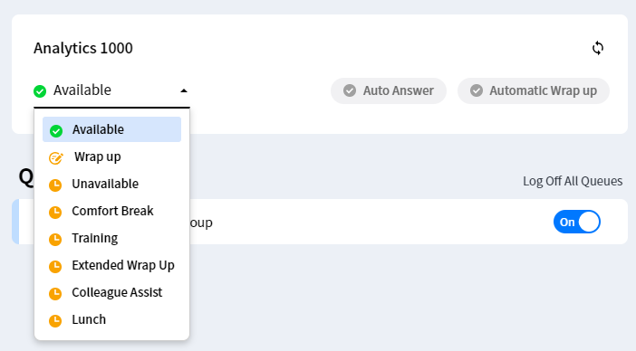
Agent Reason Codes
Agent Reason Codes (set in the Customer Manager Portal) can now be used by Agents to explain their unavailability:

Slide 12
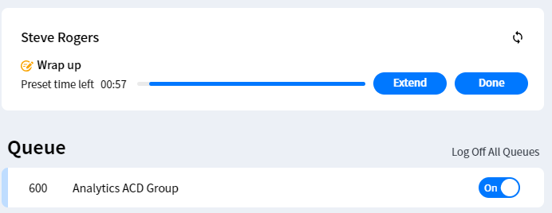

ACD Agent Wrap Up Extension (iPECS ONE)
If an ACD group is set up with call wrap-up, iPECS ONE Agents can be granted permission to extend the remaining time if needed.
Notes:
Extend button will extend wrap up to the max wrap up timer set in the customer manager

Slide 13
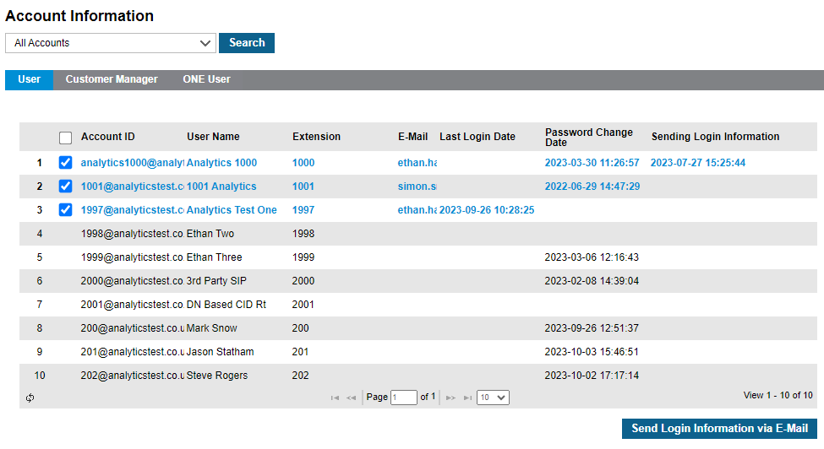
Sending Login Information to Multiple iPECS ONE Users
Login details can now be emailed to multiple iPECS ONE Users at once via the Customer Manager portal.

Slide 14
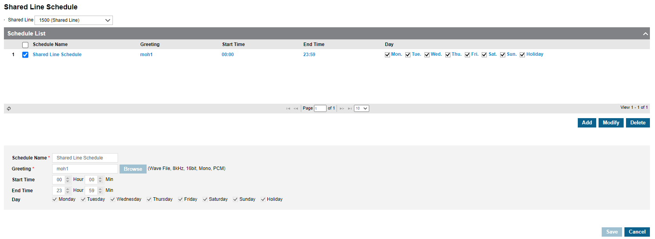
Voicemail Schedules for Shared Lines
Via the Customer Manager Portal, Voice Mail schedules can now be set for Shared Lines.
This is done via Company > Voicemail Service > Shared Line Schedule

Slide 15
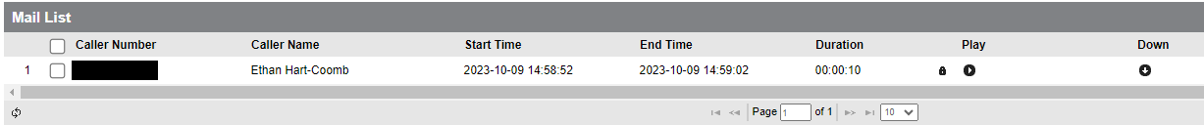
Display Names on Voicemails
If a caller’s ID is registered in “Group Speed Dial” in the Company Directory, the caller’s name will be shown in the voicemail list within the User Portal:

Slide 16
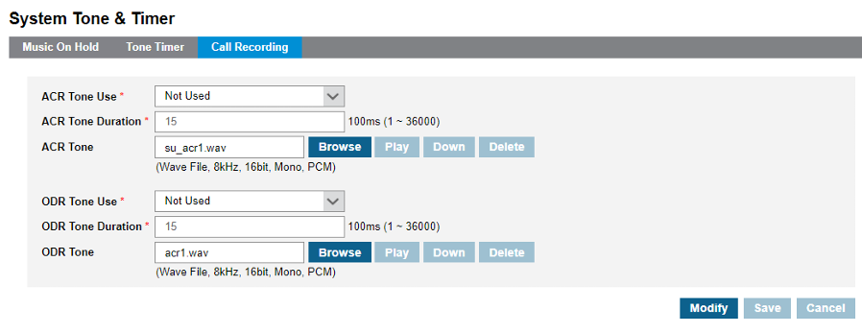
Customer Based Call Recording Tone
Call recording tones can be changed on a tenant by tenant basis.
Separate tones can be uploaded for ACR and ODR.
This is done via Company > System Tone and Timer

Slide 17
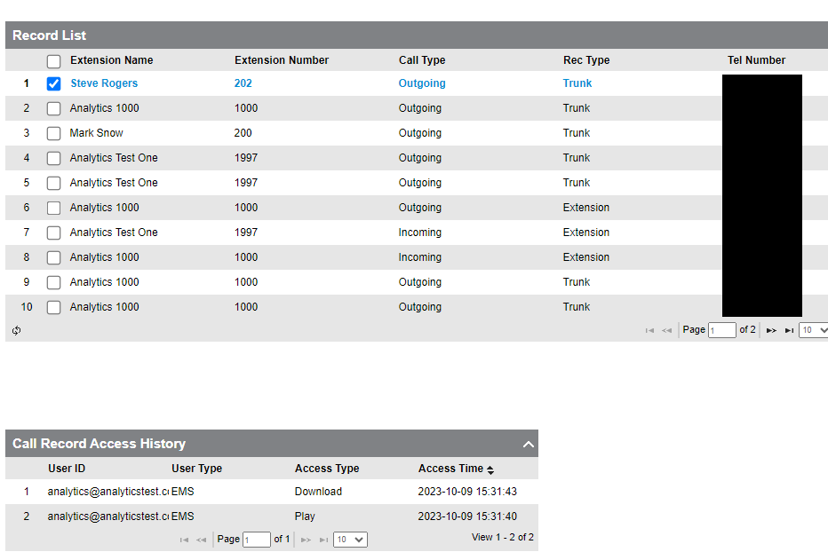
Call Recording Access History Report
In Cloud 6, an audit log will now show which users have listened to and downloaded call recordings.
Notes:
The audit log will only start recording data post-cloud 6, no historical data. No way to see who deleted call recordings.

Slide 18
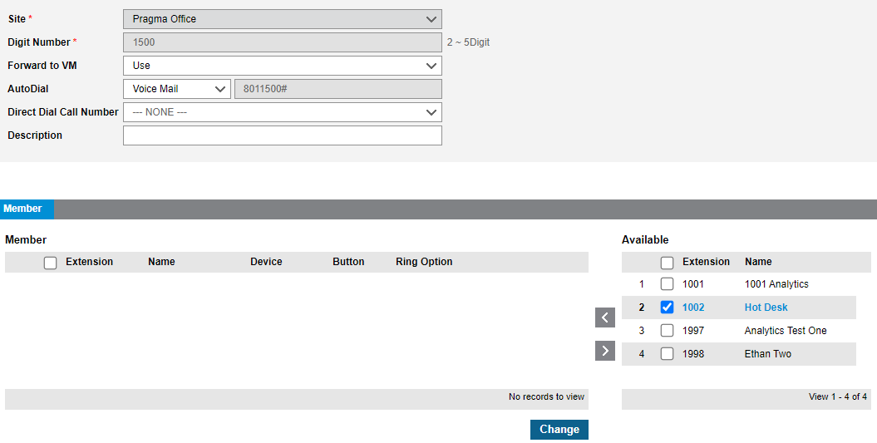
Shared Line Support for Hot Desk Users
Previously, Hot Desk users could not be part of a Shared Line.
With Cloud 6, this is now possible.

Slide 19
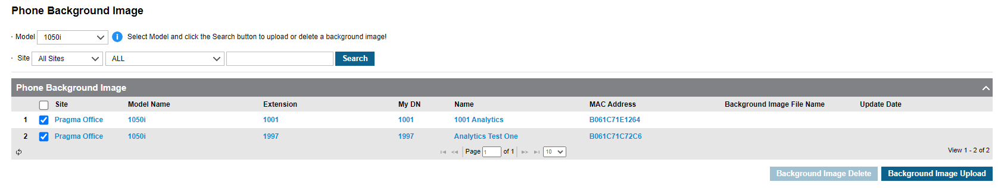
Phone Background Image Multi-Upload
Via the Customer Manager portal, 1000i handset backgrounds can be uploaded in bulk, rather than one at a time.

Slide 20
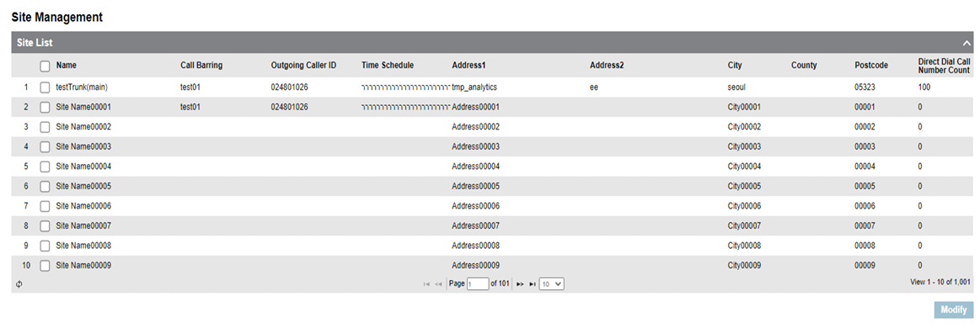
Site Limit Increase
With Cloud 6, the number of Sites under one customer tenant has been increased from 100 to 1000.

Slide 21
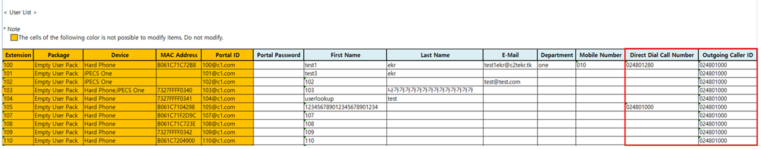
Multiple User Setup Enhancement
When editing multiple users via Excel file upload, new fields have been added:
Direct Dial Call Number
Outgoing Caller ID

Slide 22
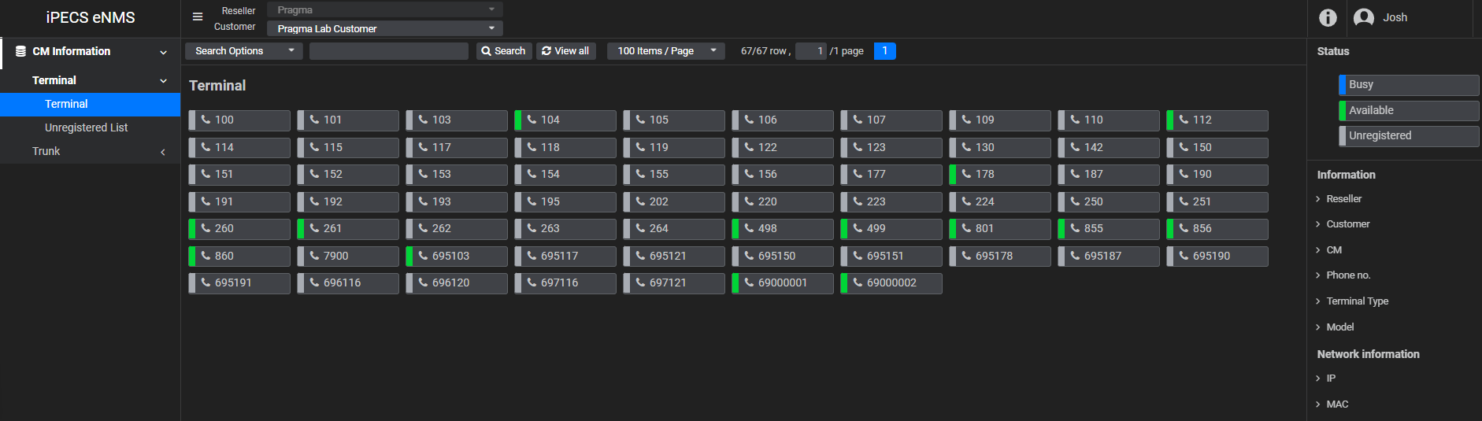
eNMS Reseller Portal
The eNMS portal shows live terminal status

Slide 23
eNMS Reseller Portal
Also available is trunk utilization status per customer

Slide 24
iPECS ONE 4.0 Overview

Slide 25
Summary of Changes
The following table references ONLY the new or enhanced capabilities within iPECS ONE 4.0:
Category | Feature | Details/Comments
UC & Telephony | Agent Reason Codes Secondary ACD Groups Agent Wrap-up timer extension Analytics integration for Call Control CRM options – Answered, Ringing 3K contacts in personal directory Call Pick-up notification New Ringtones | ACD agents can now use “Reason Codes” when unavailable. Secondary ACD Group Queues are now set via the Customer Manager Portal, instead of the Agents themselves. Agents can now be given the option to extend their “wrap-up” timer by 30 seconds. Analytics Supervisors can now make/ pick up calls via Analytics and answer through iPECS ONE. The option to search CRM can now be enabled/ disabled either during ringing or during the call. The personal directory contact limit has been increased to 3000 (previously 1000). iPECS ONE Users in a pickup group can now be presented with pickup notifications via the ONE Client. iPECS ONE support 9 different ring tones
Integration + Collaboration | MS Integration (SSO and Presence) Outlook Add-in | MS presence can now be linked to iPECS ONE presence. iPECS ONE Outlook plug-in can be used to schedule iPECS ONE meetings via Outlook calendar.
UX/UI | Mobile App UI/GUI Revision iPECS ONE Logo Redesign | The mobile/ tablet app GUI has been revised. iPECS ONE has had a brand redesign.
Non-Service Features | Edge Browser Support | iPECS ONE is now officially supported in the Microsoft Edge browser.

Slide 26
Agent Wrap-Up Timer Extension
iPECS ONE ACD Agents can now be given permission to extend their wrap up time.
This can be enabled/disabled in the customer manager portal
Clicking ‘Extend’ extends the agents wrap up time by 30 seconds

Slide 27
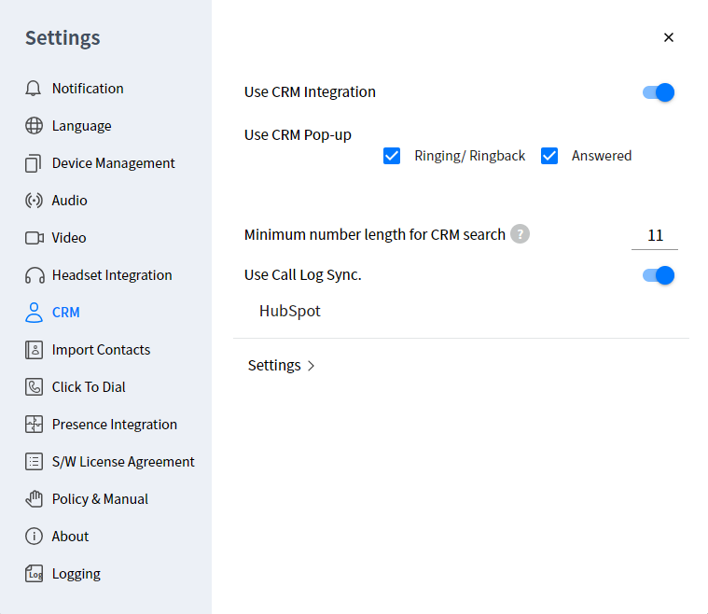
CRM Options – Answered, Ringing
New options within the CRM Settings allow users to choose when CRM pop-ups appear:
Ringing/Ringback
A CRM pop-up will appear when the call is presented to the user, but not on transferred calls
Answered
A CRM pop-up will appear when the call is answered, and on transferred calls

Slide 28
3K Contacts in Personal Directory
Previously, the personal directory in iPECS ONE was limited to a maximum of 1000 entries.
In iPECS ONE P4, this has been increased to a maximum of 3000 entries.

Slide 29
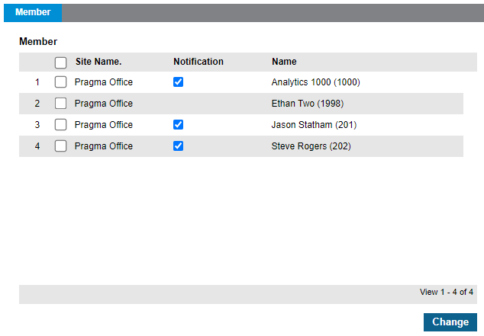
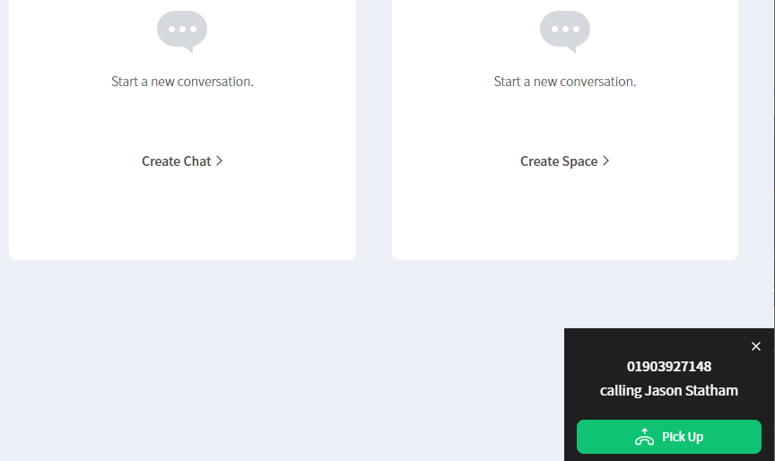
Pickup Group Notification for iPECS ONE Users
A new option within the Customer Manager Portal can be enabled to allow iPECS ONE Pickup Group members to receive a notification when a member of their group receives a call.

Slide 30
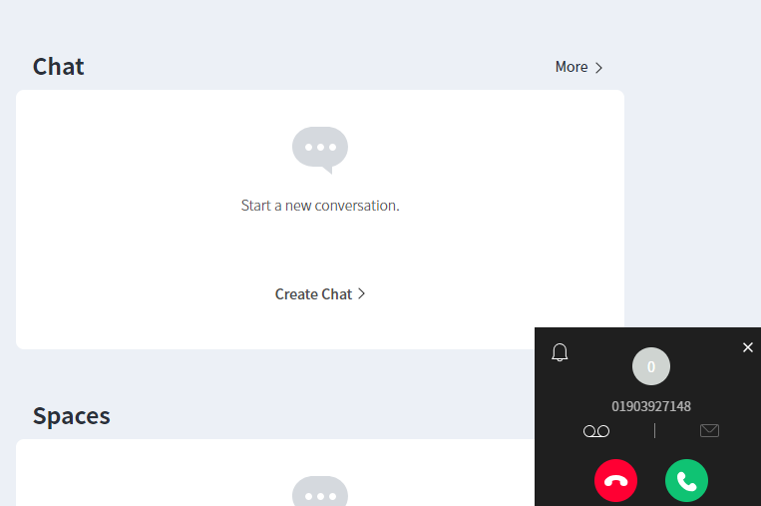
Call Pick-up Notification
iPECS ONE users in Pickup Groups can now be configured to receive notifications for calls to members of their group:
Ext 202 (Being Called)
Ext 201
Notes:
Permission must be granted
Notification will display if there is an incoming call to any member in call pick-up group
The notification will be max 3 pop-up windows concurrently
Pop up window give information on CLI & destination extension name
Pick up button can be used to pick up the incoming call to the group
No new call pickup notifications appearing during calls
ONE Mobile client not supported

Slide 31
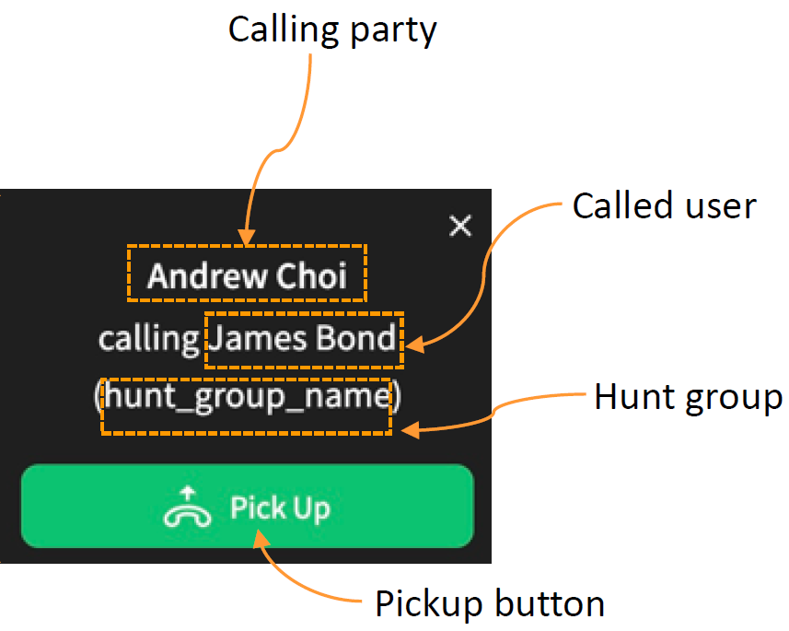
Call Pick-up Notification
The iPECS ONE Call pickup notification will show;
Called user information
Calling party information
Hunt group information (If existing)

Slide 32
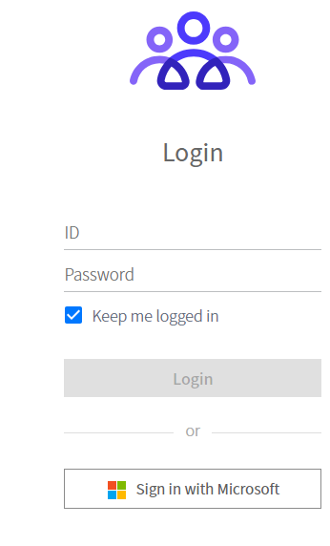
MS Integration (SSO and Presence)
Once the Microsoft Integration has been set up (a separate guide is available for this configuration), users will have access to the following across Desktop and Mobile clients:
Microsoft SSO –
Users can log in to iPECS ONE using a linked Microsoft Account providing 2FA login
Presence Integration
Users’ Microsoft Teams status is reflected in their iPECS ONE presence. IE, if a user becomes busy in teams due to a meeting or a call, their iPECS ONE presence will also change to busy.

Slide 33
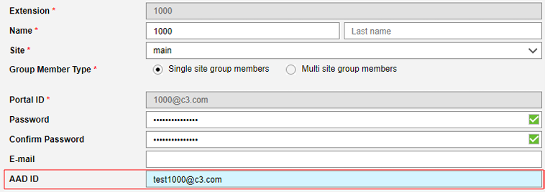
iPECS ONE Teams Presence Settings
Once a user has their AAD ID linked to their user via the Customer Manager Portal, their Teams presence will be synced through to iPECS ONE if they log in to iPECS One via the Microsoft login button.

Slide 34
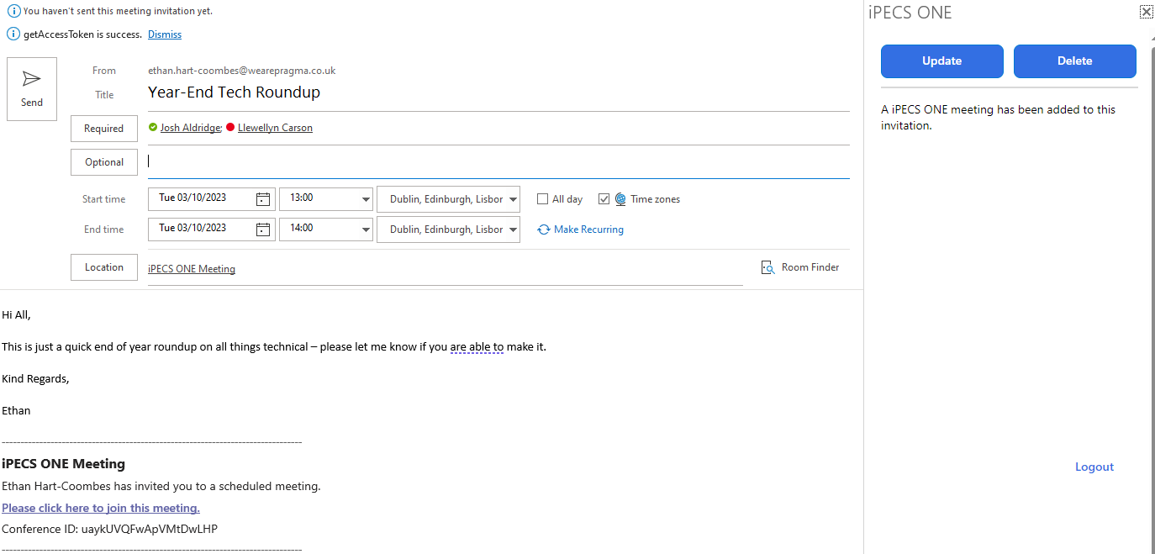
Outlook Add-in
Via the new iPECS ONE Outlook Add-in, users can schedule iPECS ONE Spaces meetings directly from the Outlook Calendar.
This creates both an Outlook Calendar and Spaces invite so presence will be synced across both services.

Slide 35
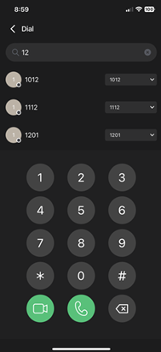
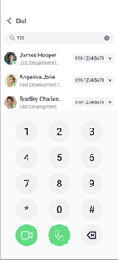
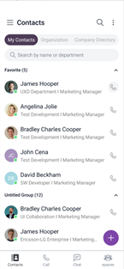
Mobile App UI/GUI Revision
The iPECS ONE Mobile App UI/GUI framework has been upgraded, allowing for new improvements:
GUI theme retouches
Dark mode support

Slide 36
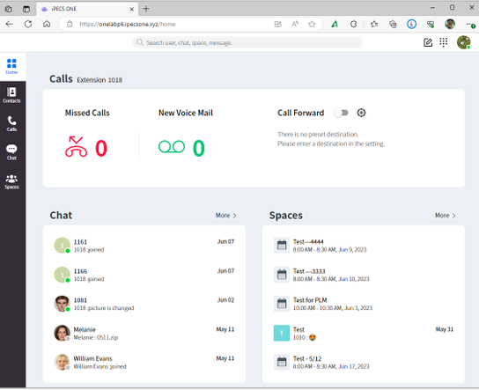
Edge Browser Support
With iPECS ONE P4, Microsoft Edge is now a supported browser.

Slide 37
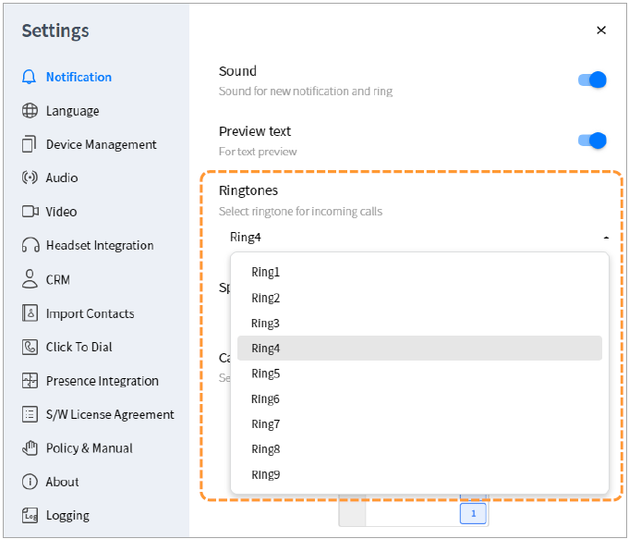
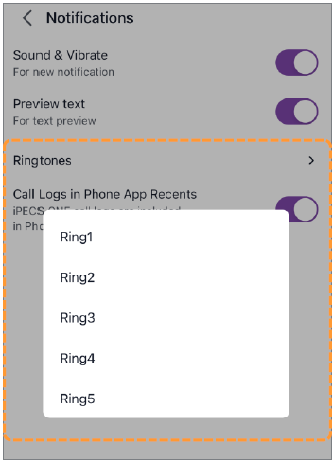
Ring Tones
iPECS ONE now supports 9 different ring tones.

Slide 38
Any Questions?

