Slide 1
Call Center (ACD)

Slide 2
Customer Manager – Call Center - ACD Group
First make sure you have the correct licenses ordered from the reseller portal;
Group licence - (x1 per group) within Feature Licences, Group Features
Notes:
Licences show as IPC2-ACDQ ACD Group User and ACD Group within the reseller portal. Site supervisors can also be added to access supervisor functions such as silent monitoring but is not required, group member licence can be used for both group member or supervisor.

Slide 3
Customer Manager – Call Center - ACD Group
Group user licence - (x1 per member of group) within Application Licences, ACD, ACD Group User

Slide 4
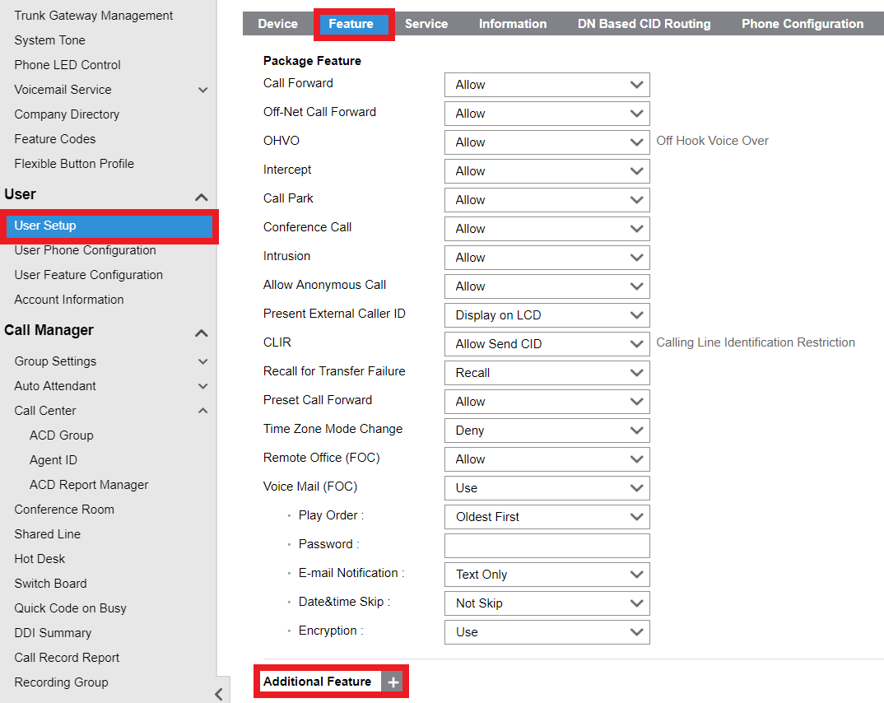
Customer Manager – Call Center - ACD Group
Now add the group user licences to the stations that will be part of the group from User Setup, Feature, Additional Feature menus.

Slide 5
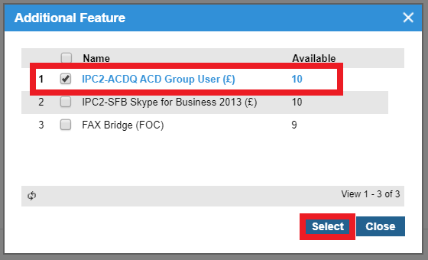
Customer Manager – Call Center - ACD Group
Confirm the licence addition by selecting the checkbox against ACD Group User then clicking Select, OK, Save, OK.
Notes:
Licence Shows as IPC2-ACDQ ACD Group User

Slide 6
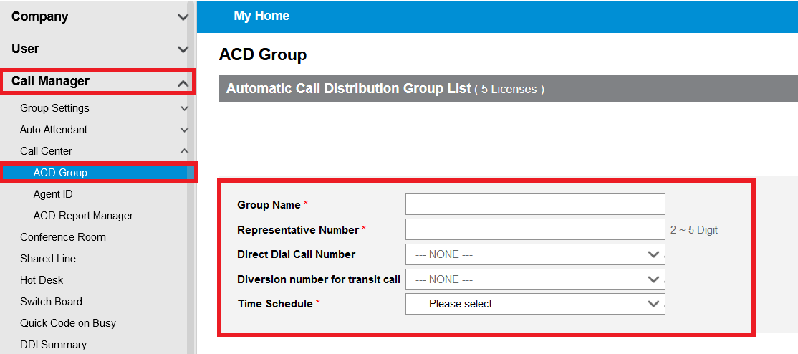
Customer Manager – Call Center - ACD Group
Create group within Call Manager, Call Centre, ACD Group
Select Add and input Group Name, Representative Group Number and Time Schedule
Notes:
Ddi an be directly assigned but as discussed we would normally route all numbers at the DDI summary table. Time schedule can be any that have been assigned in company time schedule..

Slide 7
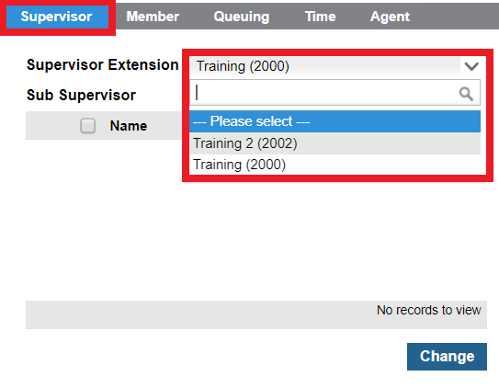
Customer Manager – Call Center - ACD Group
To add supervisors to the group select the supervisor tab and choose an extension from the supervisor extension dropdown

Slide 8
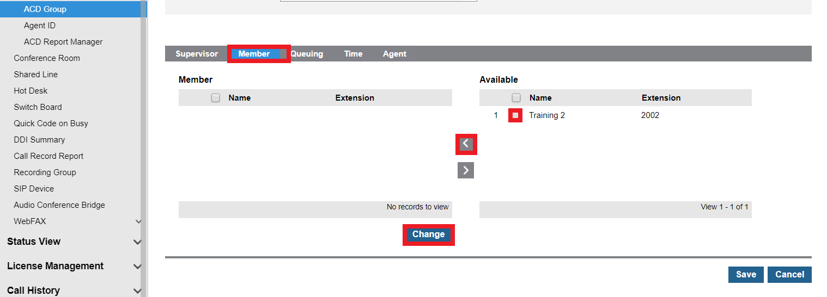
Customer Manager – Call Center - ACD Group
To add members to group click the Member tab and choose Change. Then within the Available section select the check boxes for the appropriate stations and click the left arrow to move the stations into the Member list.
Notes:
Multiple stations can be added using the check boxes. If particular stations need to be removed at a later date, reverse the process using check box in member list and the right arrow.

Slide 9
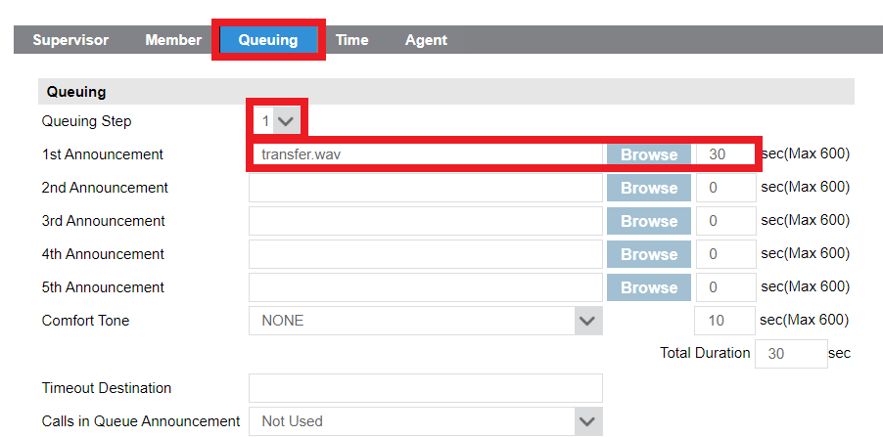
Customer Manager – Call Center - ACD Group
Next we have the Queuing Options to set. Select the Queuing tab to add queuing rules
Select the amount of queuing steps (max 5) and add appropriate prompts for selected queuing step
The 1st-5th announcement timers needs to be (the length of the wav file uploaded) + 4s
Notes:
Browse for the WAV file locally and add play time for each announcement, make sure the time is long enough to cover the announcement play time in full.

Slide 10
Customer Manager – Call Center - ACD Group
Now assign the rules for Comfort Tone including Duration
Assign Timeout Destination
Notes:
Select comfort tone to be played once queuing announcements have ended and set how long this will play for, total duration will be accumulated from all queuing steps announcements and comfort tone if set.

Slide 11
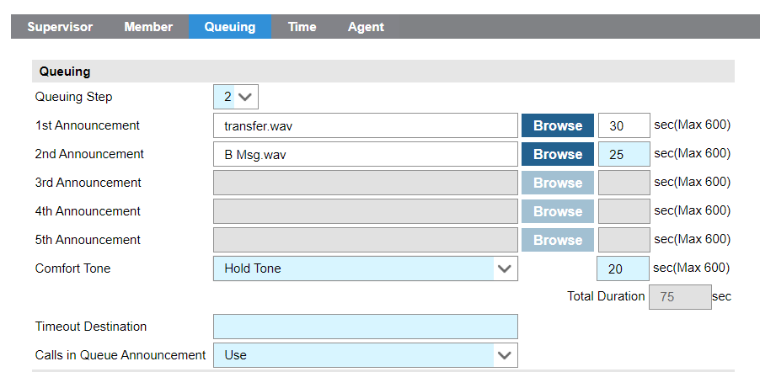
Customer Manager – Call Center - ACD Group
Then if you want to use Calls in Queue announcement, you can set it to Use. This will play an announcement saying what is your position in the queue. Example: “You are number X in the queue.”
If you have announcements, comfort tone and calls in queue enabled, the order of playing will be:
1st announcement > queueing position > comfort tone > 2nd announcement and so on.

Slide 12
Customer Manager – Call Center - ACD Group
Input amount of calls you would like to be queued when all agents are busy/unavailable
Apply Service type for the overflow, either Release, Announcement or Forward
Notes:
Amount of calls queued is dependant on lines so make sure there are enough available. Choose service type release, announcement or busy and apply announcement or forwarded destination as appropriate

Slide 13
Customer Manager – Call Center - ACD Group
Next select the Service Type, choose from Release, Announcement or Forward.
Add announcement if applicable
Add overflow destination
Notes:
Browse for the announcement file locally and set play time.

Slide 14
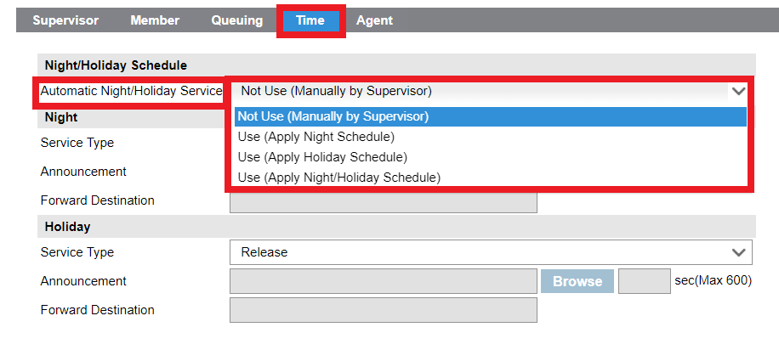
Customer Manager – Call Center - ACD Group
To apply night and holiday options click “Time” tab. Set the automatic night/holiday service mode
Notes:
Can be set to not used so will need manually intervention from supervisor. Or use night schedule, holiday schedule or night/holiday schedule.

Slide 15
Customer Manager – Call Center - ACD Group
To set specific Night and Holiday options including Service Type, Announcement and Forward destinations. Select Save to confirm changes.
Notes:
Service type can be release, announcement of forward. Make sure appropriate time for “announcement” is set so that the prompt is played as necessary,

Slide 16
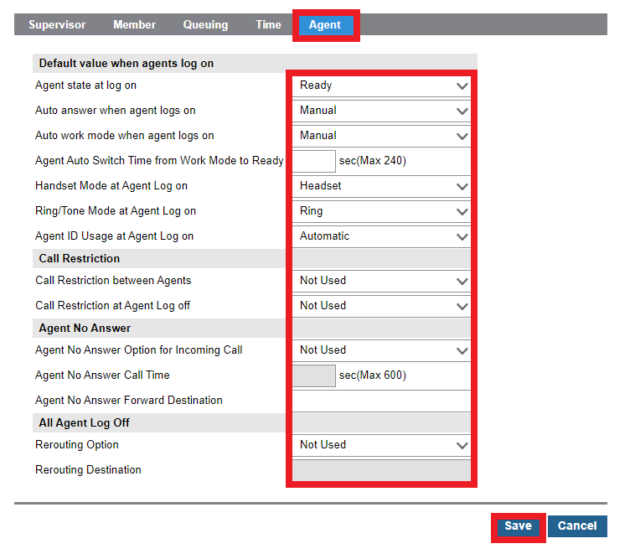
Customer Manager – Call Center - ACD Group
Under Agents you can set a variate of settings of what your ACD group can do.
Notes:
Agent log on; state when logging on, auto answer etc. Agent auto switch is wrap up time for agent to be ready for next call. Set rule for agent id usage at log on (either manual or auto) , note if this is set to auto then agent id’s will auto populate with the same id as the ext number, if we set this to manual then we need to add agent id’s manually. Manual mode will allow any agent to logo to station.

Slide 17
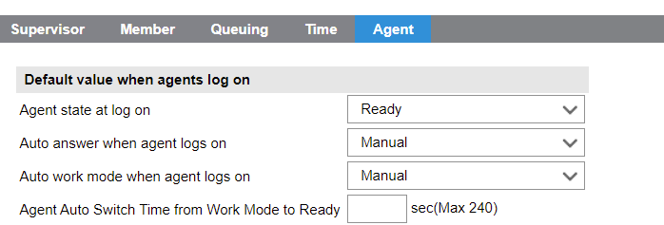
Customer Manager – Call Center - ACD Group
The agent state at log on
Is how the agent will be once it logs on. Ready to receive calls, not ready or work. Work is that the agent is in wrap mode.
The auto answer when agents logs on
You can select manual the agent needs to answer the call manually. If you set to automatic the call will be presented to the agent and automatically answered.
In auto work mode when agents log on
The agent can change from work mode to ready mode automatically or manually. If you chose manual, the agent will be in work mode after a call until they manually enter the feature code to change them to the ready mode to receive calls. Selecting automatic, the system will automatically set them to ready mode after the set amount of seconds set in agent auto switch time from work mode to ready.
Notes:
Agent log on; state when logging on, auto answer etc. Agent auto switch is wrap up time for agent to be ready for next call. Set rule for agent id usage at log on (either manual or auto) , note if this is set to auto then agent id’s will auto populate with the same id as the ext number, if we set this to manual then we need to add agent id’s manually. Manual mode will allow any agent to logo to station.

Slide 18
Customer Manager – Call Center - ACD Group
You can set the headset mode and ring tone mode as you wish.
Agent ID usage at agent log on
You can either set the agents ID manually and you can choose any agent ID, or automatic, that the agent ID will be automatically populated and have the same extension number.
If you have agents logging into more than one station, you need to set it as manual.
Notes:
Agent log on; state when logging on, auto answer etc. Agent auto switch is wrap up time for agent to be ready for next call. Set rule for agent id usage at log on (either manual or auto) , note if this is set to auto then agent id’s will auto populate with the same id as the ext number, if we set this to manual then we need to add agent id’s manually. Manual mode will allow any agent to logo to station.

Slide 19
Customer Manager – Call Center - ACD Group
Under call restriction you can restrict agents to call another agent or restrict agents to transfer calls to another agent.
And restrict outgoing calls when the agent logs off that station or restrict all calls from that station.
Under agent no answer defines what will happen to the call and the agent if a call is not answered.
If the call is not answered, you can set the agent to automatically be set to not ready and the call will drop. Or you can set to not ready and forward, the agent will be set to not ready and the call will forward to the forward a destination.
You can also set to log off to log the agent off the ACD if a call is not answered or log off and forward. Or just forward to a destination.
The no answer time is set under Agent No Answer Call Time. And the destination is set under agent no answer forward destination.
The Rerouting Option allows incoming calls to be rerouted to a certain destination when all agents are logged off. You can select it to use and set a rerouting destination.
Notes:
Agent log on; state when logging on, auto answer etc. Agent auto switch is wrap up time for agent to be ready for next call. Set rule for agent id usage at log on (either manual or auto) , note if this is set to auto then agent id’s will auto populate with the same id as the ext number, if we set this to manual then we need to add agent id’s manually. Manual mode will allow any agent to logo to station.

Slide 20
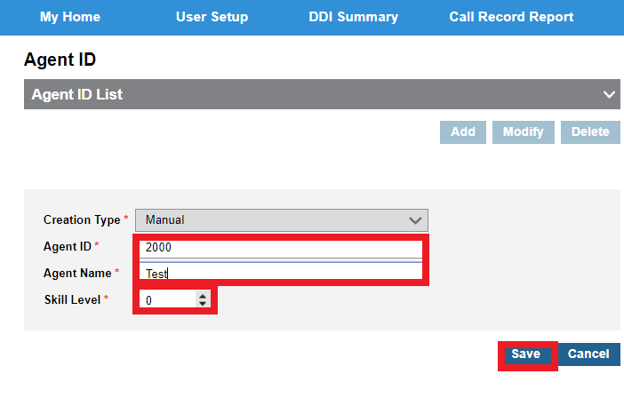
Customer Manager – Call Center – Agent ID
If you set Agent ID usage at agent log on: Manual
You need to Agent ID Select Add, Input Agent ID and Agent Name information. Lastly set skill agent, 0 being the most proficient and Save.
Notes:
Adding manually allows the agent id to differ from the station that has been added a a group member however this needs to be 4 digit exts minimum.

Slide 21
Customer Manager – Call Center – Agent ID
If you set Agent ID usage at agent log on: Automatic
You will see the agents have been created automatically with the agent ID’s matching the extension numbers that were added as group members. Note you cannot modify automatically created Agents

