Slide 2
iPECS Cloud – Azure Active Directory Integration

Slide 3
Azure Active Directory integration
Overview
By synchronising your Azure Active Directory (AAD) to the iPECS Cloud platform
it is possible to login to the customer manager portal either as a
user or manager using Office 365 login details.

Slide 4
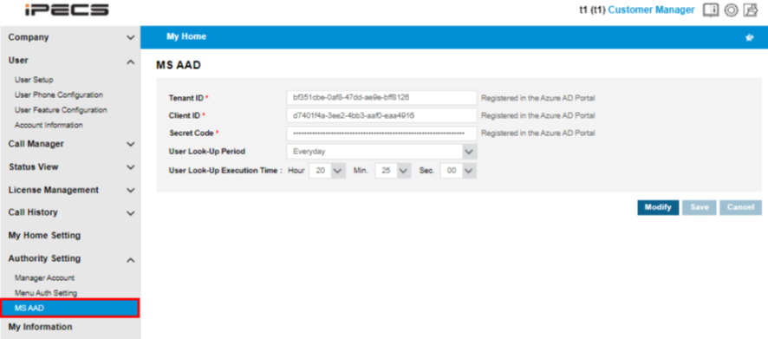
Azure Active Directory integration
Customer Manager Portal > Authority Setting > MS AAD
Tenant ID: The unique ID assigned to the customer with an active Azure Active Directory service subscription.
Client ID: The unique ID assigned to the API registered in the AAD portal for AAD User Lookup.
Secret Code: This code is generated for the API in the AAD portal.

Slide 5
Azure Active Directory integration
Customer Manager Portal > User > User Setup
A users AAD ID can be manually entered or found using the user lookup.
After entering the AAD ID and saving. The user can log in to the customer user portal using their AAD ID.

Slide 6
Azure Active Directory integration
Customer Manager Portal > My Information
Using the same process as user setup, within this menu you can manually enter or select from the dropdown which user you would like to use their AAD ID to log into the customer manager portal.

Slide 7
Azure Active Directory integration
Customer Manager Portal > Company > Company Directory
After synchronising with AAD the customer’s company directory will be updated with their contacts stored within AAD.
The information in red above is synchronized to the AAD user information and can not be modified in the company directory menu.
Other information can be updated in Company Directory menu.

Slide 8
iPECS Cloud – Azure Active Directory Configuration

Slide 9
Azure Active Directory Configuration
[1] APP registration
Azure Active Directory Portal > Azure Active Directory > App registrations
To use the AAD User Lookup service, the Azure AD tenant (company) manager needs to register an API so that the Microsoft Identity Platform can recognize and allow it to interface with Azure AD.

Slide 10
Azure Active Directory Configuration
[1] APP registration
•Azure Active Directory Portal > Azure Active Directory > App registrations
Click the New registrations in the upper area.

Slide 11
Azure Active Directory Configuration
[1] APP registration
•Azure Active Directory Portal > Azure Active Directory > App registrations
Enter the proper API name in Name input and click the Register button.

Slide 12
Azure Active Directory Configuration
[1] APP registration
You can check Application (client) ID and Directory (tenant) ID.
For the AAD User Look-Up service, Application (client) ID, Directory(tenant) ID, and client secret are required in the MS AAD menu of the customer manager portal.
The client secret needs to be generated after registering an API in the App registrations menu.
Click the Add a certificate or secret.
Azure Active Directory Portal > Azure Active Directory > App registrations

Slide 13
Azure Active Directory Configuration
[1] APP registration
Azure Active Directory Portal > Azure Active Directory > App registrations
Choose New client secret.

Slide 14
Azure Active Directory Configuration
[1] APP registration
Auzre Active Directory Portal > Azure Active Directory > App registrations
Enter a description and enter an expiry period.
The value field in the client secrets menu is used as the Secret Code in the cloud portal MS AAD menu.
The client secret’s full characters are shown only once after generating. Copy the secret and paste it into the Secret Code field in cloud portal.

Slide 15
Azure Active Directory Configuration
[1] APP registration
Azure Active Directory Portal > Azure Active Directory > App registrations > API permissions
The registered API requires permissions for the User Look-Up service.
Click API permissions.

Slide 16
Azure Active Directory Configuration
[1] APP registration
Azure Active Directory Portal > Azure Active Directory > App registrations > API permissions
There are 2 types of API permissions - Application and Delegated.
For the User Look-Up service, the API permissions shown above are required.
Click Add a permission and add permissions as above.
If the status of added permissions are not granted, click the Grant admin consent for company option.

Slide 17
Azure Active Directory Configuration
[2] Users Information
Azure Active Directory Portal > Go to https://aad.portal.azure.com and sign in.
You will need to subscribe to the Azure Active Directory service for the AAD User Lookup service.
The AAD User Lookup service allows the Cloud Customer manager company directory information to synchronize with all users’ information registered in the Users menu of the AAD portal.
If you go to the AAD portal and sign in, you will see the above screen.
Click All services and go to the Users menu.

Slide 18
Azure Active Directory Configuration
[2] Users Information
Azure Active Directory Portal > Go to Azure Active Directory > Users
Click the Azure Active Directory menu.
Click the Users menu.

Slide 19
Azure Active Directory Configuration
[2] Users Information
Azure Active Directory Portal > Azure Active Directory > Users
In the Users menu, you can add and delete users (Member or Guest), and read & modify user information.
For details on how to use this menu, please refer to the Azure Active Directory Documentation
(https://docs.microsoft.com/enus/azure/activedirectory/)

Slide 20
Azure Active Directory Configuration
[2] Users Information
Azure Active Directory Portal > Azure Active Directory > Users
Only the information marked with a red box is synchronized with the Company Directory information.
User Principle Name is shown in the AAD ID selection box of the User Setup menu and the My
Information of EMS customer manger portal only if Company Directory information is synchronize with AAD’s Users’ information.

Slide 21
Azure Active Directory Configuration

