Slide 1
Audio Conference Bridge Introduction
2018-09-04
PLM & Planning Team

Slide 2
iPECS ACB Benefits
Easy to book/manage conference room
Web GUI for participant checking/control
Auto-generated meeting notice & join guide
Cost less than external conferencing service
Simple to use
Intuitive interface
Low installation cost
Easy to install
iPECS UCM
iPECS ACB

Slide 3
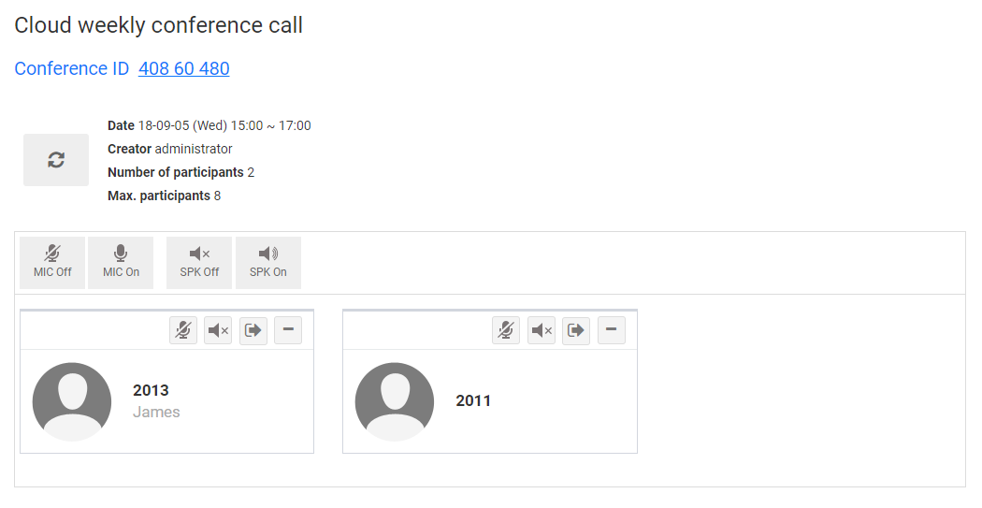
Main Features
S/W based Audio Conference Bridge
Authentication with Security Code
Participant Name Recording & Play
sRTP support
Conference Control
Conference Scheduling
Web-based management
Local System Redundancy
SNMP

Slide 4
Participant Name Recording & Play
> Join the conference bridge with participant name recording…
Play MOH
If one member in conference
1
2
3
Dial
Access Number
of Conference Bridge
Press Conference ID to get into conference room
Record
Participant Name
4
Play Participant name
to all members
ACB Plays …
‘Please record your name’
ACB Plays …
If there are members in conference bridge, the recorded participant name will be played.

Slide 5
Authentication with Security Code(Option)
1
2
5
Dial
Access Number
of Conference Bridge
Press Conference ID to get into conference room
Record
Participant Name
4
User PIN
3
Press
Conference PIN #
Attendee
4
Admin PIN
Moderator

Slide 6
Attendee / Moderator Controls ( Phone Dial Buttons )
Action | Description | Command digit | Attendee | Moderator
Talk Vol. down | Decrease talk volume by 1 unit | 1 | O | O
Talk Vol. up | Increase member talk (mic) volume into conference by 1 unit | 3 | O | O
Conference Count | Announce count of conference members | 0 |  | O

Slide 7
Attendee / Moderator Conference Controls ( Web UI )
Common (Attendee or Moderator)
Conference member count
Display of all members (including Station number, display name)
Moderator
Mute/Unmute all / each member
Deaf/Undeaf all / each member
Kick out each member

Slide 8
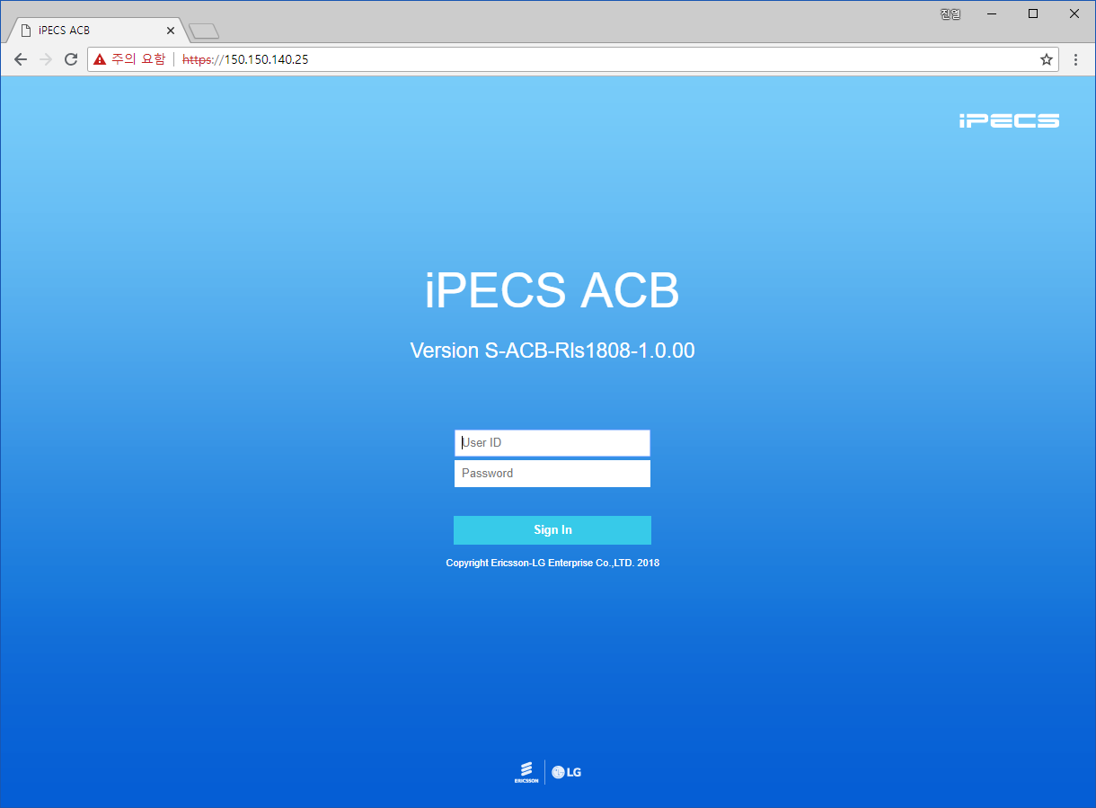
ACB Web Application - Login

Slide 9
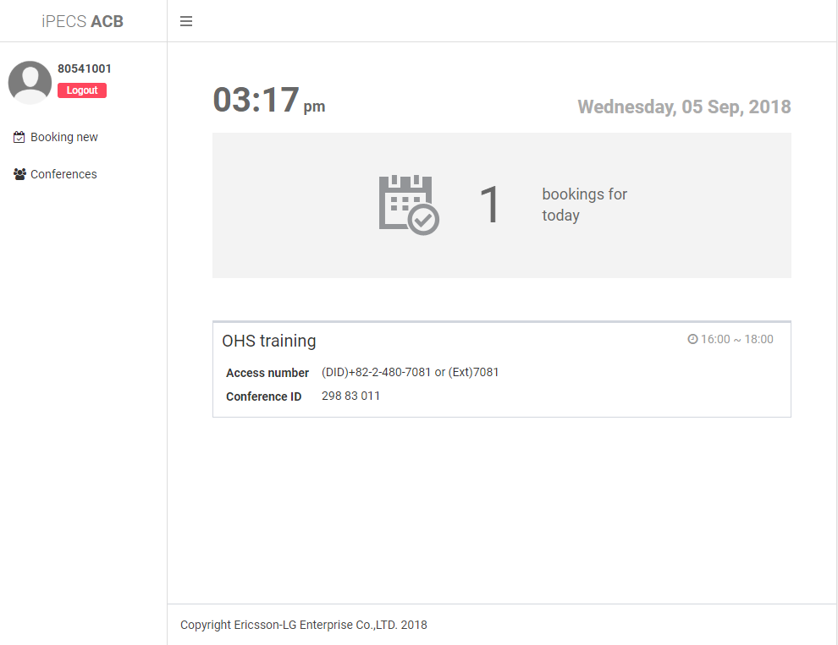
ACB Web Application – Home(user)

Slide 10
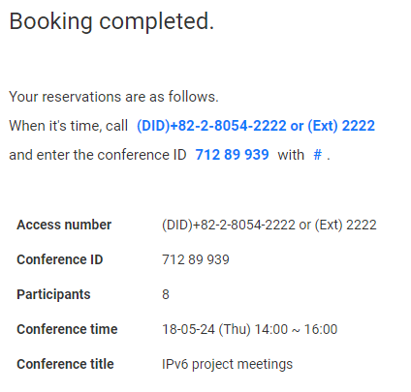
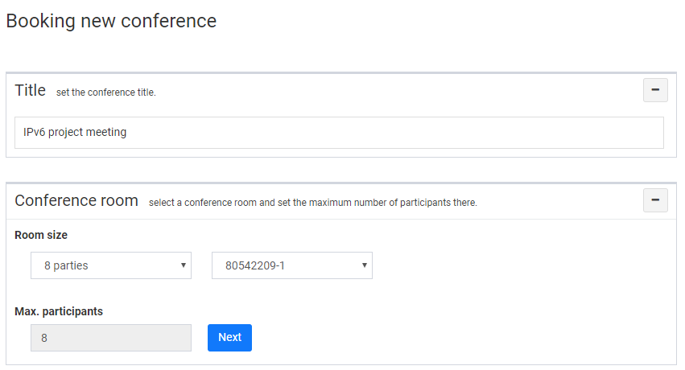
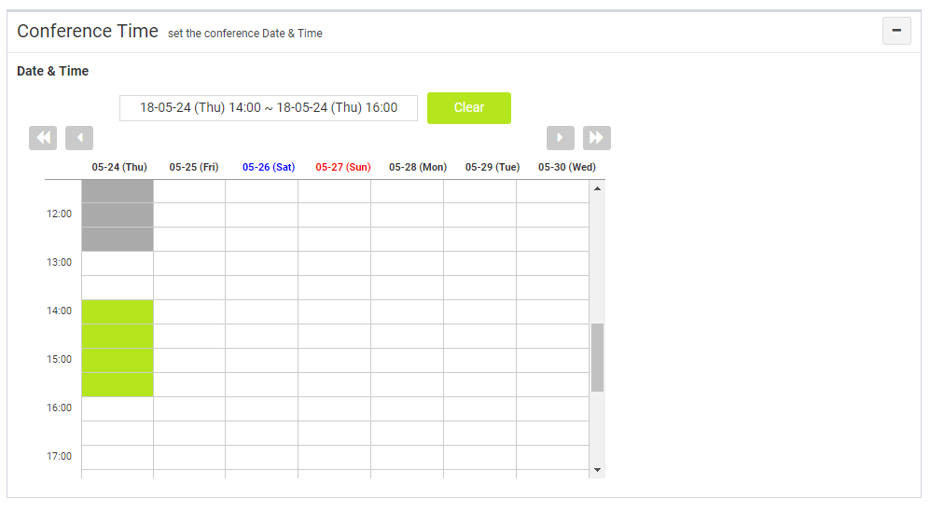
ACB Web Application(users) - Booking
1
2-1
2-2
2-3
3
For “User channel room” option, available max. # of participants is displayed.
Number of expected participants can be entered.
* When booking completed, Conference ID is randomly generated.
4
* The PIN number allows digits from 0 to 9

Slide 11
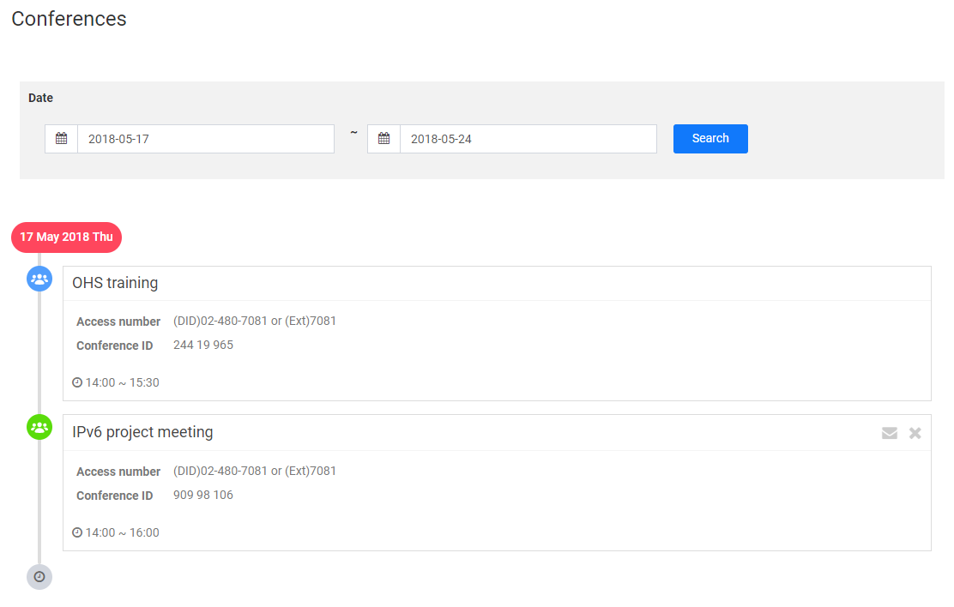
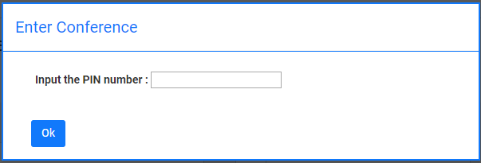
ACB Web Application(users) - Conferences
* If user presses this button, the e-mail client runs automatically. User has to enter e-mail recipients and send invitation mail .
Send Conference Invitation
Subject : [Audio Conference Bridge] Invitation to meetings
Please join the conference below.
(Call Access number, enter Conference ID and press #)
-----------------------------------------------------
Title: IPv6 project meeting
When: Thu, May 17, 2018 14:00 ~ 16:00
Access number: (DID)02-480-7081 or (Ext)7081
Conference ID: 909 98 106
PIN number: 567890
-----------------------------------------------------
Login user
≠
Creator
Login user
=
Creator
Delete
* For conference with PIN, when deleting or entering the conference, PIN required.

Slide 12
ACB Web Application(users) - Conference Detail
When admin PIN is entered, Moderator control is displayed
Moderator screen
Refresh
Control(MIC/SPK) buttons for all members
Control(MIC/SPK/kick) buttons for individual member

Slide 13
ACB Web Application(users) - Conference Detail
Action | Description
 | Disable audio from all members into the conference | Control all members
 | Enable audio from all members into the conference | Control all members
 | Block audio from conference to all members | Control all members
 | Allow all conference members to hear again | Control all members
 | Enable / Disable audio from this member into the conference | Control individual member
 | Unblock / Block audio from conference to this member | Control individual member
 | Kick this member from the conference | Control individual member

Slide 14
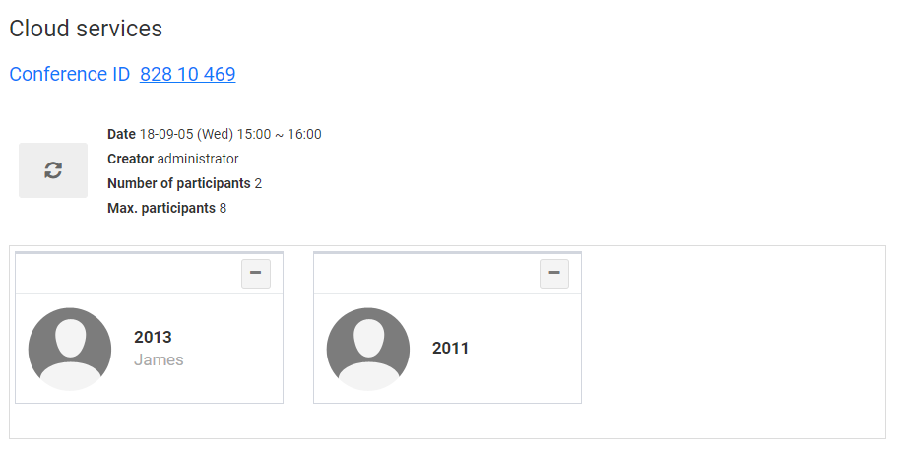
ACB Web Application(users) - Conference Detail
When conference has no PIN or user PIN is entered, there is no control buttons
Attendee screen

Slide 15
Required License for UCM/Cloud
Type | License | Remark
On-prem UCM On-prem version | UCML-ACBF (per channel) UCML-ACB8 (8 user) UCML-ACB25 (25 user) | With web GUI * ACB8/ACB25 license provides channel reservation scheme for 8-users/25-users

Slide 16
Comparison with conference room feature in iPECS UCM/Cloud
Feature | Conference room (UCM/Cloud) | Audio conference bridge (ACB)
Conference room creation | Only admin/manager can create conference rooms through WMS/EMS (room number & password is set by admin/manager) | Any user can create & reserve conference room through web page (calendar) and sets access PIN (conference ID is randomly generated)
Conference room access | [1] Moderator enters activation code, room number, password through phone [2] Attendee enters room number, password through phone | [1] Moderator enters access number, conference ID, admin PIN through phone [1] Attendee enters access number, conference ID, user PIN through phone
Conference room monitor | Only number of participants in a Conference Room is displayed (on phone LCD) | Web Conference Detail page displays attendee phone numbers/names & mute/deaf control buttons
Conference room resource management | No management : Error tone is played when number of users exceed installed VPCM resource | Resource is managed by reservation calendar and license assignment

Slide 17
Comparison with conference room feature in iPECS UCM/Cloud
Feature | Conference room (UCM/Cloud) | Audio conference bridge (ACB)
Security | Room number is usually fixed and anyone with password can enter | Conference ID is randomly generated for each call
Participant Name Recording & Play | Not supported | Supported
Conference Control | No control | Mute/deaf control Input/output volume control Kick-out control
Conference Scheduling | No scheduling | Web page displays conference schedules

