Slide 1
IP DECT Alarms

Slide 2
IP DECT Alarms Contents
Overview
Alarm Types
Alarm Support on Handset and Call Server
150dh handset pull cord and alarm button
Alarm Configuration of the Base Station
Use of the alarms
Alarm Configuration on the Handset
Pre-Alarm display

Slide 3
IP DECT Alarms Overview
IP DECT has two types of alarms, Alarm Call and Alarm Message.
Currently iPECS only supports Alarm Call, which is the scope of this course
IP DECT Alarms can be used on UCP and Cloud
This course covers the 150dh handset which supports the Alarm Call types defined.

Slide 4
IP DECT Alarms: Alarm Types
Alarm Button
This alarm is triggered by long pressing (3 seconds) the red button on top of the handset.
Pull Cord Alarm
The Pull Cord alarm can be triggered by pulling a cord containing a magnet from the pull cord hole on the right side of the handset.
Running Alarm
To trigger the Running Alarm the handset needs to be shaken up and down for a couple of seconds. Hereby the running alarm is triggered by running if the user has the handset in the hand or in a pocket or similar during running.
Man Down Alarm
The Man Down alarm is triggered if the handset is lying down in an angle from 60degrees. The time for the handset to be still before the alarm is triggered can be set on base station web interface.
No Movement Alarm
To trigger the No Movement, alarm the handset needs to be in no movement. As with the man down alarm the time for this before the no movement alarm is triggered is set on the base station web interface

Slide 5
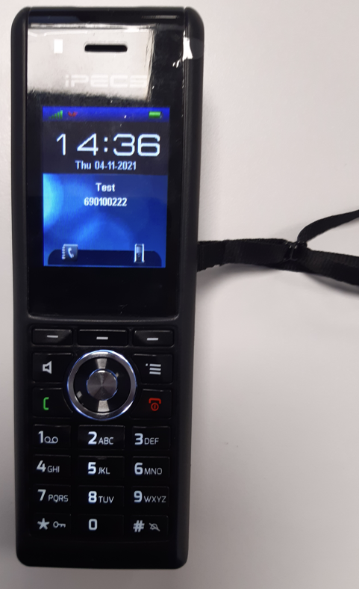
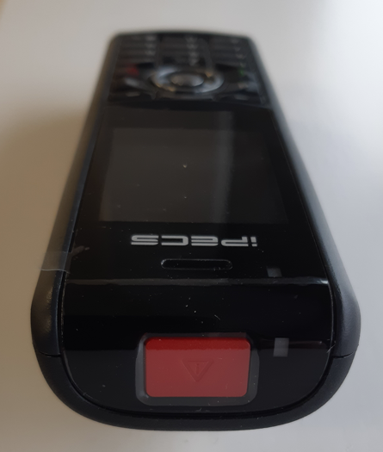
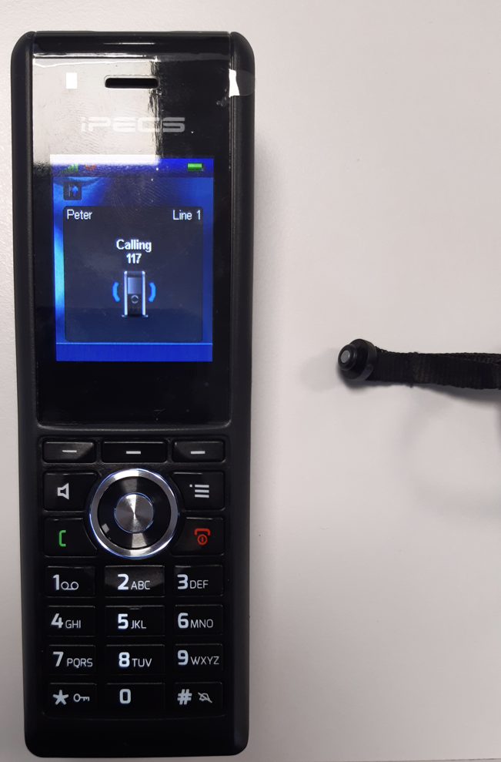
IP DECT Alarms: 150dh handset alarm button & pull cord
150dh handset pull cord and alarm button is shown below
When the Alarm call is answered the 150dh automatically goes into speakerphone mode

Slide 6
IP DECT Alarms: Alarm Configuration of the Base Station
In the Alarm Settings menu, it is controlled how an alarm appears on the handset. For example, if the handset detects “Man Down”, then it is defined in this menu what alarm signal this type of alarm will send out and if a pre-alarm shall be signalled etc. The Alarm is activated by a long press on the Alarm key (3 sec).
All configuration of the handset Alarm Settings is done from the base station. The concept is that on the “Alarm” page on the web server, eight different alarm profiles can be configured. Afterwards for each handset, it can be selected which of the configured alarm profiles, the given handset shall subscribe to. When this is done the selected alarm, profiles are sent to the handset

Slide 7
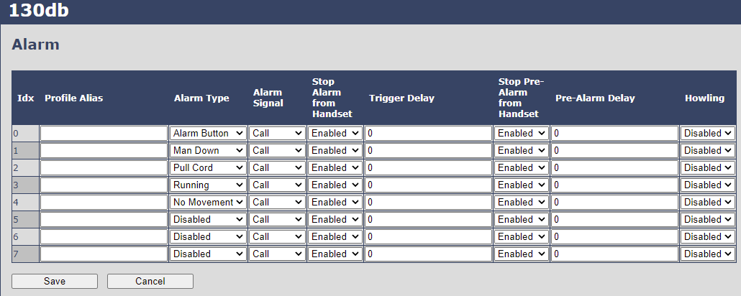
IP DECT Alarms: Alarm Configuration of the Base Station
In the Alarm section you can enable the Alarm Types required, see example below
Profile Alias is an alias or user-friendly name to help identify the different profiles when selecting which profiles to enable for the individual handsets
Alarm Signal. Set to Call. This is the number the alarm call will be sent to

Slide 8
IP DECT Alarms: Alarm Configuration of the Base Station
Stop Alarm from Handset: Enable/Disable the possibility to stop/cancel the alarm from the handset.
Trigger Delay: The period from when the alarm has fired until the handset shows a pre-alarm warning. If set to 0, there will be no pre-alarm warning, and the alarm will be signalled immediately. The alarm algorithm typically needs about 6 sec. to detect e.g. man down etc.
Stop Pre Alarm from Handset: Enable/Disable the possibility to stop/cancel the pre-alarm from the handset.
Pre-Alarm Delay: The period from the pre-alarm warning is shown until the actual alarm is signalled. The maximum value is 255
Howling: Enable/Disable if howling shall be started in the handset, when the alarm is signalled. If disabled, only the configured signal is sent . Note this only provides one burst of howl tone. So this may not be suitable to use in practice.
AFTER CONFIGURATION, THE HANDSET MUST BE REBOOTED AND THE ALARM TESTED

Slide 9
IP DECT Alarms: Alarm Configuration of the Base Station
IMPORTANT NOTE
Whilst very unlikely, in some circumstances after making base programming changes when alarm calls are in progress, the handset may enter a state where new alarm calls fail.
You may see ‘Auto answer’ displayed in the handset if this happens
To return the handset to normal operation go to Menu, Settings, Answer mode, select Normal, press hang up key twice and check idle display has Auto answer removed.
Turn off the phone by a long press on the red hang up/power key, then the display is off. Long press on red hang up/power key to power up the phone
Test the alarms work normally

Slide 10
IP DECT Alarms: Use of the Alarms 1
As described in the base station configuration, it can be configured if it shall be possible to stop an alarm from the handset. If the possibility to stop an alarm from the handset is disabled, it is ensured that an alarm is not stopped before someone at e.g. an emergency centre has received the alarm and reacted upon it.
The behaviour of a handset when an alarm “is sent” depends on the configured Alarm Signal:
When the Alarm Signal is configured as “Call”, the handset will make a call to the specified emergency number, and the alarm is considered stopped when the call is terminated. If it is not allowed to stop the alarm from the handset, it will not be possible to terminate the call from handset, and the alarm will be considered as stopped only when the remote end (e.g. the emergency centre) terminates the call.

Slide 11
IP DECT Alarms: Use of the Alarms 2
All type of alarms has the same priority. This means that once an alarm is active, it cannot be overruled by another alarm until the alarm has been stopped. However, if the alarm is not yet active, i.e. if it is in “pre-alarm” state and an alarm configured with no pre-alarm is fired, then the new alarm will become active and stop the pending alarm.
Alarms with no pre-alarm are considered important, and there is no possibility to cancel them before they are sent, and therefore alarms with no pre-alarm, are given higher priority than alarms in pre-alarm state.
The Emergency Button could be an example of an alarm which would be configured without pre-alarm. Thus, when the Emergency Button is pressed you want to be sure the alarm is sent. However, if another alarm was already in pre-alarm state, it could potentially be cancelled, and if the Emergency Button alarm was ignored in this case, no alarm would be sent. This is the reason alarms with no pre-alarm, are given higher priority than alarms in pre-alarm state

Slide 12
IP DECT Alarms: Receiving Party
When an alarm call is made, the receiving party will get an incoming call. After answer an audio connection is made with the IP DECT station.
For an external call the CLI from the customer site can be displayed at the destination. The outgoing CLI could be configured for the IP DECT alarm extension rather than the site’s normal outgoing CLI.
For an internal call the IP DECT station could be named, eg Room 1. This will then be displayed at the destination station, typically as follows
Cloud
Call to Internal 1030i, Alarm call from IP DECT station 201. Station named Room 1
Call from 201
Room 1
201
Call to Internal 150dh
Room 1
Alerting
201

Slide 13
IP DECT Alarms: Receiving Party
UCP
Call to Internal 1050i , Alarm call from IP DECT station 1010. Station named Room 1
Call from Room 1
Room 1
STA 1010
Call to Internal 150dh
Room 1
Alerting
1010

Slide 14
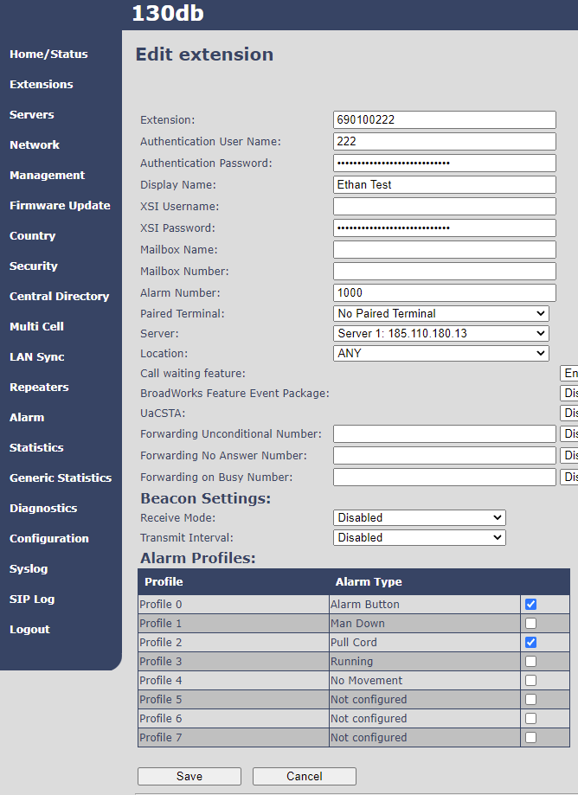
IP DECT Alarms: Alarm Configuration of the Handset
Set up each handset with Alarm Type required. Note you cannot do this by extension range
Alarm Number is the destination number to be dialled when the alarm is triggered

Slide 15
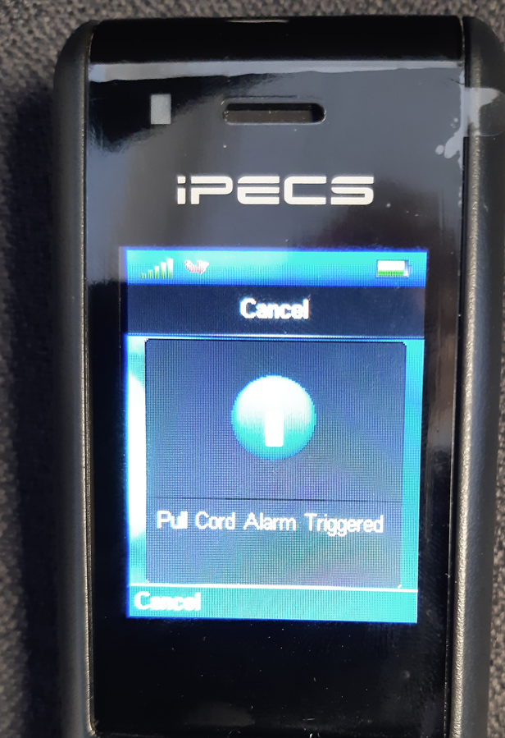
IP DECT Alarms: 150dh Pre-Alarm display
An example of a pre-alarm display is shown below

