Slide 1
IP-DECT 130dB Multi-cell Set up

Slide 2
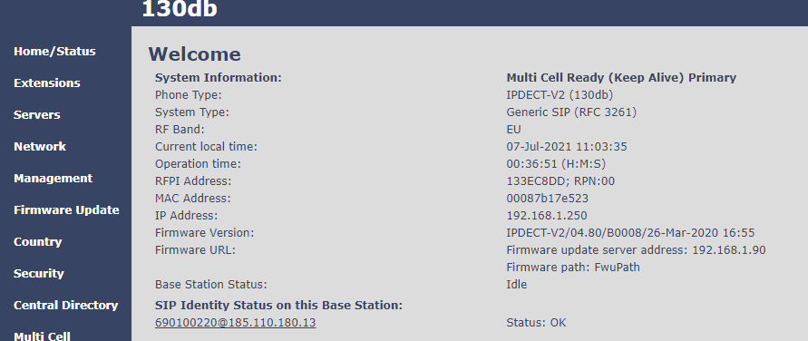
Multi-cell: Base Version
Check all bases stations are on the same software version

Slide 3
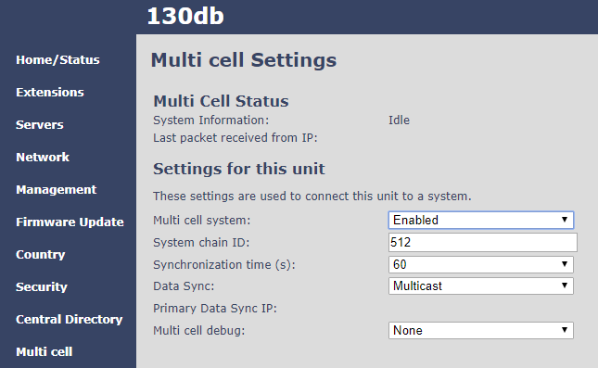
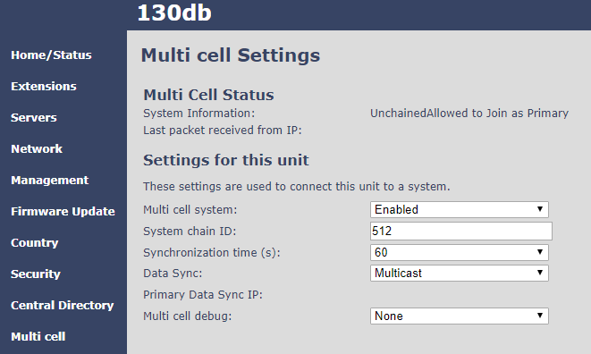
Multi-cell: Primary Base
On the first base station at least one extension should be registered
Enable Multi cell system and save and reboot
Multi cell status is Unchained Allowed to join as Primary

Slide 4
Multi-cell: Second Base
Connect a second base and enable multi cell, Save and Reboot
Multi Cell initial status, Unchained Allowed to Join as Secondary

Slide 5
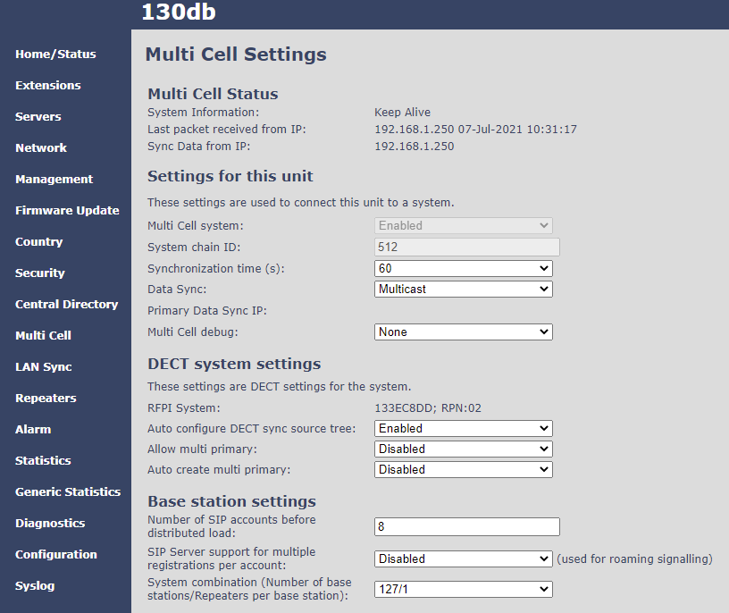
Multi-cell: Second Base
On the second base when synchronised (up to 5mins) check the multi cell status

Slide 6
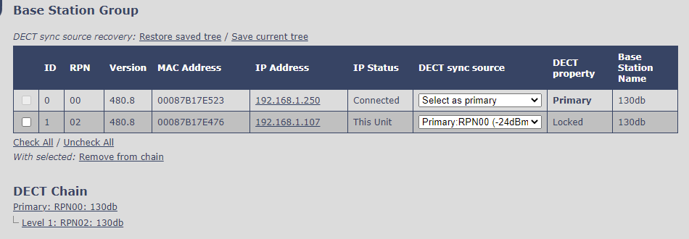
Multi-cell: Second Base
Check the second base is synchronised (locked) to the primary base station in the Base Station Group
You can see the base relationship in the DECT Chain

Slide 7
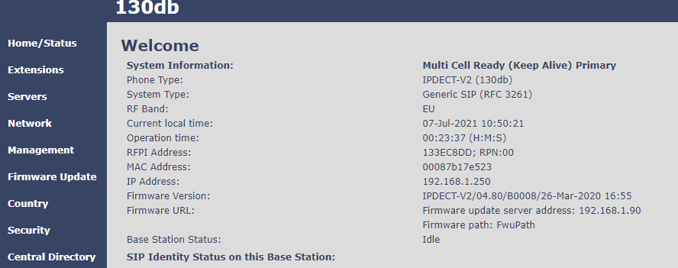
Multi-cell: Primary after multi-cell synchronisation
Primary base shows Multi cell Ready(Keep Alive) Primary

Slide 8
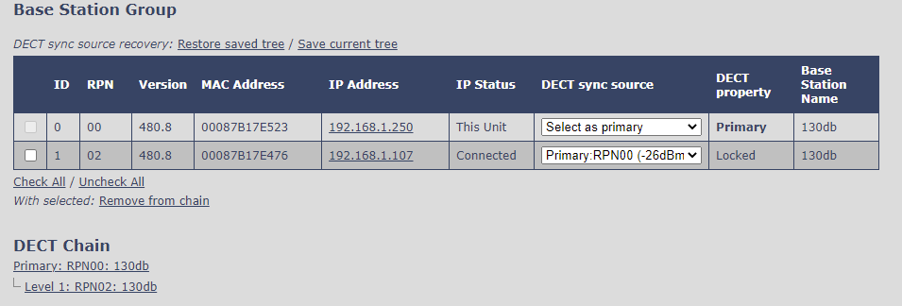
Multi-cell: Primary after multi-cell synchronisation
On the Primary base Multi Cell, the Base Station Group you can see the primary and second base (Locked) and the DECT Chain.
Repeat this process to add more bases stations

