Slide 1
IP Dect 130db User Setup Cloud

Slide 2
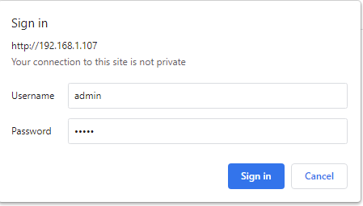
Configuration
Base Station
1. Method for Base IP Setting
1) Network mode of the base station is set as DHCP by default.
2) Connect a base station to the POE switch and make it get IP address from a DHCP server.
3) On the handset, press [Menu] button and dial *47* to enter “Base Searching mode”.
4) MAC Address of the base station will be shown with IP address obtained by a DHCP server.
5) Connect the base station Web Admin by accessing the IP. (For example, if the acquired IP is 192.168.125.183)
(http://192.168.125.183)
6) Enter ID(admin) and Password(admin)
7) Make sure all bases and handsets are on the latest firmware

Slide 3
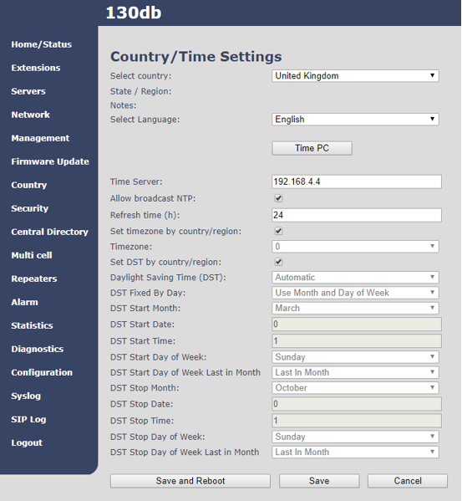
Configuration Country/Time Settings
On the Base select UK, set the Time Server IP address/URL as you prefer and check DST settings
Save and Reboot

Slide 4
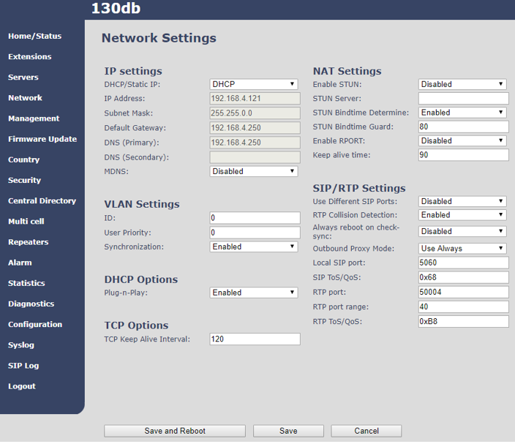
Configuration
Base IP Setting
Click [Network].
Select DHCP or Static IP.
In case of Static IP, enter network information.(IP, Subnet Mask, Default Gateway, DNS)
Click [Save] to save new configuration.
Reboot the base station.

Slide 5
Configuration
Reseller Portal
The call server IP address can be found Under Customer Info, Phone Setting Info, SIP Phone Registration IP address

Slide 6
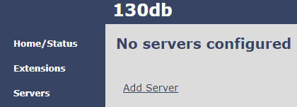
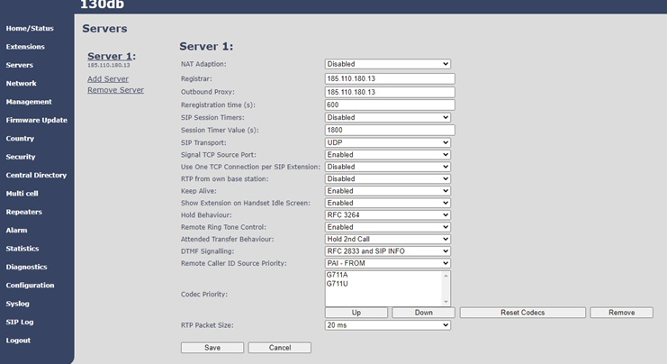
Configuration
Base Station
Server registration
Click Servers, Add Server
Registrar, Outbound Proxy. Enter the SIP Phone Registration IP Address from Phone Setting Info obtained in the Reseller portal.
NAT Adaption : Select Disable or Enable based on the network environment
Codec Priority : Remove G.722 and adjust the Codec Priority. (G.711A ← G.711U)
Click [Save] to save new server information.

Slide 7
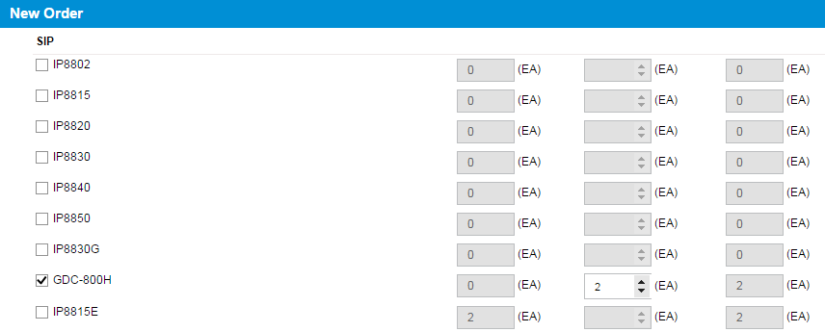
Registration
On Reseller portal
1. Ordering GDC-800H/110dh handset
1) Order request from reseller 800H or 110dh
2) Wait for confirmation from Pragma
3) Order Final Confirm from reseller

Slide 8
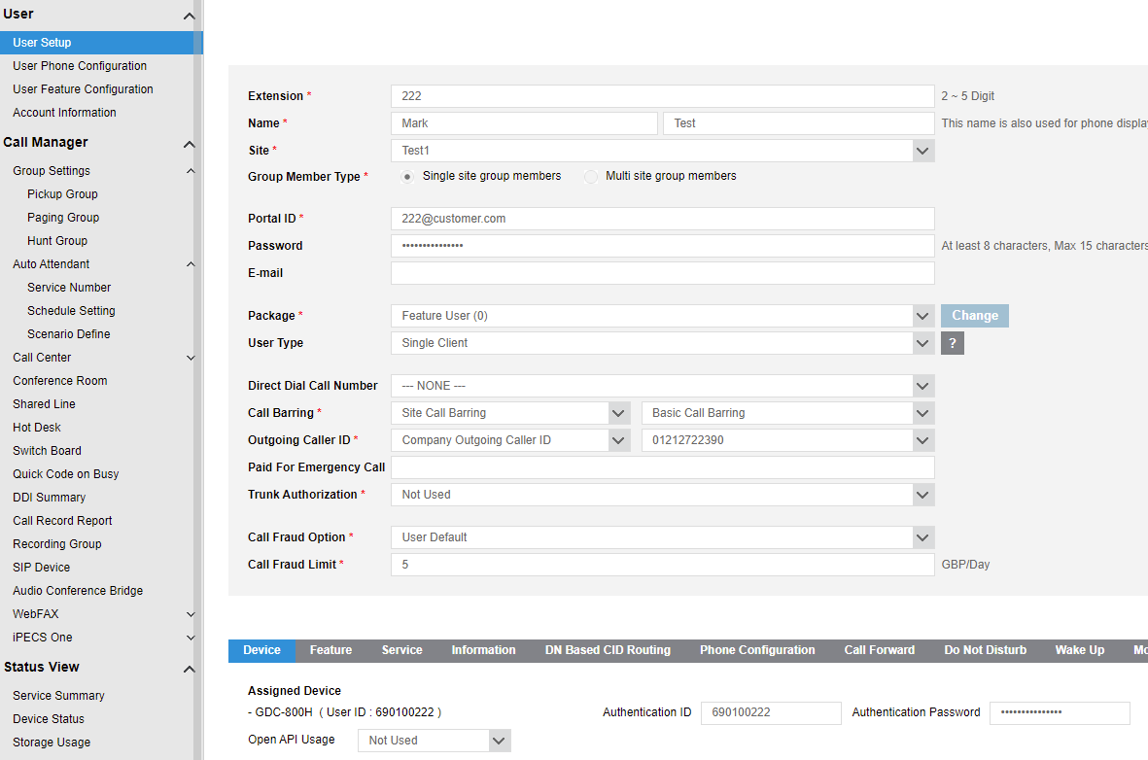
Registration
On Customer Manager portal
Select User, User Setup
Enter User Information
In Device tab select Phone GDC-800H/110dh
Enter Authentication ID to match User ID. Add Password.(Mandatory). MAC Address selection is not required
Important, ensure a secure password is set, include more than 3 types, lower case, upper case, number, symbol
Save.

Slide 9
Registration
At Base
1. Handset registration
1) Click [Extensions] in menu and [Add extension].

Slide 10
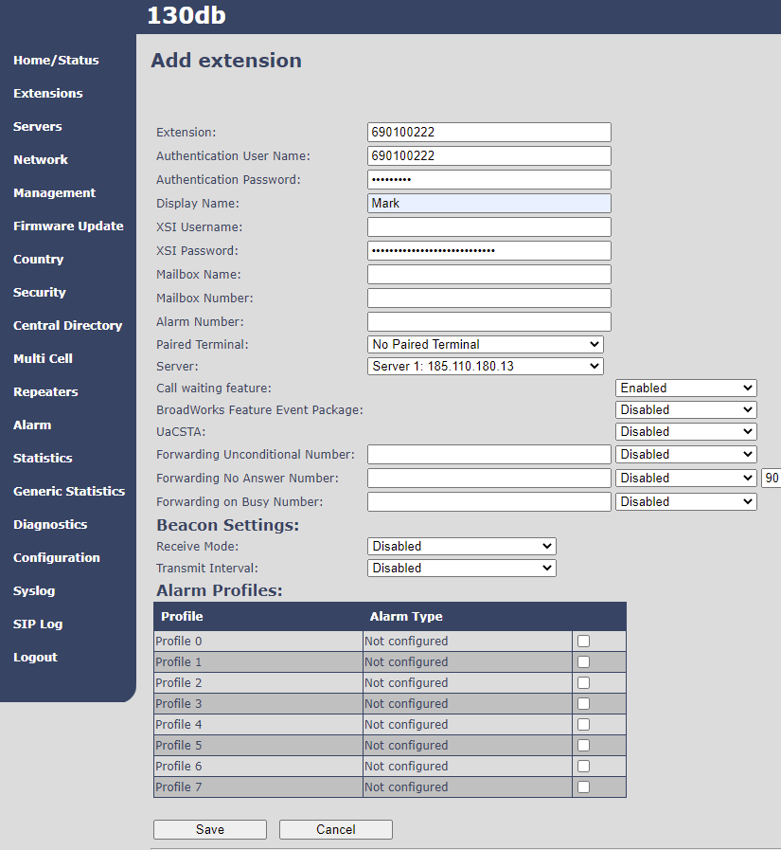
Registration
At Base
Extension: Enter User ID (Tenant Prefix + Extension Number) defined in Customer Manager portal, User, User Setup, Device
Authentication User Name: Enter (Authentication ID defined in Customer Manager portal)
Enter Authentication Password. (defined in Customer Manager Portal )
Click [Save].
Note. Make sure there are no spaces in these fields, especially when using copy and paste from Customer Manager Portal. Otherwise this can cause registration to fail

Slide 11
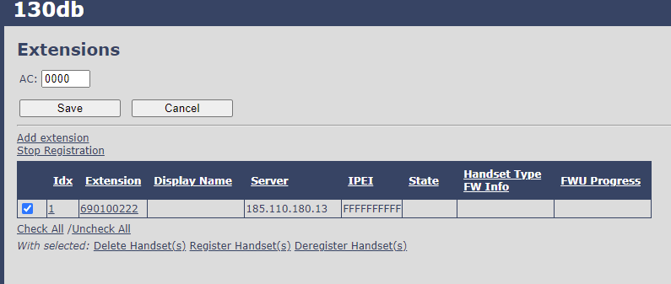
Registration
At Base
Handset registration
In Extensions select extension to register
Click “Register Handset(s).
Base station is waiting for the GDC-800H/110dh handset registration request.

Slide 12
Registration
At Base and Handset
At Handset
Press [Menu] button.
Select [Connectivity] button.
Select [Register] button.
Enter AC code. (0000)
Click [OK].
Handset displays Name & User ID
Base shows registered

Slide 13
End Thank you
Go to www.wearepragma.co.uk for more information

