Slide 1
IP Dect 130dB User Setup UCP/eMG80

Slide 2
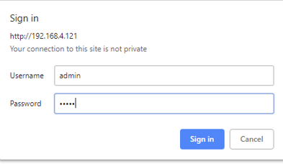
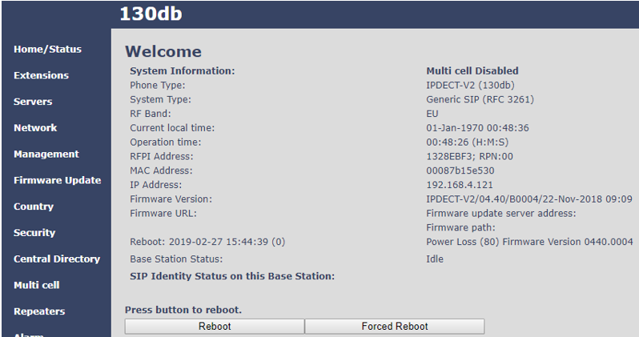
Configuration Find Base IP address and login
Base Station
Method for Base IP Setting
1) Network mode of the base station is set as DHCP by default. So you need a DHCP server on the network.
2) Connect a base station to the POE switch and make it get IP address from a DHCP server.
3) On the handset, press [Menu] button and dial *47* to enter “Base Searching mode”.
4) MAC Address of the base station will be shown with IP address obtained by a DHCP server.
5) Connect the base station Web Admin by accessing the IP. (For example, if the acquired IP is 192.168.4.121)
(http://192.168.4.121)
6) Enter ID(admin) and Password(admin).

Slide 3
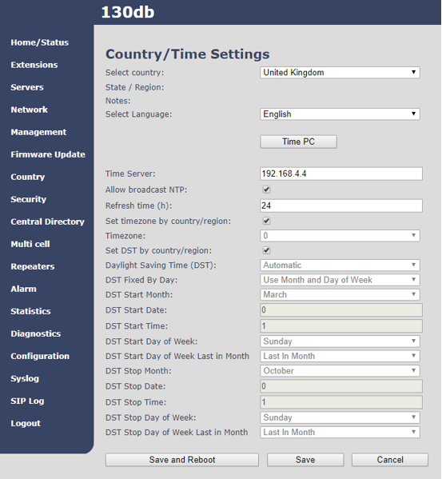
Configuration Country/Time Settings
On the Base select UK, set the Time Server IP address/URL as you prefer and check DST settings
Save and reboot

Slide 4
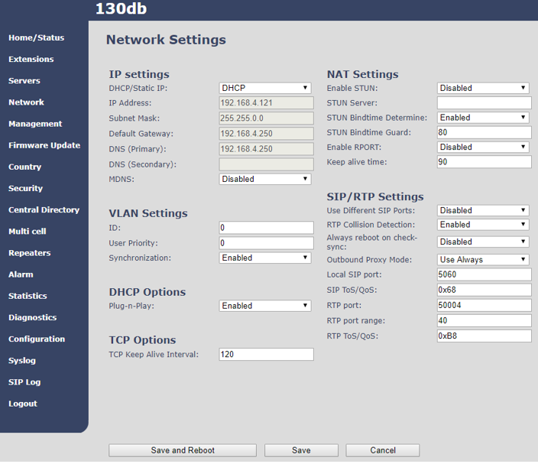
Configuration
Base IP Setting
Click [Network].
Select DHCP or Static IP.
In case of Static IP, enter network information.(IP, Subnet Mask, Default Gateway, DNS)
Click [Save] to save new configuration.
Reboot the base station.

Slide 5
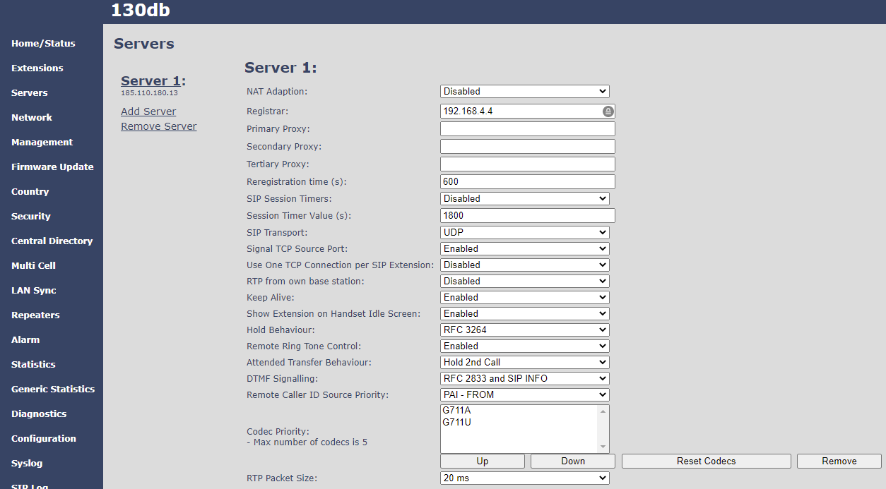
Configuration Add Call Server
Call Server registration
Click [Servers] and enter the UCP IP Address in Registrar
NAT Adaption : Select Disable or Enable based on the network environment
Remove G722 codec if not used, note G722 requires double the channels. Codec Priority : Adjust the Codec Priority. (G.711A ← G.711U)
Click [Save] to save new server information.

Slide 6
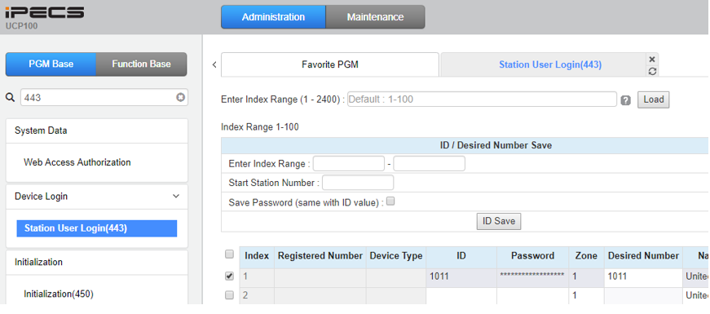
Registration
UCP / eMG80
On UCP/eMG80 PGM443 add the ID (that would be the extension number) ,the password and the desired number (also extension number and available in PGM105)

Slide 7
Configuration Handset Registration
At Base
1. Handset registration
1) Click [Extensions] in menu and [Add extension].

Slide 8
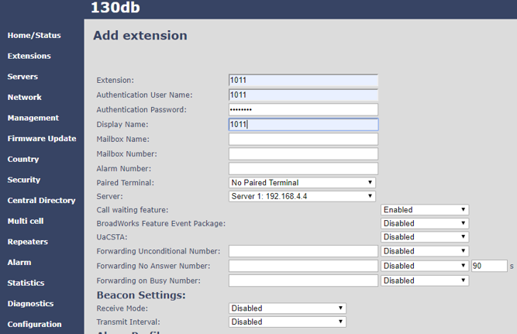
Configuration Handset Registration
At Base
Enter Extension number. (same as in PGM443)
Enter Authentication User Name. (same as in PGM443)
Enter Authentication Password. (same as in PGM443)
Click [Save].

Slide 9
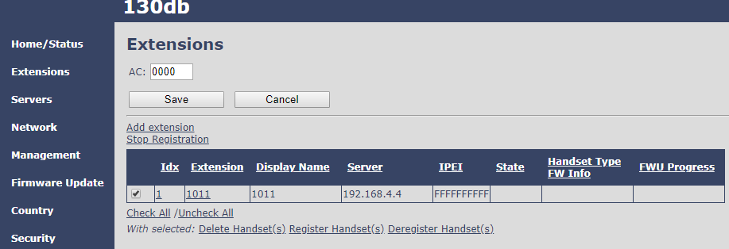
Configuration Handset Registration
At Base
1. Handset registration
Check the desired handset and Click “Register Handset(s).
State changes to enabled and the base is waiting for the handset request

Slide 10
Configuration Handset Registration
At Handset
Press [Menu] button.
Select [Connectivity] button.
Select [Register] button.
Enter AC code. (0000)
Click [OK].
Phones says registering
Front screen displays the extension number
On 130dB confirm extension registration as shown
At Base

Slide 11
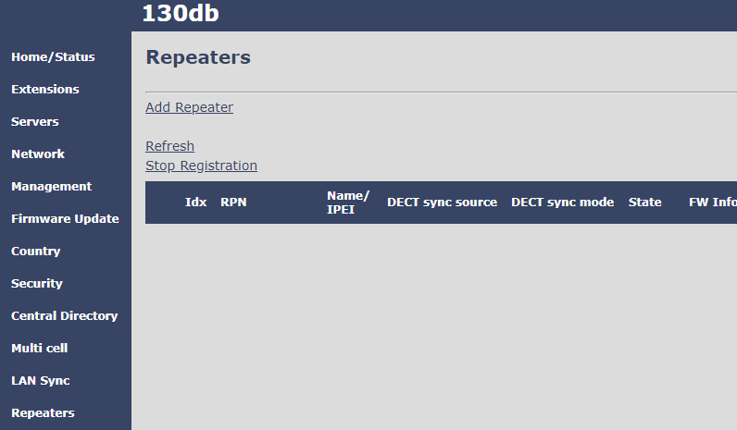
Configuration Repeater Registration
From repeaters web select “Add Repeater.

Slide 12
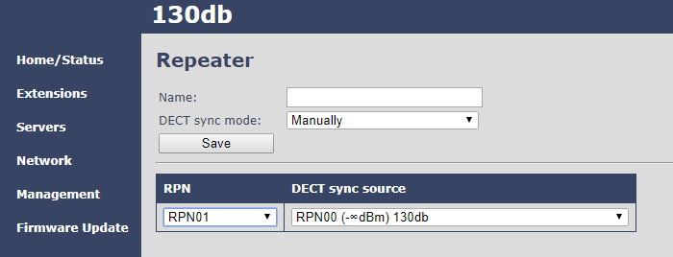
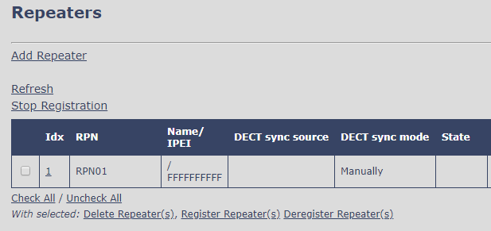
Configuration Repeater Registration
Select DECT sync mode. Manually: User controlled by manually assign “Repeater RPN” and “DECT sync source RPN” Local Automatical: Repeater controlled by auto detects best base signal and auto assign RPN
Then tick check box and select Register Repeater

Slide 13
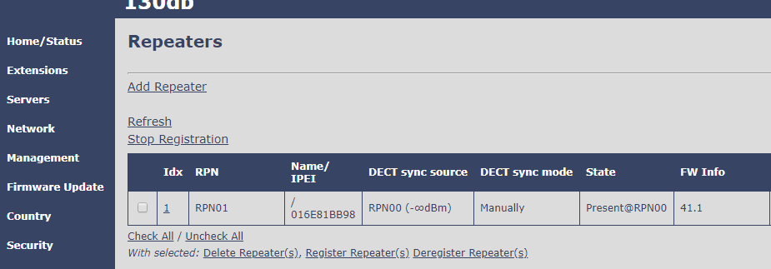
Configuration Repeater Registration
Repeater LED will change from flashing green to solid green and the repeater will show as present in the State column

Slide 14
End

