Slide 1
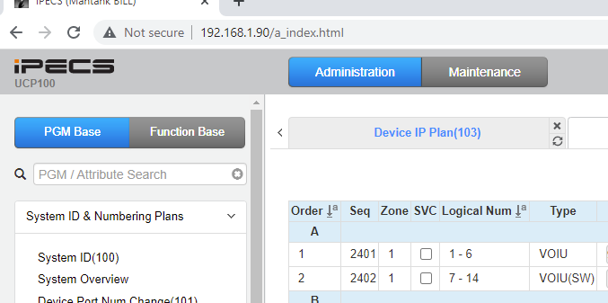
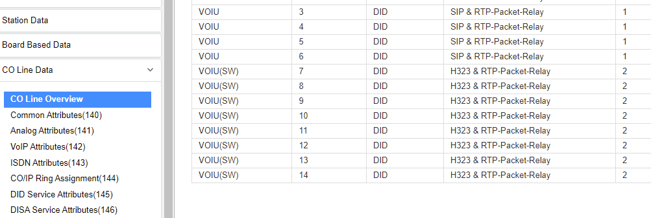
System Networking EQ Congestion error message on inbound call
The calling IP address and CO group must be entered in the H323 incoming routing table to use voice networking feature with IP bind
1. PGM 103. Find the sequence number for the VOIP device used for system networking. In this example VOIUSW is used.
2. CO Line Overview. Find the CO Group used for the networking CO lines

Slide 2
3. PGM 326 Enter sequence number for VOIP device and check IP Bind is set ON (default)
PGM 326
4. PGM 328 Enter the remote systems IP address and enter the CO group used for the networking CO lines
5. Repeat this for the remote networking systems

