Slide 1
Skype for Business With Voice

Slide 2
Configuring Skype for Business Soft Client
First, you will need to check you have the correct licenses. The license is the following shown in the system overview tab.
Next, you will need to set the user up in PGM 443 – Station user login

Slide 3
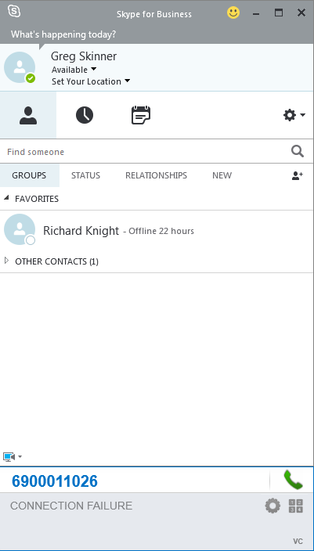
Configuring Skype for Business Soft Client
Next you will need to download and install the Lync RCCV client from our website.
You will then have the below plugin once you open Skype for Business

Slide 4
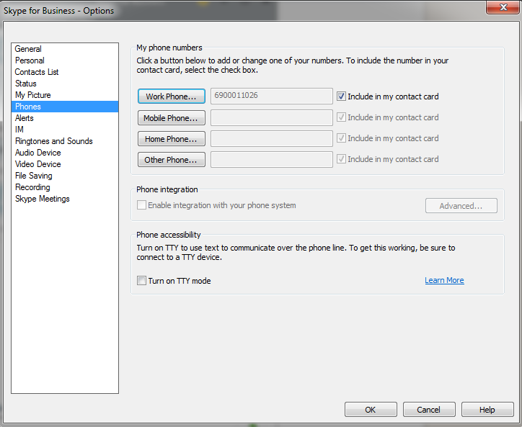
Configuring Skype for Business Soft Client
You will now need to go in to properties on Skype and then phones and amend your work phone to the registration user name set in PGM 443 as shown on the screenshot.

Slide 5
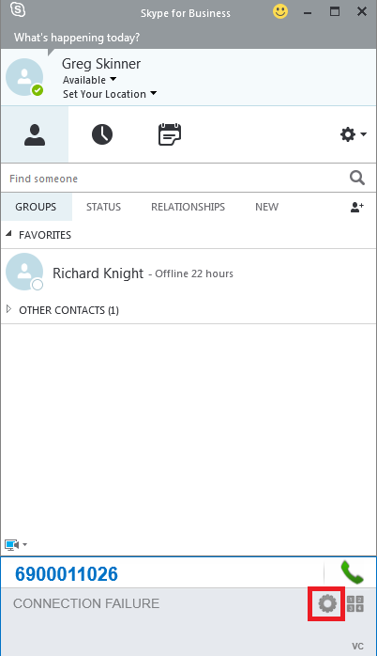
Configuring Skype for Business Soft Client
Next we will need to configure the client its self we can do this by clicking the cog found at the right of the bolt on.

Slide 6
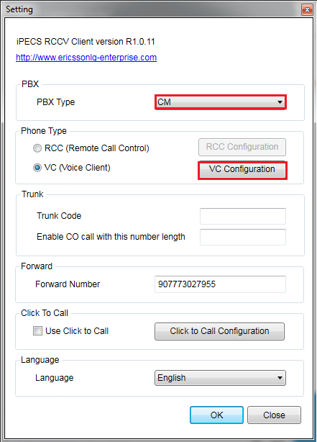
Configuring Skype for Business Soft Client
This will bring up the registration details, you will need to set the PBX type to your PBX type e.g. UCP, eMG80.
Also make sure to set Phone type to VC as this is the Softphone option, and once this is done you will need to click VC configuration to input the credentials.

Slide 7
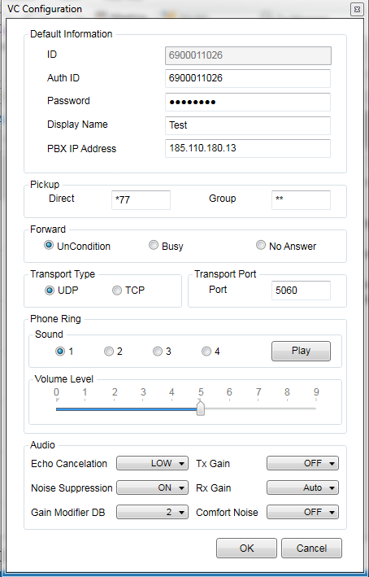
Configuring Skype for Business Soft Client
You will now need to enter your Username and Password as well as the PBX address

Slide 8
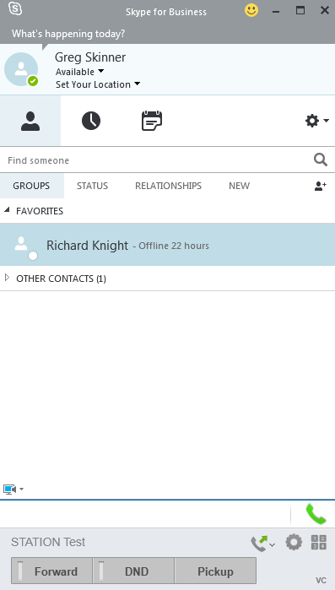
Configuring Skype for Business Soft Client
The softphone will now be registered as shown.

