Slide 1
wqh

Slide 2
Skype for Business Activity

Slide 3
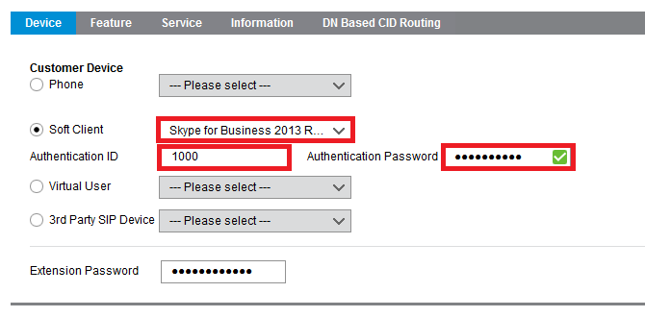
Activity Soft Client Setup
Soft Client – Skype for Business
When configuring the station select Skype for Business within Soft Client.
Once you have selected this device now see 2 fields that need to be populated.
The first field is Authentication ID this will be used for registration enter a value that you would like to use.
Next you will need to set an Authentication Password we advise to use a strong password as this is going to be used for your registration

Slide 4
Activity Soft Client Setup
Soft Client – Skype for Business
Now navigate back to the client to enable you to obtain all of the information needed to regiser.

Slide 5
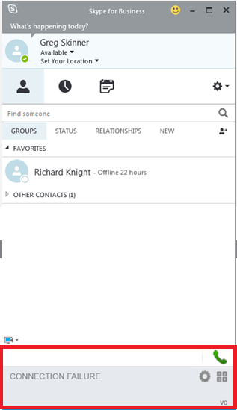
Activity Soft Client Setup
Next you will need to download and install Lync RCCV client from our website.
You will then have the below plugin once you open Skype for Business

Slide 6
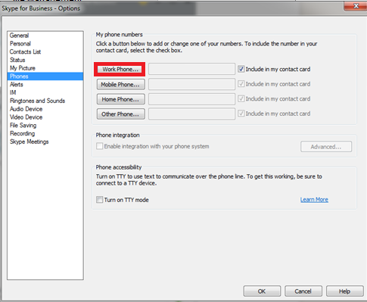
Activity Soft Client Setup
You will now need to go in to properties on Skype, then Phones and amend your work phone to the registration user name or auth id? as shown bellow

Slide 7
Skype for Business
Voice Client

Slide 8
Configuring Skype for Business Soft Client
Create a User as you would normally do but instead of selecting Phone, select Lync RCCV from the drop down list.
PLEASE NOTE !!!
This option will not be available unless you have purchased a licence.

Slide 9
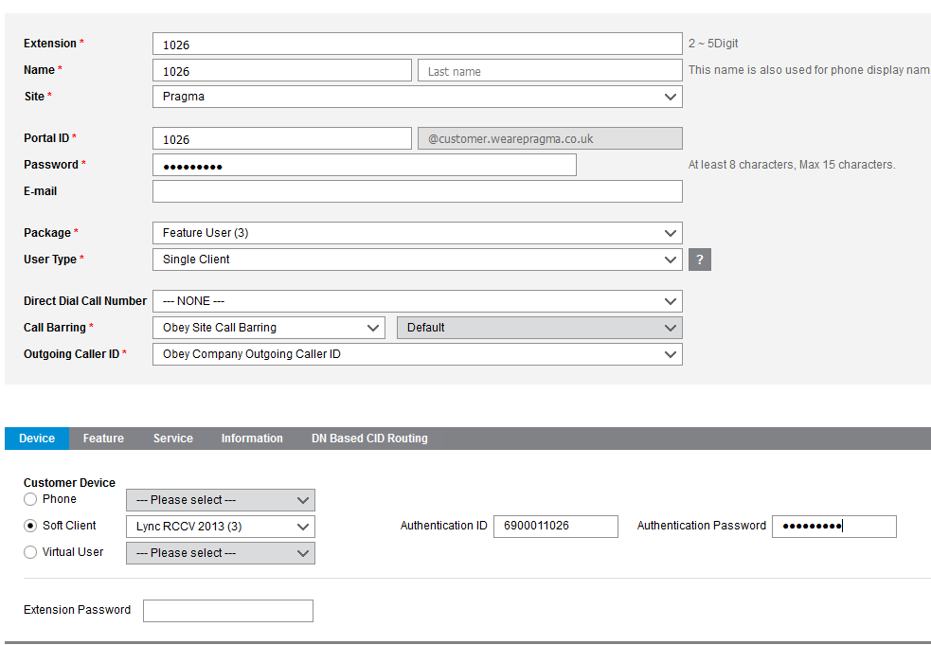
Configuring Skype for Business Soft Client
Once you have selected this option you will then need to input the username and password that will be used to register your client.
Currently you will need to contact support to get your unique identifier as this must be a prefix to the extension number as shown in the image.
As you can see we have the prefix of 69001 followed by the extension 1026.
You will also need to select a strong password as this is going to be used for your registration.

Slide 10
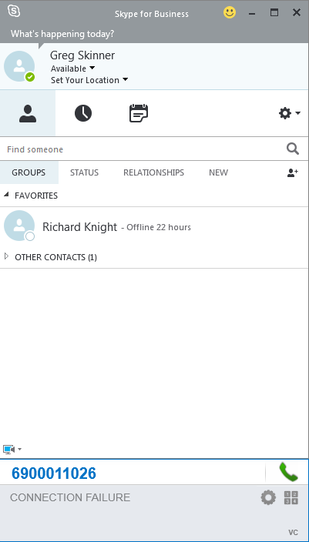
Configuring Skype for Business Soft Client
Next you will need to download and install Lync RCCV client from our Resource Centre.
Download Link
You will then have the below plugin once you open Skype for Business

Slide 11
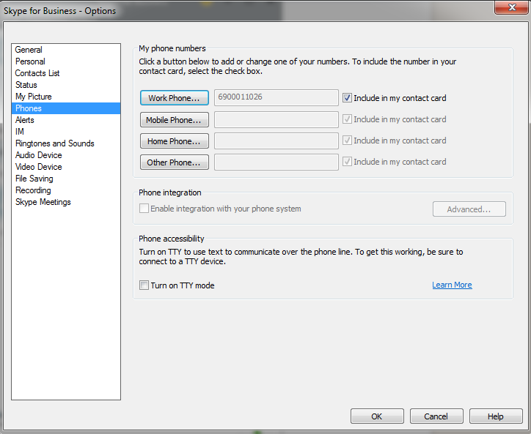
Configuring Skype for Business Soft Client
You will now need to go in to properties on Skype and then Phones and amend your Work Phone number to the registration user name set on the portal as shown on the screenshot.

Slide 12
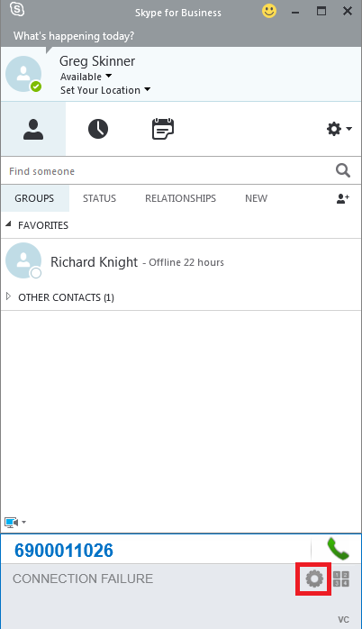
Configuring Skype for Business Soft Client
Next we will need to configure the client its self we can do this by clicking the cog found at the bottom right of the bolt on.

Slide 13
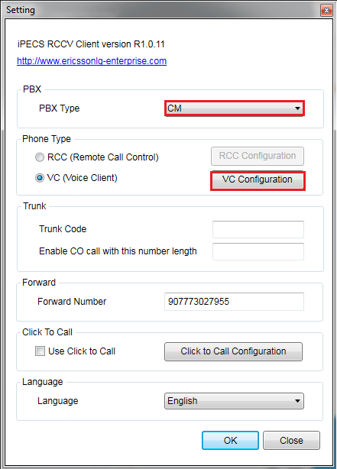
Configuring Skype for Business Soft Client
This will bring further information, you will need to set the PBX type to CM
Also make sure to set Phone type to VC as this is the Softphone option, and once this is done you will need to click VC configuration which will provide a popup.

Slide 14
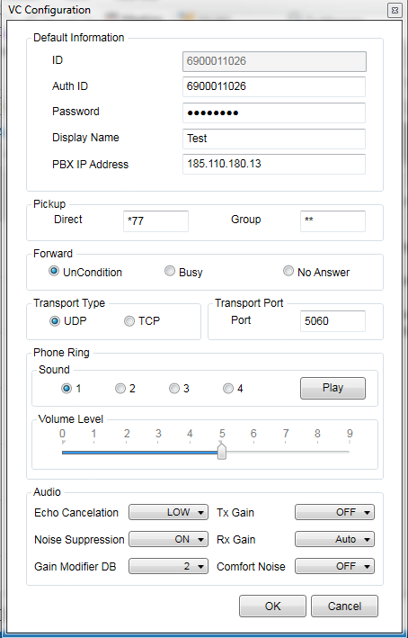
Configuring Skype for Business Soft Client
You will now need to enter your Username and Password as well as the SIP registration IP which will be 185.110.180.13.
You will need to make sure the port is set to 5060 and then click OK

Slide 15
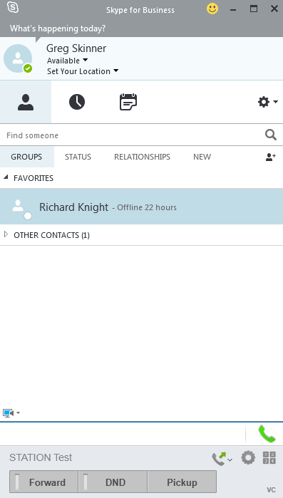
Configuring Skype for Business Soft Client
Skype for Business Voice client will now be registered.

Slide 16
Skype for Business
Call Control Client

Slide 17
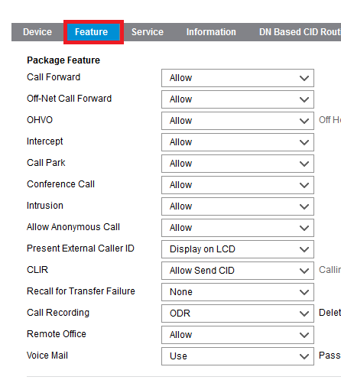
Configuring Skype for Business Call Controller Client
First create an extension with a desk phone as normal. Next go to features within User Setup and you will see the screen shown below.

Slide 18
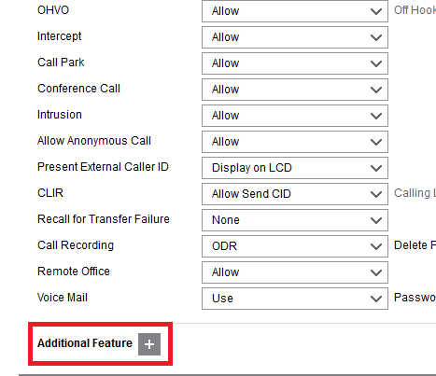
Configuring Skype for Business Call Controller Client
Now if you scroll to the bottom you will see Additional features with a + button next to it. If you click then then you will get a pop up screen with further options.

Slide 19
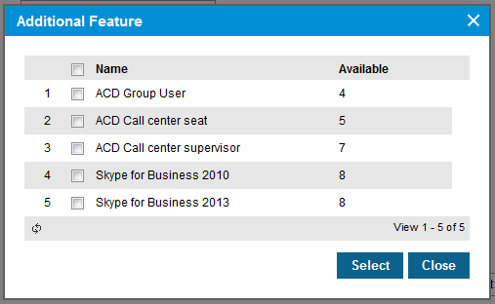
Configuring Skype for Business Call Controller Client
You will now need to select the correct version of Skype normally this will be 2013 for any versions of S4B 2013 onwards . Once selected click save

Slide 20
Configuring Skype for Business Call Controller Client
You will need to inter your tenant prefix to obtain this please contact the pragma technical support team.

Slide 21
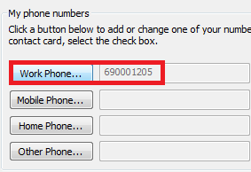
Configuring Skype for Business Call Controller Client
Now we need to go to Skype and set the phone number under Settings, Phone, Work Phone

Slide 22
Configuring Skype for Business Soft Client
Next we will need to configure the client its self we can do this by clicking the cog found at the right of the bolt on.

Slide 23
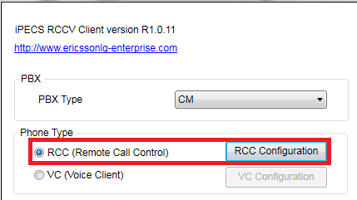
Configuring Skype for Business Call Controller Client
You will then need to go under the RCCV client and select RCC .

Slide 24
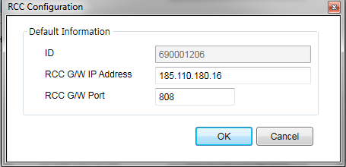
Configuring Skype for Business Call Controller Client
You then need to input the IP address that you phone registers to in the RCC G/W IP Address.

Slide 25
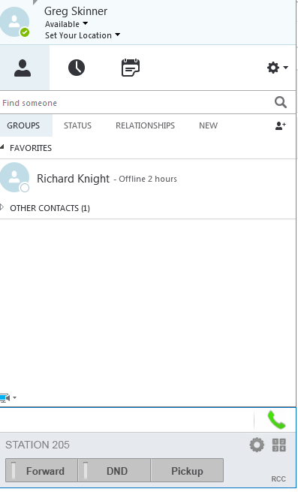
Configuring Skype for Business Call Controller Client
You will then have a registered call controller.

