Slide 1
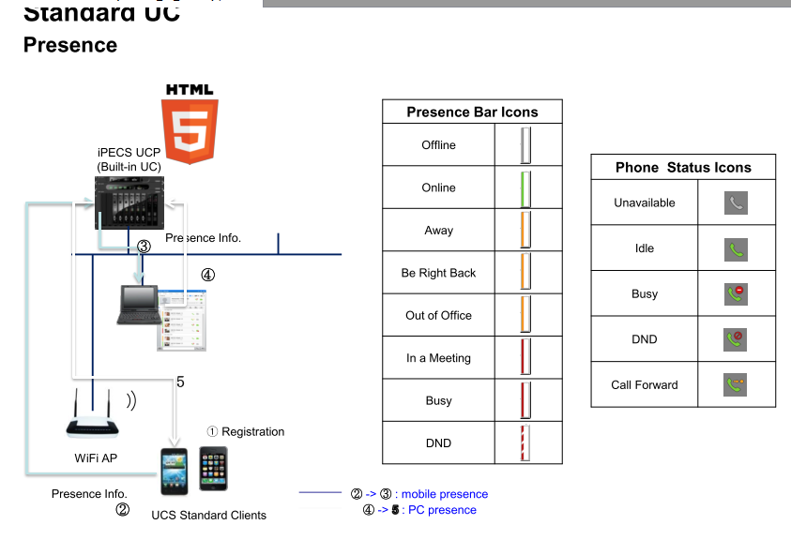
Teach: Unified Communications Service

Slide 2
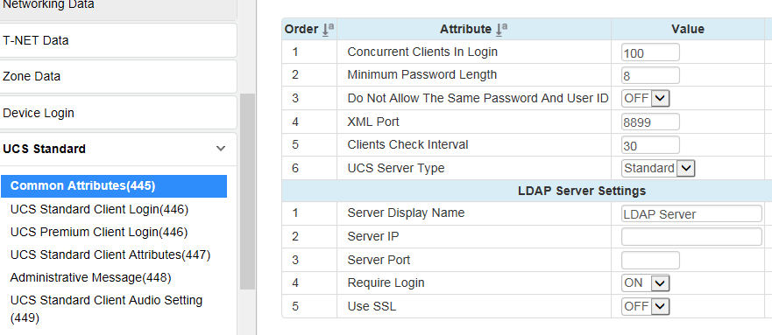
Teach: Unified Communications Service - Standard

Slide 3
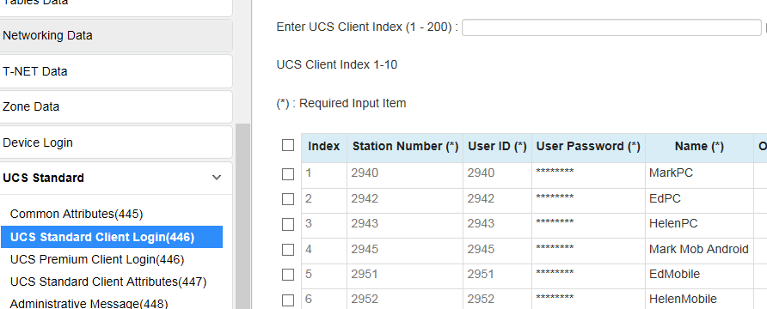
Teach: Unified Communications Service - Standard

Slide 4
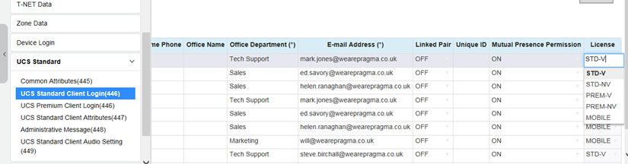
Teach: Unified Communications Service - Standard

Slide 5
Teach: Unified Communications Service – Standard Port Forwarding
UCS Client Router Port forwarding
Signalling TCP/UDP_5588, TCP_8899, TCP_7878
Audio and video ports refer to port usage table depending on the VOIP gateway used.

Slide 6
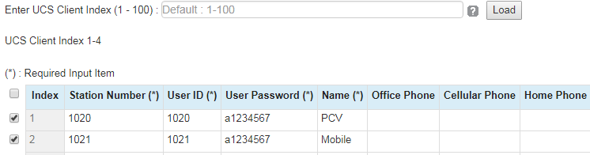

Exercise: Unified Communications Service – Client Installation, PC
In PGM445 set password length to 8 & User Server Type to Standard
In PGM446, enter client Index 1-4 and data as below
sales sales@sales.com
sales sales@sales.com

Slide 7
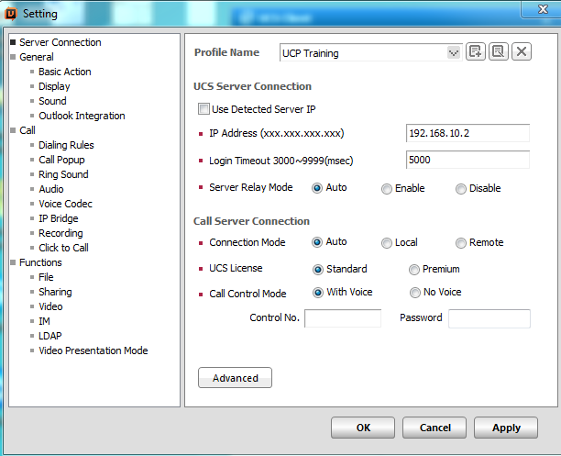
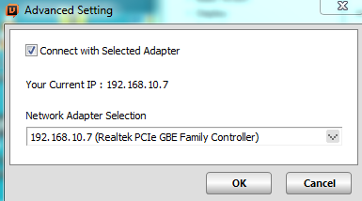
Exercise: Unified Communications Service – Client Installation, PC with Voice
Run UCSClient exe file and install on your PC. On File, Setting, enter UCP IP address, UCS Licence: Standard, Call Control: With Voice . Check PC NIC address is set according to Slide 23.
Set UCP IP address UCP1 192.168.10.3, UCP2 192.168.10.4, UCP3 192.168.10.5, UCP4 192.168.10.6.
UCP5 192.168.10.7, UCP6 192.168.10.8, UCP7 192.168.10.9, UCP8 192.168.10.10 Under Advanced select your network adapter

Slide 8
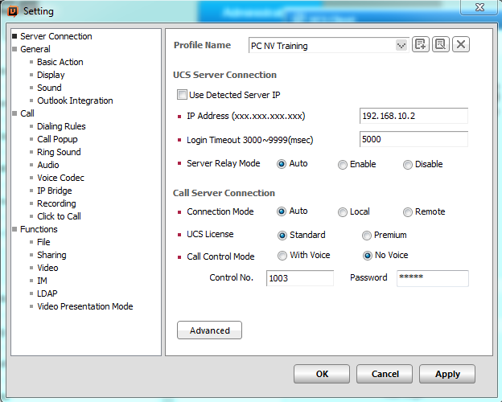
Exercise: Unified Communications Service – Client Installation, PC with No Voice
Run UCSClient exe file and install on your PC. On File, Setting, enter UCP IP address, UCS Licence: Standard, Call Control: No Voice, Station number and its password in PGM227
Set UCP IP address UCP1 192.168.10.3, UCP2 192.168.10.4, UCP3 192.168.10.5, UCP4 192.168.10.6.
UCP5 192.168.10.7, UCP6 192.168.10.8, UCP7 192.168.10.9, UCP8 192.168.10.10 Under Advanced select your network adapter

Slide 9
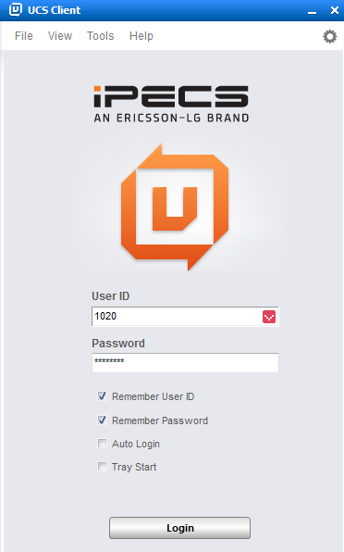
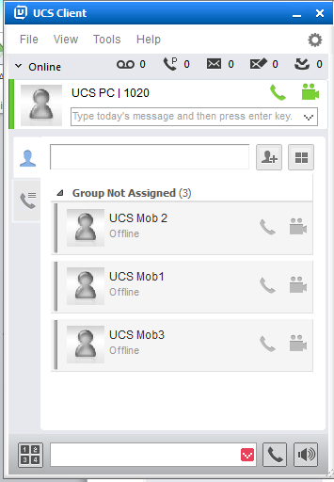
Exercise: Unified Communications Service – Client Installation, PC
Enter User ID & Password and Login

Slide 10
Exercise: Unified Communications Service – Client Installation, PC with No Voice
For PC Non voice UCS client, a personal group PGM260 is automatically created. Check that the master is the IP Phone and the slave is the UCS client. If not these can be swapped over
Check that the UCS client can dial out by controlling the IP Phone

Slide 11
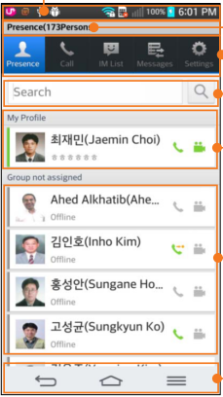
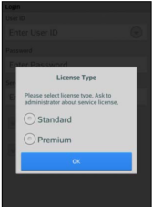
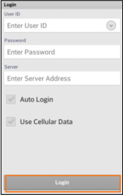
Exercise: Unified Communications Service – Client Installation, Android
In Play Store search for Ericsson UCS, install and run the app.
Connect Training WiFi router and select this network on Android
Enter Standard Licence, User ID: 1021, Password: a1234567, Server Address: Set UCP IP address UCP1 192.168.10.3, UCP2 192.168.10.4, UCP3 192.168.10.5, UCP4 192.168.10.6. UCP5 192.168.10.7, UCP6 192.168.10.8, UCP7 192.168.10.9, UCP8 192.168.10.10 Login and check the screen presence

Slide 12
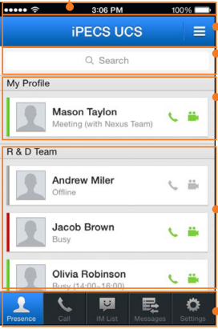
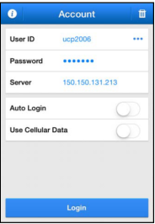
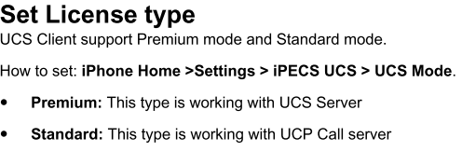
Exercise: Unified Communications Service – Client Installation, iPhone
In Apple Store search for Ericsson UCS, install and run the app
Connect Training WiFi router and select this network on iPhone
Enter Standard Licence, User ID: 1022, Password: a1234567, Server Address: Set UCP IP address UCP1 192.168.10.3, UCP2 192.168.10.4, UCP3 192.168.10.5, UCP4 192.168.10.6. UCP5 192.168.10.7, UCP6 192.168.10.8, UCP7 192.168.10.9, UCP8 192.168.10.10 Under Advanced select your network adapter
Login and check the screen presence

Slide 13
Exercise: Unified Communications Service UCS Client operation
Add presence group and change presence and check this is shown on the other clients
Tap another presence member and call them
Select video and check video operation
Test visual voicemail. In File/My Phone Status/ set busy/no answer forward destination to VSF 420
Make a call to UCS client and leave a voice mail
In Messages select visual voicemail and playback the message
Make a call using Call Tab and dial pad
In UCS PC Client, logout and set Click to Call and test (see following slides)
Enter UCS station number under flex keys on a LIP9030/40 and check presence

Slide 14
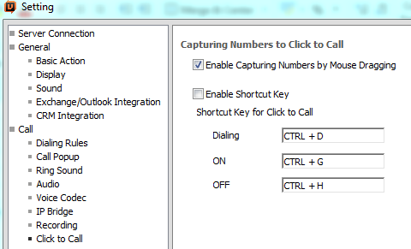
Exercise: Unified Communications Service – Click to call
Enable click to call

Slide 15
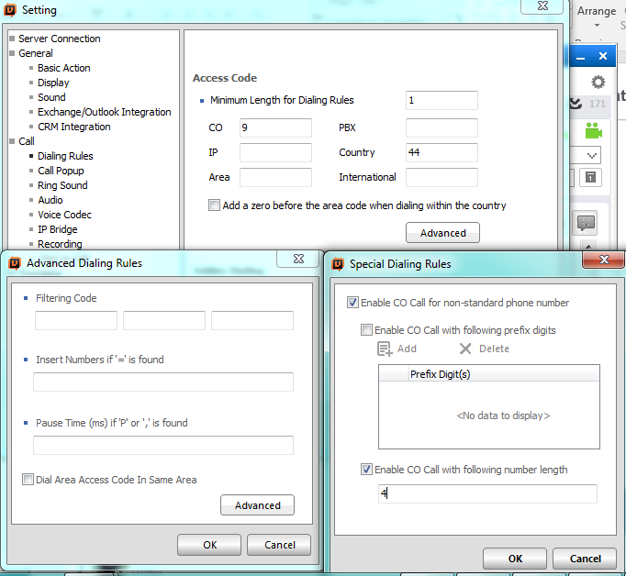
Exercise: Unified Communications Service – Dialing Rules

