Slide 1
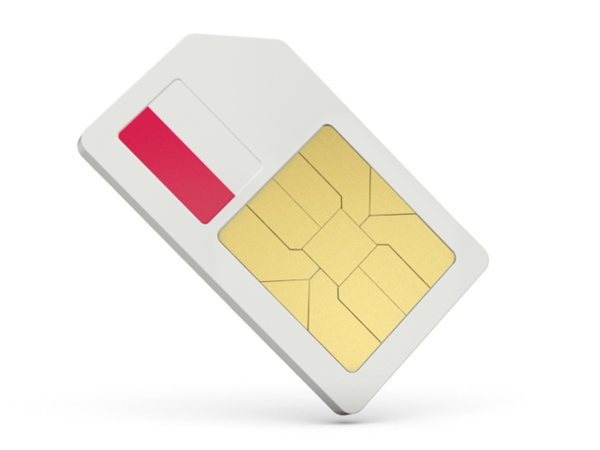
Setup Guide
iPECS Cloud Mobile

Slide 2
iPECS Cloud Mobile Guide
Licences required
Provisioning of the SIM card
Setup of the user
iCM features
Notes:
Member on hunt group, pickup group. Can set forwards.

Slide 3
iPECS Cloud Mobile – Product Overview
iPECS Cloud Mobile (iCM) is a mobile SIM card that can be used in a mobile phone that acts as an extension on the iPECS Cloud. This extension functions like a normal extension on the Cloud platform. iCM can receive calls on the assigned mobile number and any DDI on the customers account.
Registers as a SIP extension.
Functions like a normal extension.
Call recording and playback through the Cloud portal.
Receive inbound calls on mobile and DDI numbers.
Ability to be used as a multi-client user paired with a desk phone
Notes:
Member on hunt group, pickup group. Can set forwards.

Slide 4
Ordering iPECS Cloud Mobile
Step 1
Add the amount of new mobile numbers that are required
Make it clear in the notes field that these are for iCM
Steps:
Reseller Portal > Modify Existing > Change Order > Number Ordering/Porting
NOTE: If you are porting a mobile number across from another service provider you will also need to add the PAC code and mobile number in the notes field at this step
A mobile number is required for each SIM

Slide 5
STEP 2
Create new user/users in the End User Customer account
Steps:
Reseller Portal > Modify Existing > Change Order > Order Items
If you are adding the iPECS Cloud Mobile to an existing extension (as a multi client) you won’t need another user licence.

Slide 6
STEP 3
Add iPECS Cloud mobile Licence/licences
Steps:
Reseller Portal > Modify Existing > Change Order > Order Items

Slide 7
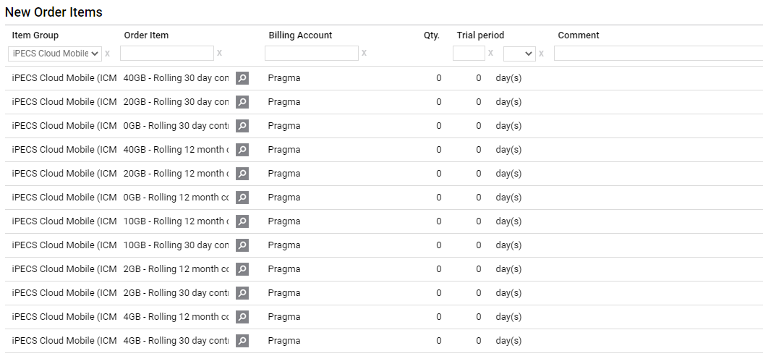
STEP 4
Select the required iPECS Cloud Mobile Package (Contract) and SIM for each user
Steps:
Reseller Portal > Modify Existing > Change Order > Order Items > Choose Package
also require 10 x SIMs

Slide 8
STEP 4
Select the required iPECS Cloud Mobile Package (Contract) and SIM for each user
Steps:
Reseller Portal > Modify Existing > Change Order > Device Ordering
NOTE: Every new iCM package (contract) must have a SIM card. Example, if you select 10 x 3 year, 5GB contracts then you will need 10 SIM cards.

Slide 9
STEP 5 > 7
STEP 5: Pragma will send out your SIMs and iPECS Cloud Mobile User Provisioning Form
STEP 6: Pragma will confirm the order and allocate your mobile numbers
STEP 7: Reseller to final confirm the order

Slide 10
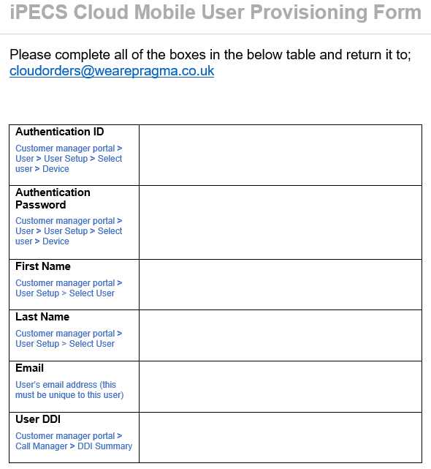
iCM Provisioning Form
Reseller would complete this after creating the user
Email address of user
Steps: Confirm email address of the user. This email must be unique to this user, duplicate email addresses will cause the sim to fail to register

Slide 11
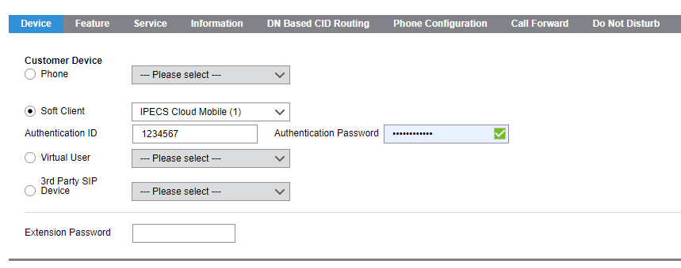
STEP 8
Reseller to complete the iCM User Provisioning Form
Authentication ID and Authentication Password
Steps: Customer Portal > Modify Existing > User > User Setup > Select User > Device
You will need to add a dummy Authentication ID here and a secure password.

Slide 12
STEP 8
Authentication ID and Authentication Password
One you save the user the User the User ID will be populated next to the iPECS Cloud Mobile licence.
You would need to copy and paste to the Authentication ID. Check for spaces before and after the number that might cause the user to fail to register.

Slide 13
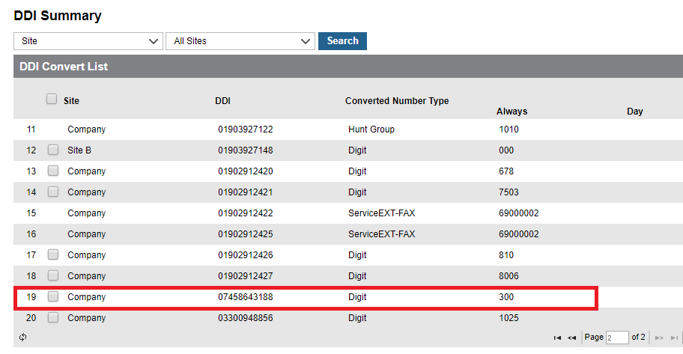
STEP 9
DDI Summary
You then need to point the DDI of your mobile number to the iPECS Cloud mobile extension created previously so the mobile can receive calls.

Slide 14
STEP 10 & 11
STEP 10: Send the completed iCM User Provision form back to Pragma
STEP 11: Pragma will provision your iCM service within 72 hours
To view registration status from the cloud portal, within the customer manager
Status view > Device status
The phone needs to be turn on.

Slide 15
STEP 12 - Initial mobile phone settings
Enabling roaming
Android:
Settings > Network > Mobile Networks > Data Roaming (On/off)
iOS:
Settings > Mobile Data > Mobile Data (On/Off) > Mobile Data Options > 4G & Data Roaming (On/Off)

Slide 16
Functionality
To dial extensions with a 3 digit number plan;
* + extension number
Dialling extension number using 4+ digit numbering plan dial as normal.
To perform a blind (unannounced) transfer:
1. Dial *26
2. Dial the extension number you require
3. Hang up
To perform a screened (announced) transfer:
1. Dial *82
2. Dial the extension number you require
3. Announce the call
4. Hang up
Notes:
* + extension roadmap to not need *

Slide 17
Feature codes
504 - DND - Number dials and receive ring back tone, after hanging up DND is enabled/disabled
512 - Call park - able to pick up calls from park when dialing access code (512) and park location number e.g. 001
510 & 511 - Group & direct call pickup - ringing 511 picks up call after 2-3 seconds. Dialling 510 + ext number picks up call from ext.
501/502 - Forward register - dialling 501 + (1 - 4) + destination receives audible tone and forwards handset. 502 cancels forward.
Notes:
* + extension roadmap to not need *

Slide 18
Mobile roaming
The iCM SIM roams between EE and O2.
The iCM SIM chooses the strongest signal when turned on, the SIM will only change carrier when all connection is lost to the current carrier.
WiFi calling is currently not possible but is on the roadmap for the future.

