Slide 1


Slide 2

LCM Cloud Portal

Slide 3
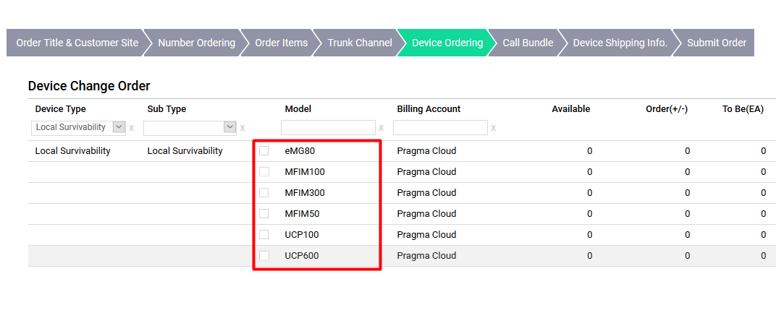
LCM – Cloud Configuration
First log in to the iPECS Cloud Customer Manager Portal for the customer you want to enable LCM on before you do anything you will need to configure the portal.
For each LCM device you will be using you will require a license. Currently you can connect a device per site, you can use either a UCP, MFIM or EMG80 from version 3.5 onwards.

Slide 4
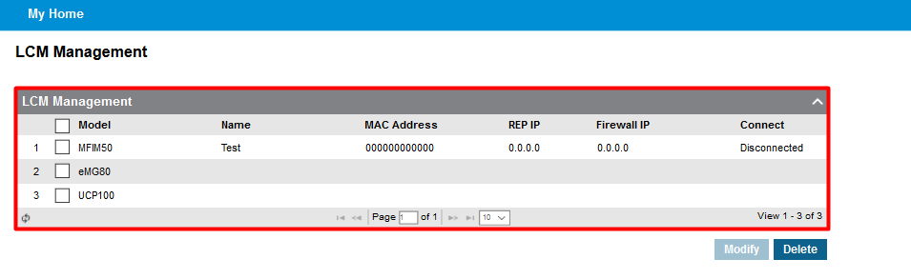
LCM – Cloud Configuration
Once you have a license assigned to the customer this will show within Company > LCM Management on the portal.

Slide 5
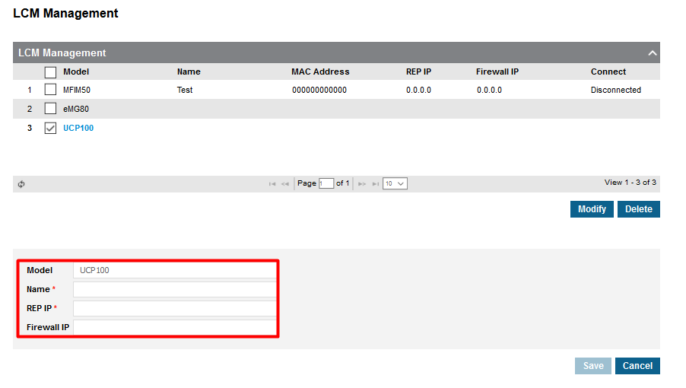
LCM – Cloud Configuration
To configure the LCM select the device you would like to amend, and you will then have to configure some additional settings as shown below :
Model – This is the device that you are configuring EG UCP 100, UCP 600, EMG80
Name – Name for the LCM, this will be used when assigning the device so is good to use an easily identifiable name.
Rep IP – This is the IP for the local system
Firewall IP – This is the WAN address for the customer site.
When the device is correctly set up on both sides this will show a connected on this page.

Slide 6
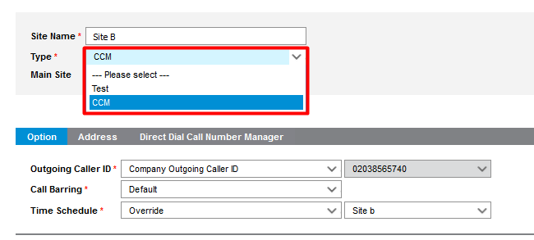
LCM – Cloud Configuration
Once you have configured the LCM you will need to assign this to the site you would like to use. This can be done within Company > Site Management.
Once you have selected the site you will see that there is option for Type this is where you will see to use LCM or not.
If this is set to CCM this is directly connected to the cloud. The other options will show the name for the LCM devices configured in LCM management.
NOTE : You must assign the LCM to the site before you add any users, or you will have to delete all users to amend.

Slide 7
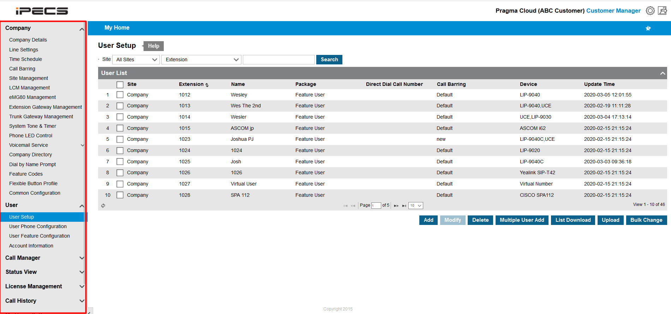
LCM – Cloud Configuration
You can now configure the rest of your cloud system as normal.

Slide 8
LCM Cloud Portal EMG

Slide 9
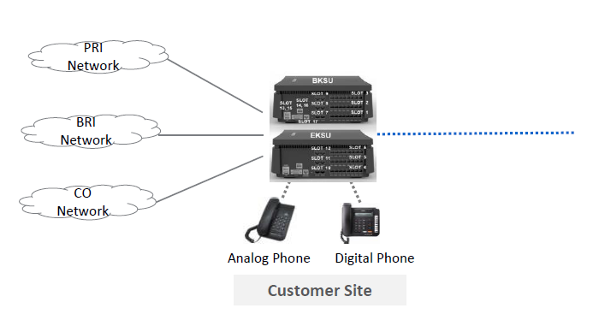
Customer Manager - eMG80 LCM - Overview
eMG80 is available as an LCM (Local Call Manager) for redundancy.
In a normal working state all phones will be connected to the cloud, if there was any failure that meant that the eMG80 and Cloud could not communicate then you can fall back to using ISDN or Analogue lines on the local system.
Things to note:
Conference features cannot be used on an eMG80 in LCM mode.
You need either a VOIU or VOIB to establish a voice call between any device. ( If you do not have any channels available the call will connect but you will have no audio.)
The following is not supported by the eMG80 in LCM mode:R2 in E1IB, T1IB, VMIU/VMIB, WTIB/SOIB/MCIB/MISU.
iPECS Cloud
Notes:
Overview

Slide 10
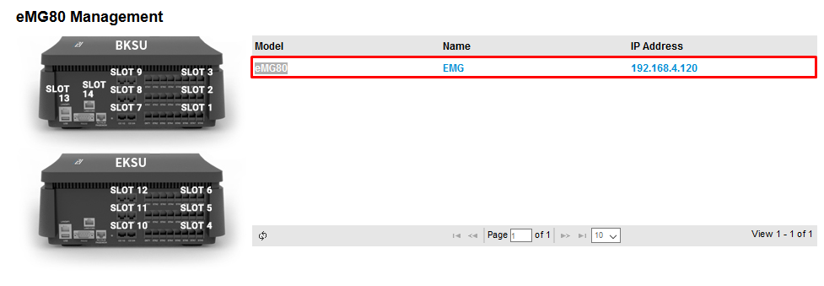
eMG80 LCM – Board Management
Configuration on the eMG80 slots can be done through the eMG80 section of the portal.
From here you are able to see the slot numbers that you will need to match with the boards installed in the eMG80 unit.
You are also able to configure the expansion EMG from the same screen.

Slide 11
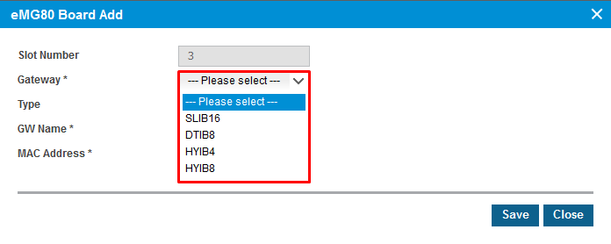
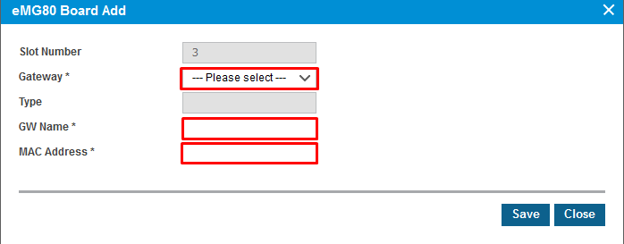
eMG80 LCM – Board Management
To configure first select the slot number you would like to identify.
Once selected you will be able to choose the module that you have installed in that position on the eMG80.
Once you have chosen your module from the list, you will be able to choose the Gateway Name and MAC Address
NOTE: Depending on the slot you select you will have different modules available.

Slide 12
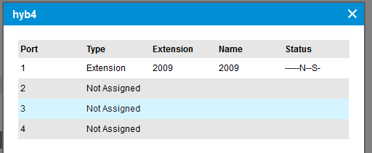
eMG80 LCM – Board Management
You will then be able to see if the gateway is registered or not in the Connected field.
If you would like to see what is allocated to the board select the magnified glass icon
This will then provide the information in a new popup window.
Notes:
Screenshot once connect changed to Status

Slide 13
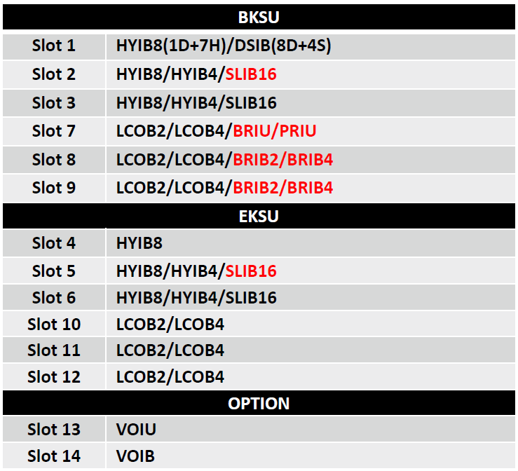
eMG80 LCM – Board Management
eMG80 in an LCM supports the bellow slot configuration.
Notes:
Screenshot once connect changed to Status

Slide 14
eMG80 LCM – Board Management
When setting a BRIB2 you will need to configure some additional options when setting up
You will additionally need to configure the trunk channels used by the board and TEI Type.
Notes:
Screenshot once connect changed to Status

Slide 15
LCM Phone System Configuration.

Slide 16
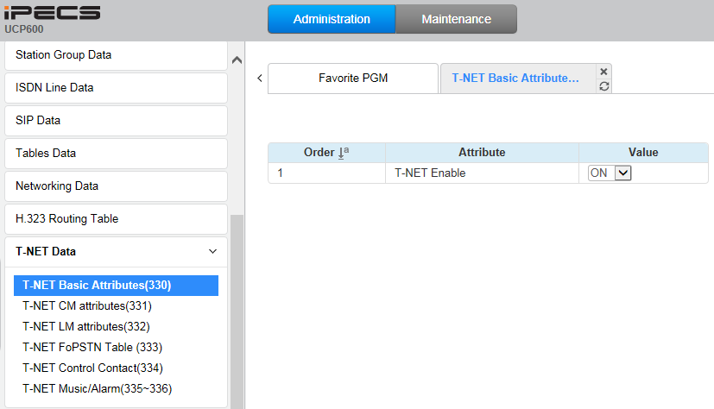
LCM – Enable TNET
Enable TNET in the eMG80

Slide 17
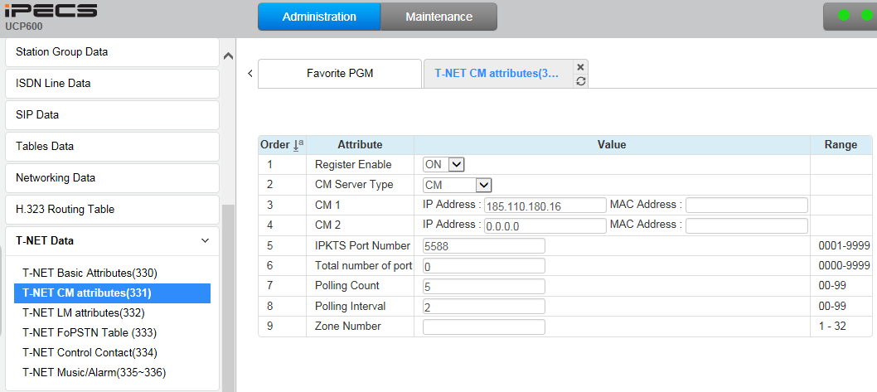
LCM - CM Attributes
Register Enable → Select “CM” in CM Server Type → Enter “IPKTS Relay Public Representative IP Address” in IP Address

Slide 18
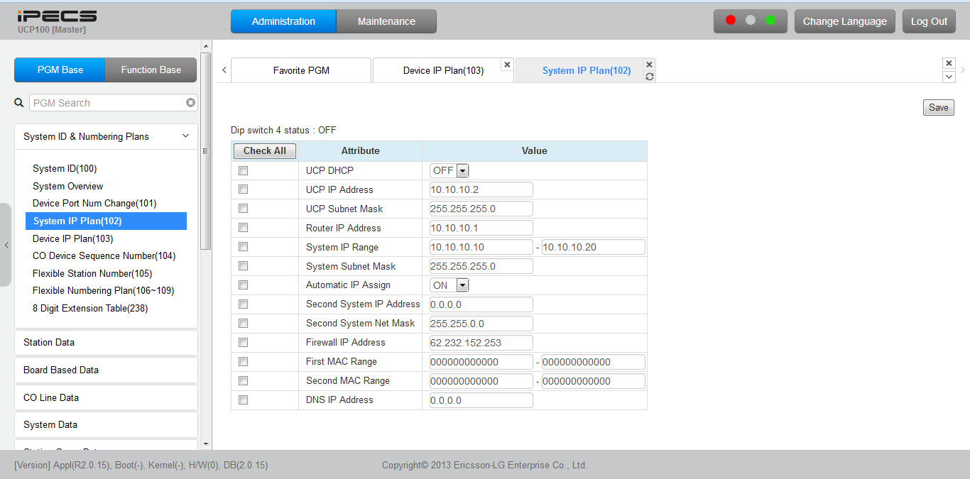
LCM – Registering Phones to LCM
Register Phones to the LCM system first(NOTE MAKE SURE THAT THE HANDSETS ARE SET TO REMOTE).
When Phones are registered to LCM, make sure that gateway IP of the router(ie .10.10.10.1) is set to the phones.
If this is not showing you are able to set this on the phones.

Slide 19
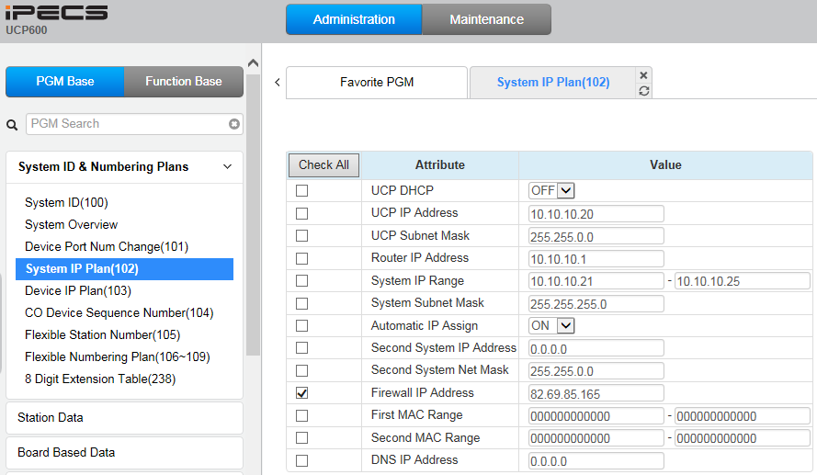
LCM – Registering Phones to LCM
In case that the LCM is located behind the NAT, enter Firewall IP Address.

Slide 20
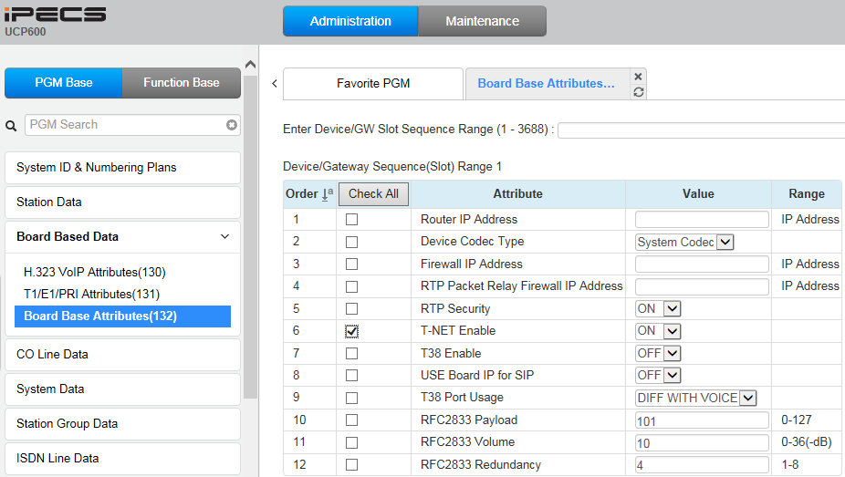
LCM – Enable TNET for Phones
Enable TNET for all phones to connect to the Cloud automatically when TNET connection is normal between LCM and Cloud.

Slide 21
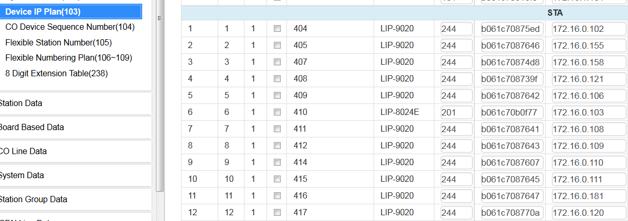
LCM – Users
Phones are normally connected to the UCP and this will then connect to Cloud
This should be displayed as below in the UCP device.

Slide 22
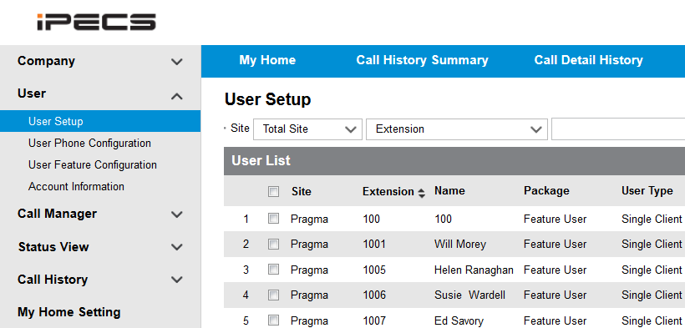
LCM – Users
Setup users on the cloud platform

Slide 23
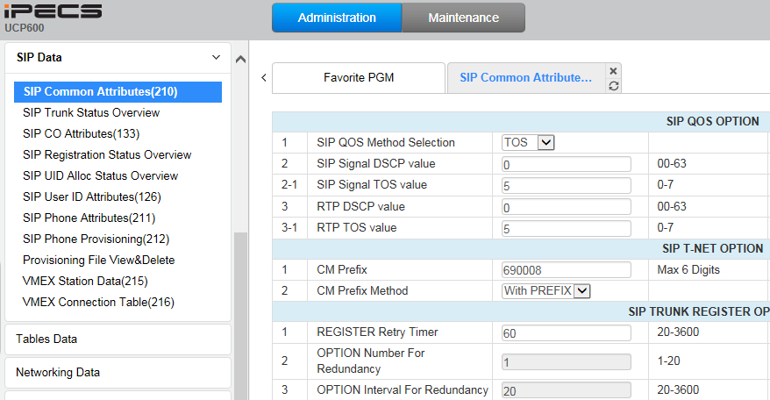
LCM – Tennant Prefix
Enter the customer tenant prefix in CM Prefix. (This will be provided by Pragma)
Select “With PREFIX” in CM Prefix Method.

Slide 24
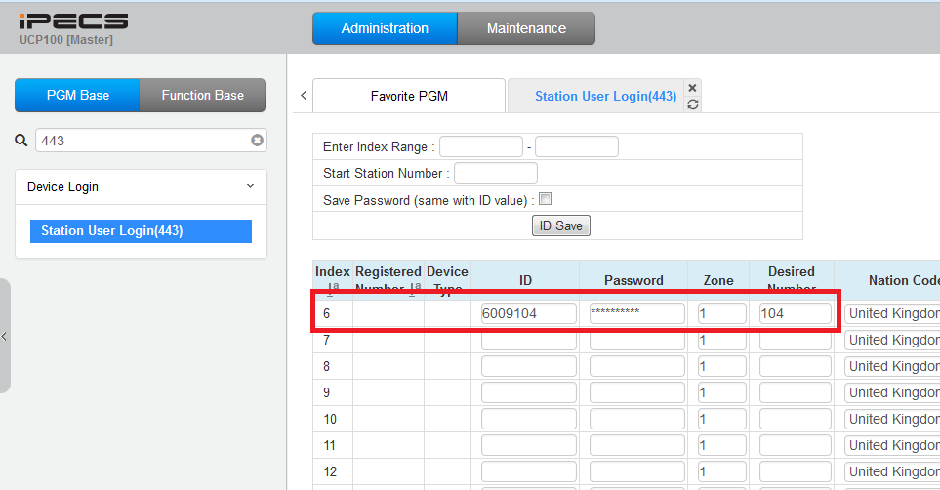
LCM – Station Authentication
Enter the Stations Authentication ID and Password that has been configured on the Cloud Portal

Slide 25
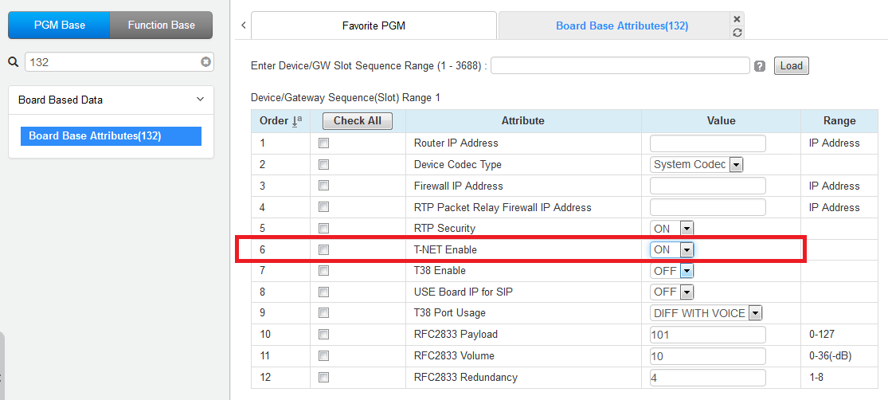
LCM – TNET
You will also need to enable T-NET for the handset

Slide 26
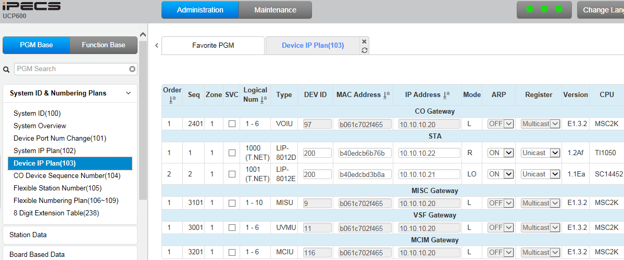
LCM – Complete
You will now see the below configuration in PGM103, as you can see the handsets are connected to the cloud platform Via T-NET

Slide 27
LCM – Trouble Shooting
If you have any issues with this, please make sure that you have double checked the below.
Handset is set to remote.
Correct IP and subnet are on the phone.
You have a Gateway Address on the handset.
Ensure the following ports have been opened / forwarded to the LCM IP address;
UDP 5588
UDP 10,000 – 30,000

