Slide 1
iPECS ONE
Notes:
Overview

Slide 2
iPECS ONE: Portal Setup
iPECS ONE is the new soft client for Cloud.
There are two licences available for iPECS ONE:
iPECS ONE Call Control: This is the iPECS ONE non-voice license and can only be used on the Web Client. The iPECS ONE Call Control license will work in conjunction with an E-LG phone. You can make and answer calls on the iPECS ONE Web Client but the speech will be passed through the E-LG phone.
iPECS ONE UC: This is the iPECS ONE with voice license. You can use the Web Client where the audio with come through the PC or on the iPECS ONE Mobile app.
Order the licence as normal in the Reseller portal > Change Order.

Slide 3
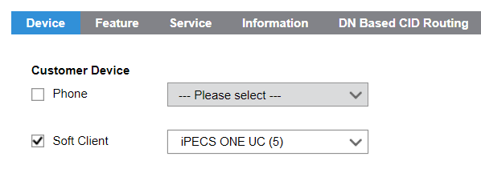
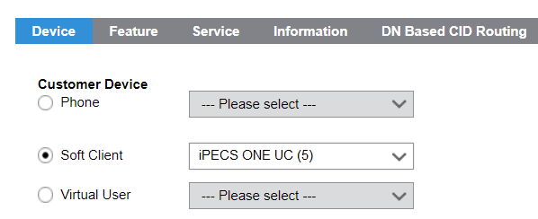
iPECS ONE: Portal Setup
To create a iPECS ONE UC, go to User Setup.
You can add this licence to a single or multiclient user.
You can also add this licence to an already existing user by clicking on Modify > Add – then selecting the licence.

Slide 4
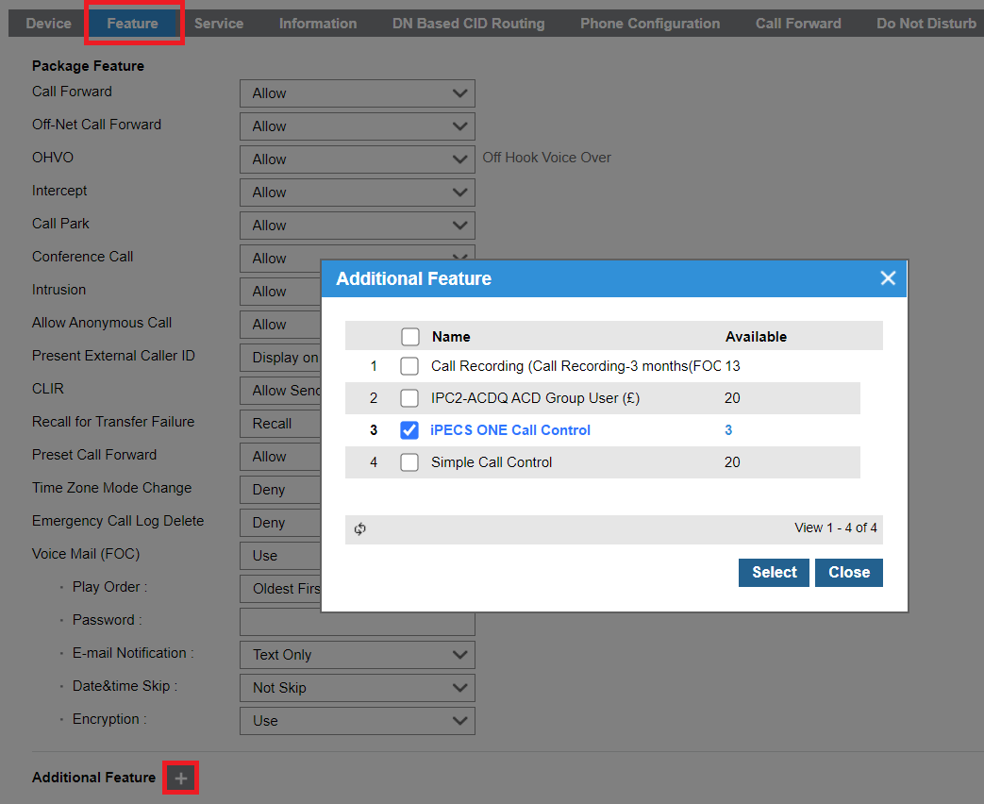
iPECS ONE: Portal Setup
To assign the iPECS ONE Call Control licence, go to User Setup > select the user > Features and click on the plus icon to add an additional feature. If you have the licence, you will be able to add it by clicking Select.

Slide 5
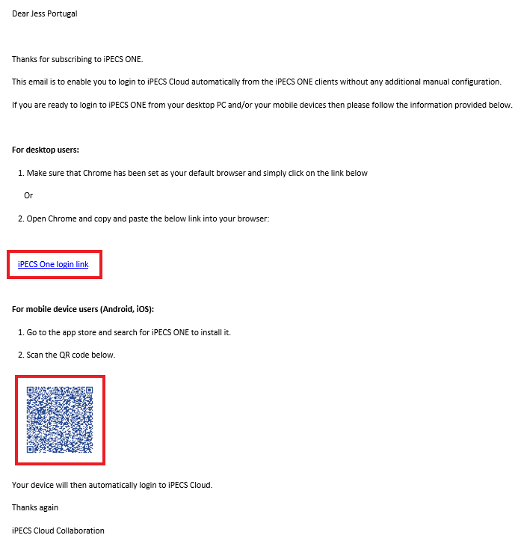
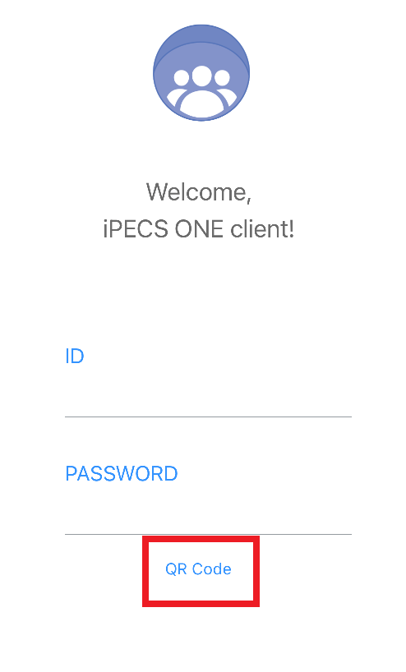
iPECS ONE: Portal Setup
You can enter an email in the email field of an extension. Once this extension is created, an email will be send to the email entered.
Clicking in this link will login the user automatically with no need to enter ID and password (Web Client).
You can also use the QR code to login automatically with no need to enter ID and password on your mobile app. Open the app and click in QR code than scan the emailed QR code.

Slide 6
iPECS ONE: Portal Setup
To login to iPECS ONE manually you will need the Portal ID and password set in the User Setup.

Slide 7
iPECS ONE: Web Client
Notes:
Overview

Slide 8
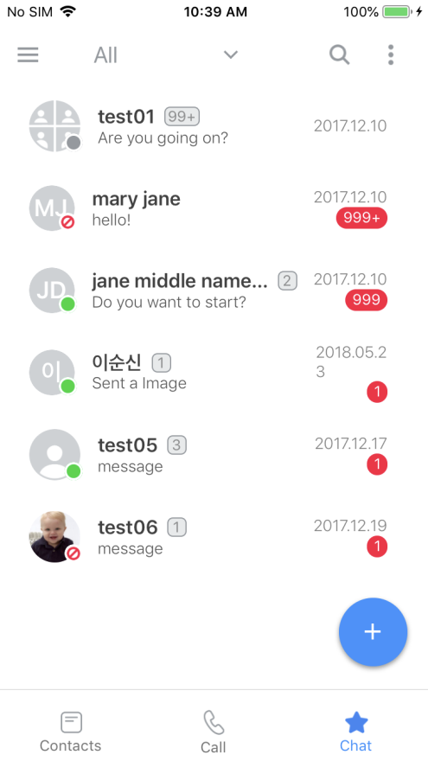
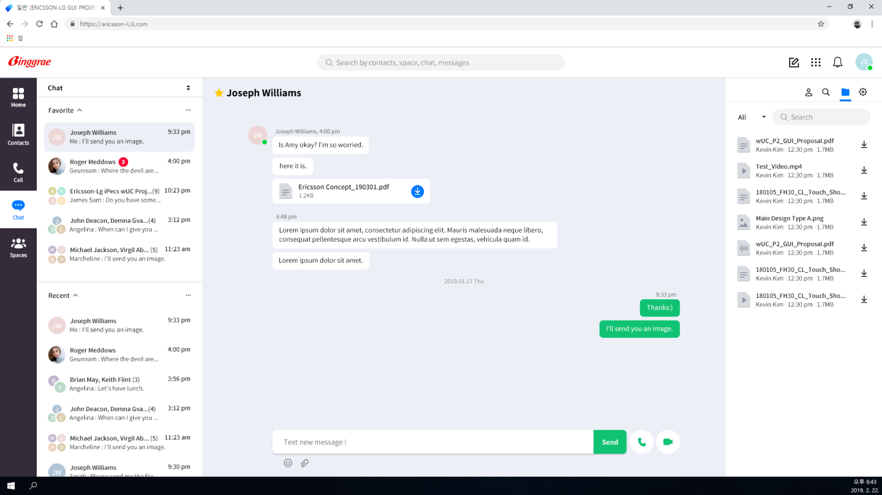
iPECS ONE – Coming in v3.6
With iPECS ONE, you don’t need to download a desktop app, the desktop version is done via browser.
iPECS ONE is compatible with Chrome browser, Android and iOS devices.
Some of the features include:
Dashboard for missed calls, VM, forward
Chat
1:1 Video calls
Dialpad with key features
Contact detail with presence
CRM Integration
Ad-hoc conference
Group call
Like UCE, you can login to multiple devices simultaneously.
Multiple device management - Synchronized Communication
Android devices
Chrome Browser
iPhone
Simultaneous logging in
Presence, Call log, Chatting continuity, Chat history
Chatting continuity

Slide 9
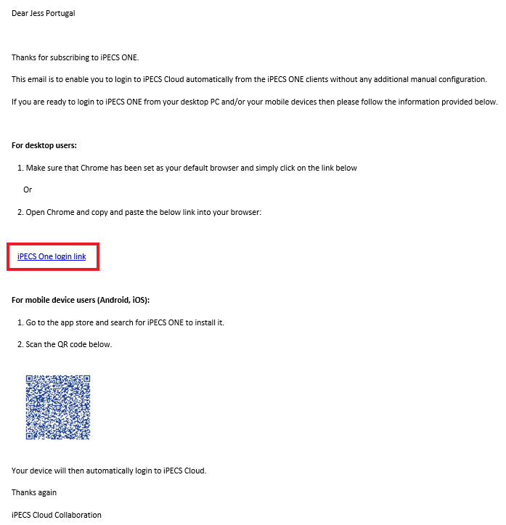
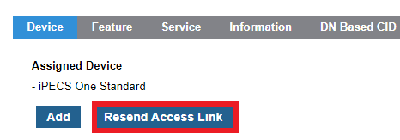
iPECS ONE – Web Client
To log in for the first time to the Web Client, please use the link in the email you will receive in the email address set in User Setup.
You can resent this email once the user is created, by clicking the Resend Access Link.

Slide 10
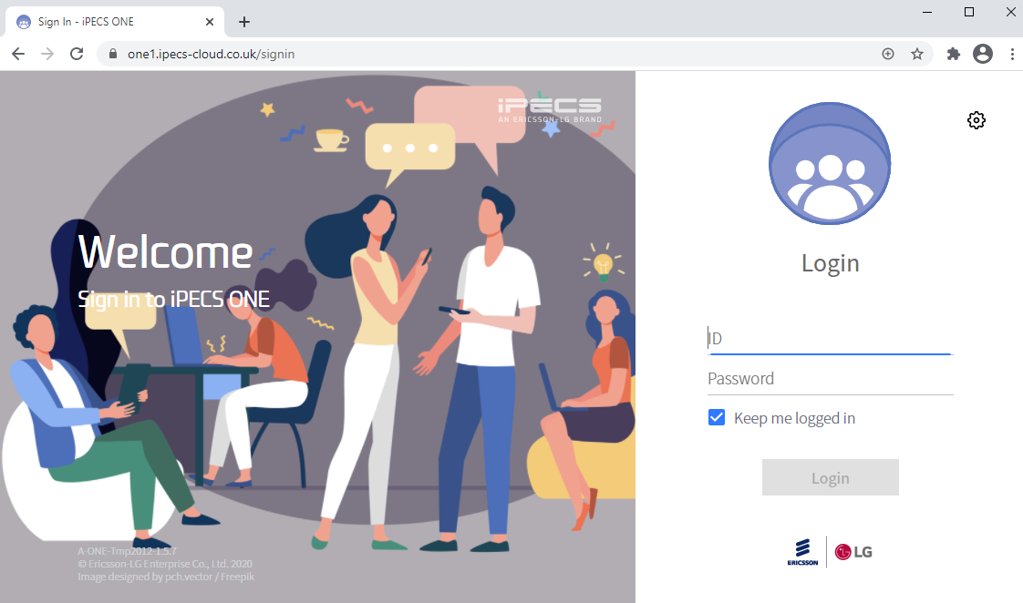
iPECS ONE – Web Client
After you log in for the first time, you can check the Home Server URL address you are logged in as and set it as a bookmark.
Once you know the Home Server URL you can then login manually if you want using the Portal ID and password.
Please note that Chrome is the only supported browser.

Slide 11
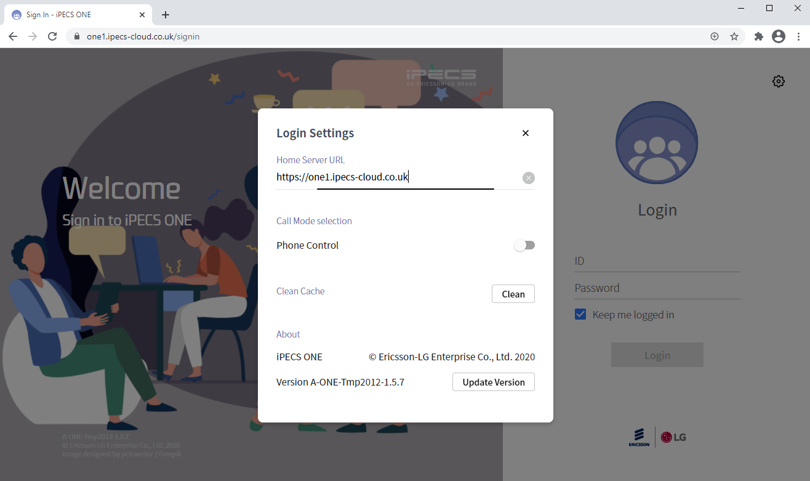
iPECS ONE – Web Client
Click (Login Settings) button to open “Login Settings” window. On “Login Settings” window, enter Home Server URL. It can be one of three:
https://one1.ipecs-cloud.co.uk
https://one2.ipecs-cloud.co.uk
https://one3.ipecs-cloud.co.uk
Currently, this can only be found by logging in using the link sent to your email (previously slides).
Enter the Home Server URL and click “X” button to update and close the window.

Slide 12
iPECS ONE – Web Client
You can also choose if the Web Client will be with voice (iPECS ONE UC) or non-voice (iPECS ONE Call Control) if you have both licences assigned to the same user by enabling or not the setting Phone Control (this will be call controlling the phone).

Slide 13
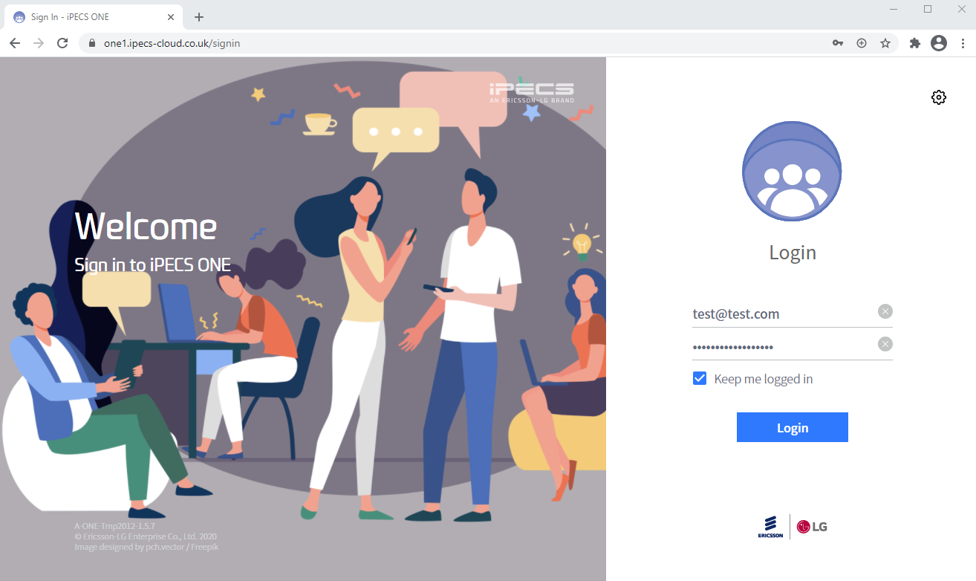
iPECS ONE – Web Client
Login with your Portal ID and Password create on User Setup.

Slide 14
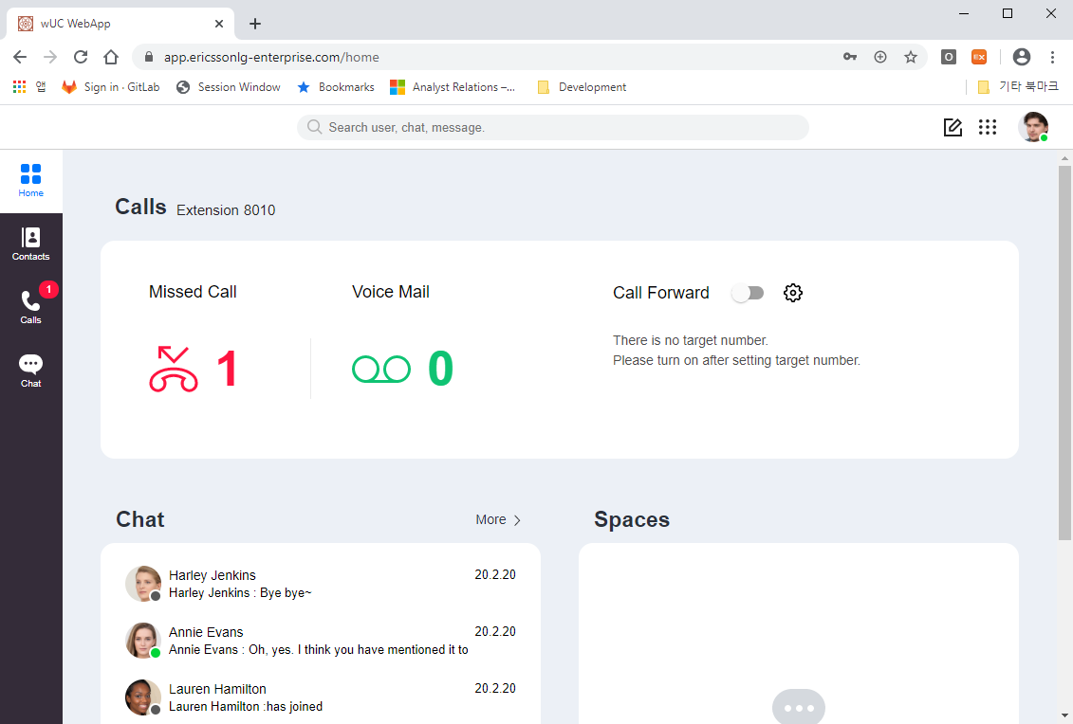
iPECS ONE – Web Client: Home
In the Home screen, you will have a dashboard with missed calls, voice mails and call forward setting.
The recent chat window is also displayed. On the left you have the main menu tab and on the top of the page you have the search box, new chat icon, dial pad and user settings.

Slide 15
iPECS ONE – Web Client: Home
Main Menu tab.
Go to Home screen
Go to Contacts screen
My contacts (Favorites, Personal contact, Group)
Organization directory, CRM
Directory search
Go to Calls screen
Call logs (All call, Missed call)
Keypad (for dialing & searching)
Voice mail, Pickup, Unpark, Barge in
Go to Chat screen
Chat list (Favorite, Recent)
Chat area
Participants, Search, Files, Setting

Slide 16
iPECS ONE – Web Client: Home
Global search, new chat, keypad and personal settings.
Global Search
Comprehensive search for participants & room names (immediately as you type), and message contents (when pressing Enter key)
New Chat
Creates new chat
Keypad
Shows keypad for dialing & searching
Personal Setting
Shows and/or edits personal info, presence, notification, call forward, anonymous call reject, device settings and password
Log out

Slide 17
iPECS ONE – Web Client: Home
Dashboard and my extension number.
My extension number
Missed Call
Shows number of missed calls
When clicked, goes to ‘Calls’ screen
Voice Mail
Shows number of voice mails
When clicked, accesses voice mail
Call Forward
Shows and edits call forward setting

Slide 18
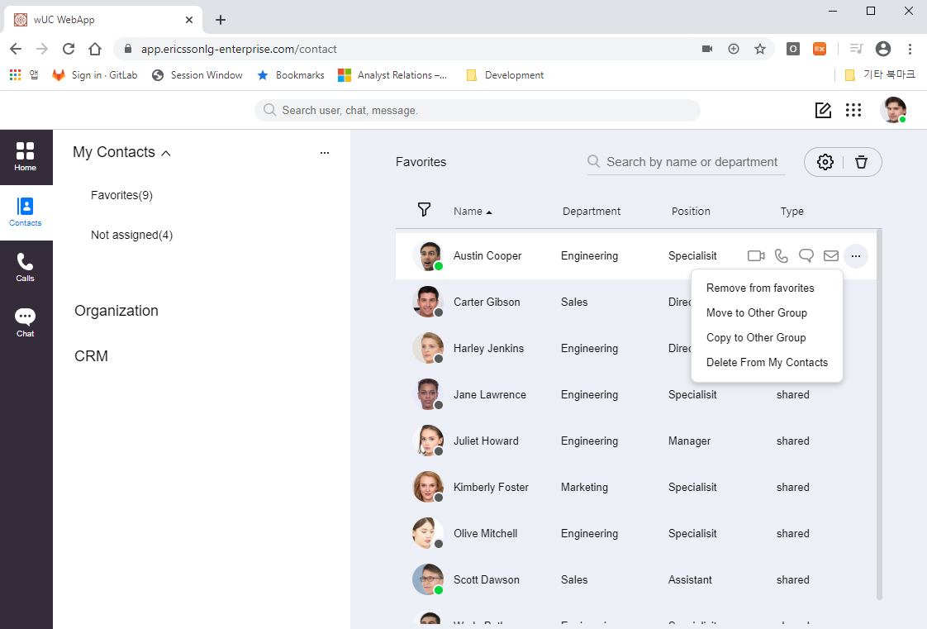
iPECS ONE – Web Client: Contact
In Contacts, when hovering the mouse over a contact item, menus for video, voice calls, chat and e-mail are displayed.
Clicking (Menu icon) on the menu shows popup menus for adding/removing the contact from Favorites, moving/copying to other group and deleting from My Contacts.

Slide 19
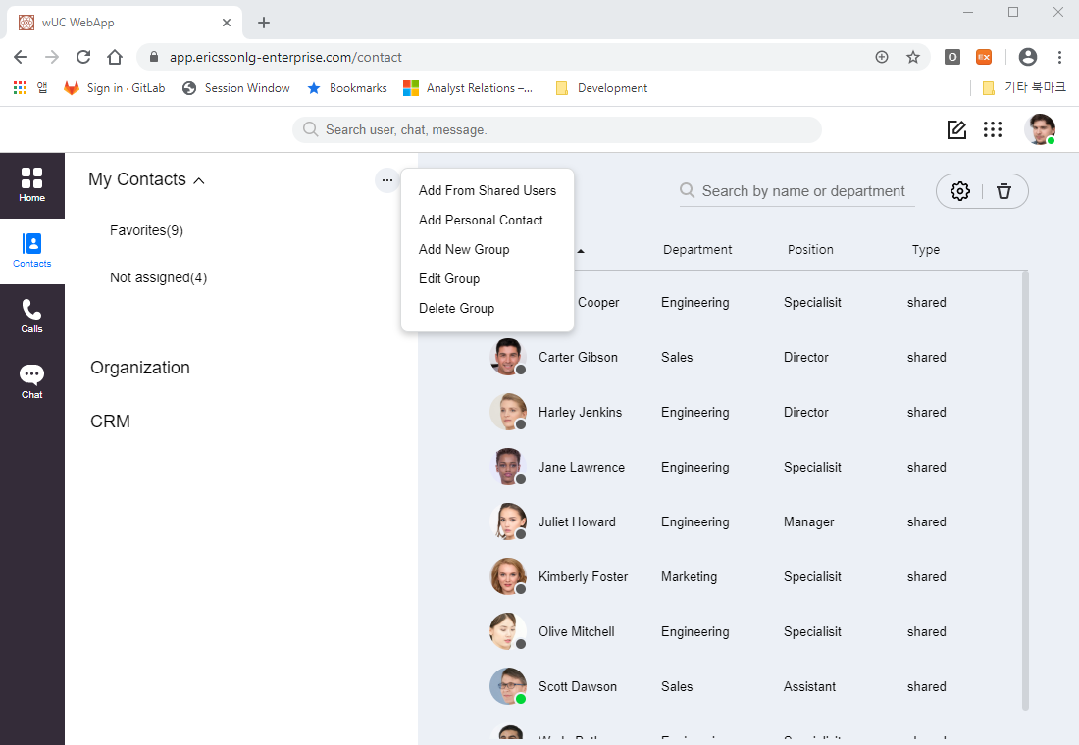
iPECS ONE – Web Client: Contact
By clicking (Menu icon) contacts and groups can be added, edited or deleted.
In the search box you can search for user’s name and departments.
(Setting icon) allows editing columns of the contact list.
(Delete icon) is used to delete selected user from contact list of a group.

Slide 20
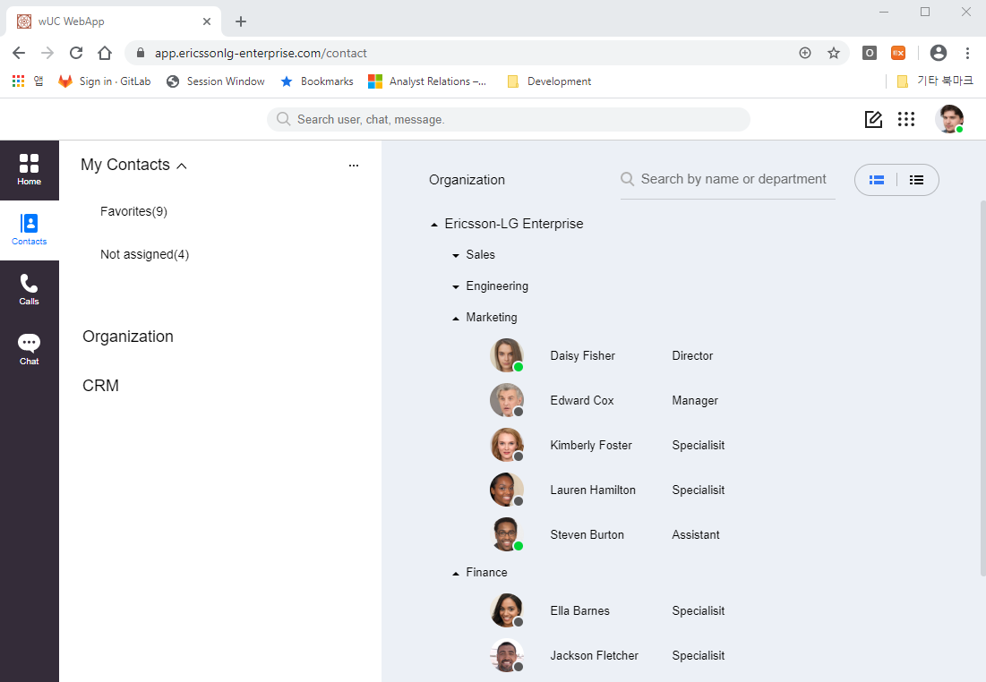
iPECS ONE – Web Client: Contact
Organization shows the organization’s directory and its displayed as groups of departments.
The CRM area shows CRM specific configurations if it is integrated.

Slide 21
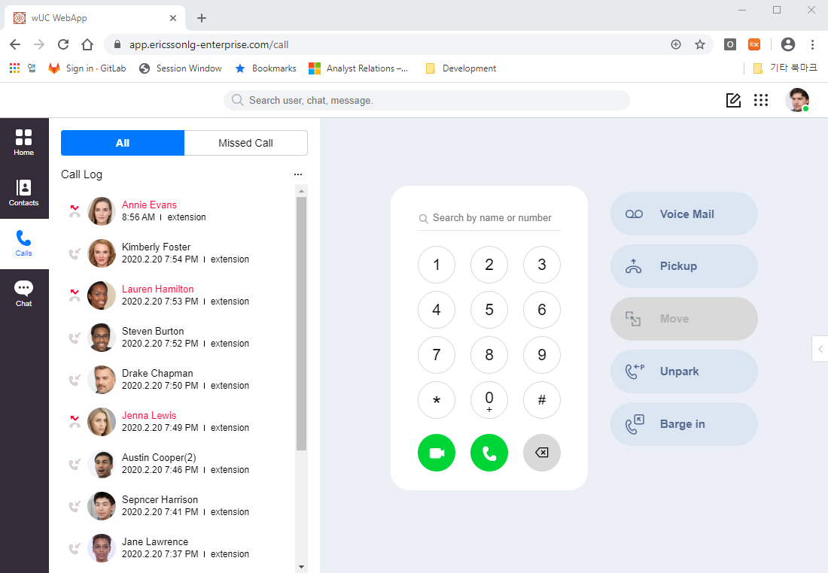
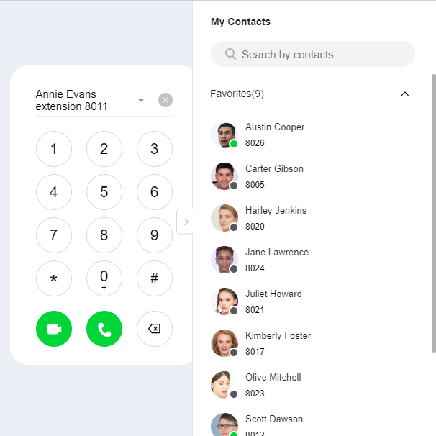
iPECS ONE – Web Client: Call
In the call log area is displayed all call logs and missed call logs.
The call operation area is used to make calls, access voice mail, pick up/unpark calls and barge in.
This side menu is for displaying ‘My Contacts’ at the right edge.

Slide 22
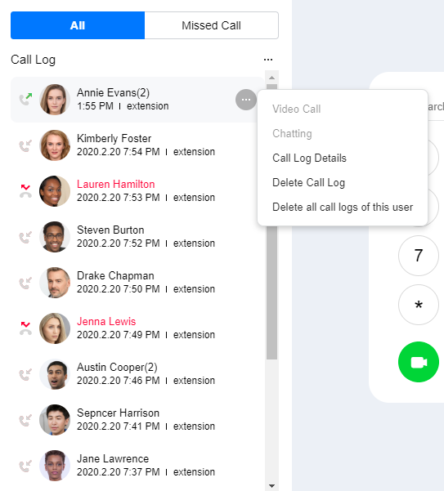
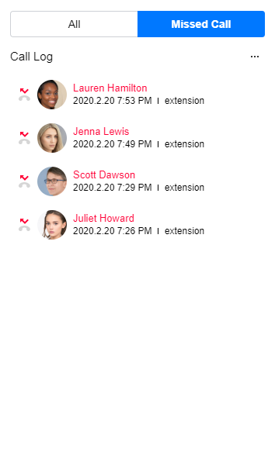
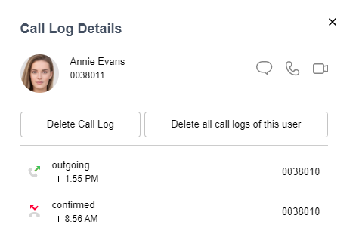
iPECS ONE – Web Client: Call
Clicking ‘All’ or ‘Missed Call’ selects type of call logs to be displayed.
(Menu icon) of a call will show a popup menu for call details and deleting from call log.

Slide 23
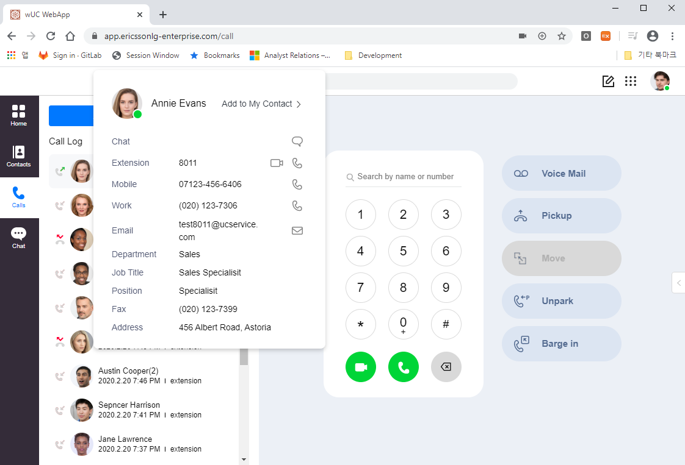
iPECS ONE – Web Client: Call
When hovering a mouse over a picture of the call log entry, detailed personal info will be displayed.
On ‘Add to My Contact’ menu, this person can be added to a contact group (Favorite, Not assigned, etc.)
On this window, chat, video, voice calls or e-mail can be made with corresponding menu icons.

Slide 24
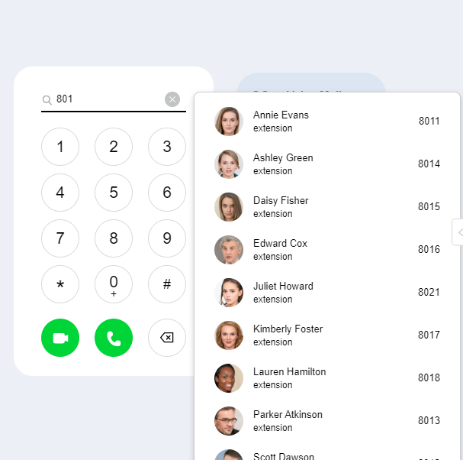
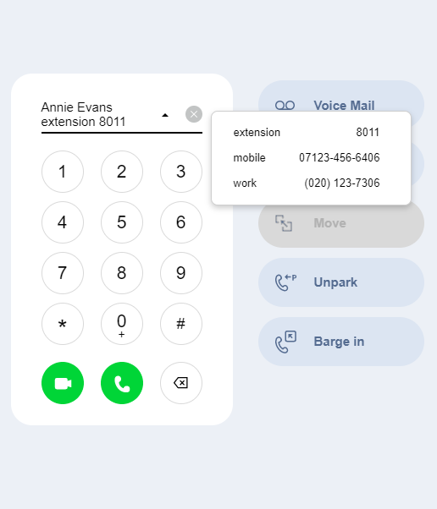
iPECS ONE – Web Client: Call
While typing or clicking a phone number, the contact list is searched for that number.
After selecting a contact item, (phone number list) icon can be clicked for number selection.
After the phone number is set, video or voice button can be clicked to make call.

Slide 25
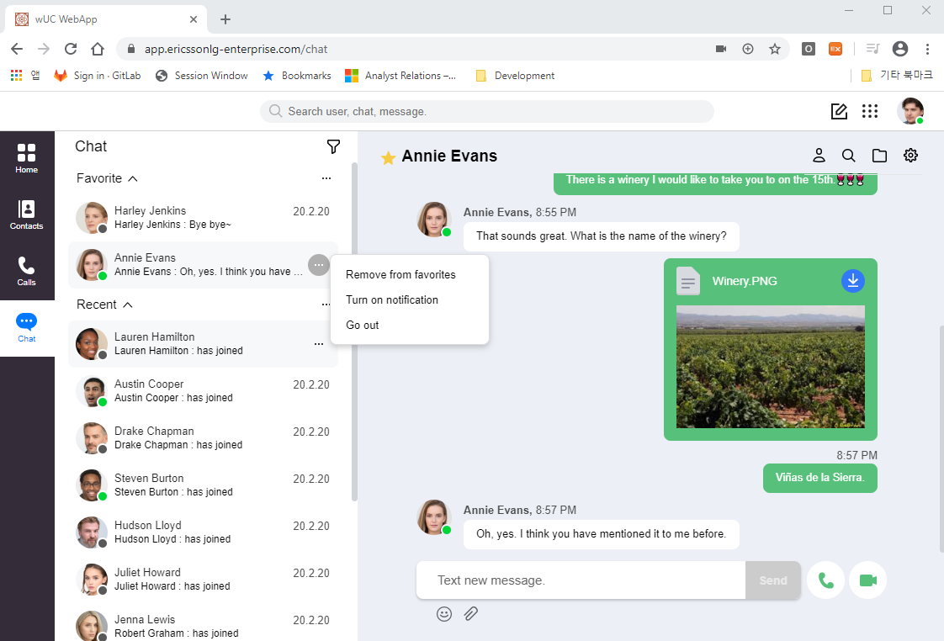
iPECS ONE – Web Client: Chat
In Chat is displayed a list of Favorite and Recent chats.
In the chat area, text messages, emojis and pictures can be exchanged, and video and voice call can be made between the participants (1:1 or group call)
Chat session menu shows participant info, message search, attached files and settings. (Menu icon) of a chat shows a popup menu for adding/removing from Favorites, turning on/off message notification and leaving the chat.
(Sort icon) menu can be used for sorting by time or unread message

Slide 26
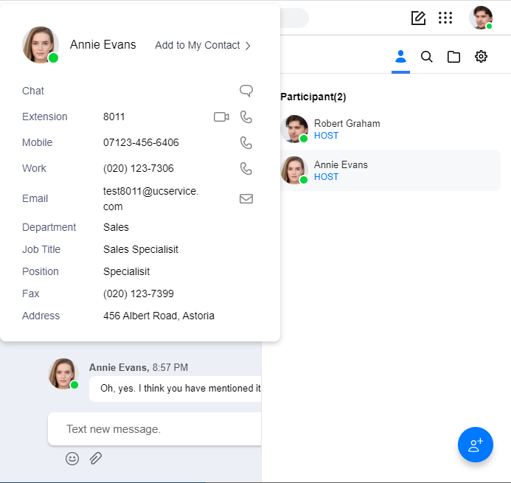
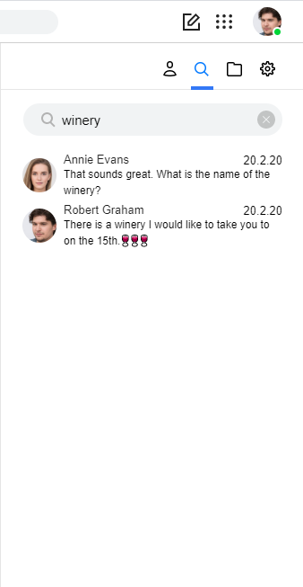
iPECS ONE – Web Client: Chat
(Participant icon) menu shows the participants of the chat. (Click the icon again to hide the window)
Detailed info (when hovering mouse over a picture) and inviting participant are supported.
(Message search icon) provides key word search in the chat messages.

Slide 27
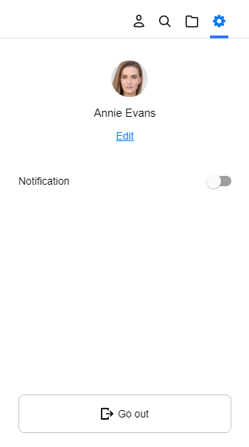
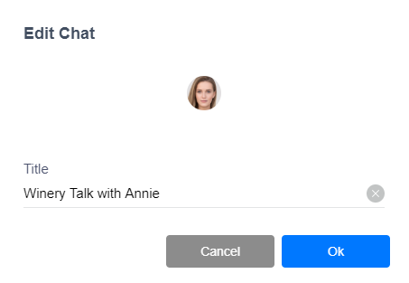
iPECS ONE – Web Client: Chat
(File icon) shows a list of files attached to chat message. (Click the icon again to hide the window)
When hovering a mouse over an item, menus for file delete and file download appear.
(Setting icon) shows a window for editing the chat name when clicking on ‘Edit’, setting notification option ON/OFF and exiting a chat by clicking ‘Go out’(If the last user remaining leaves the chat, the room is removed).

Slide 28
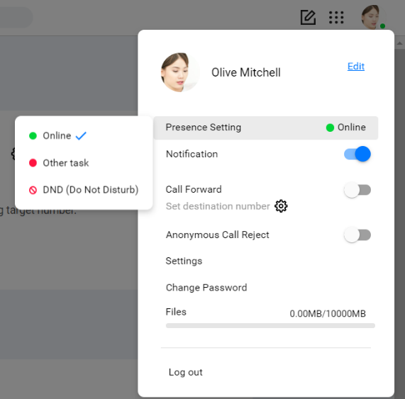
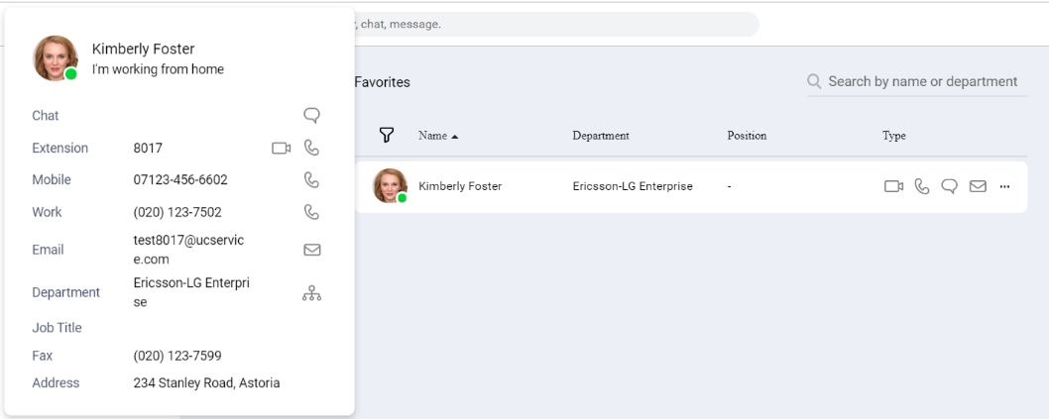
iPECS ONE – Web Client: Presence
You can set your presence status as Online, Other task or DND on user settings screen that is shown by clicking your picture on top right corner.
Online : Indicates you are online and available for contact
Busy : Indicates you are online but busy working on other task, on a call, in a meeting, etc.
DND (Do Not Disturb) : Indicates you don’t want to receive a call or don’t want notifications to pop
Offline : Indicates you are offline
A user’s presence status is displayed if it is added to your contacts or as chat participant.

Slide 29
iPECS ONE: Mobile
Notes:
Overview

Slide 30
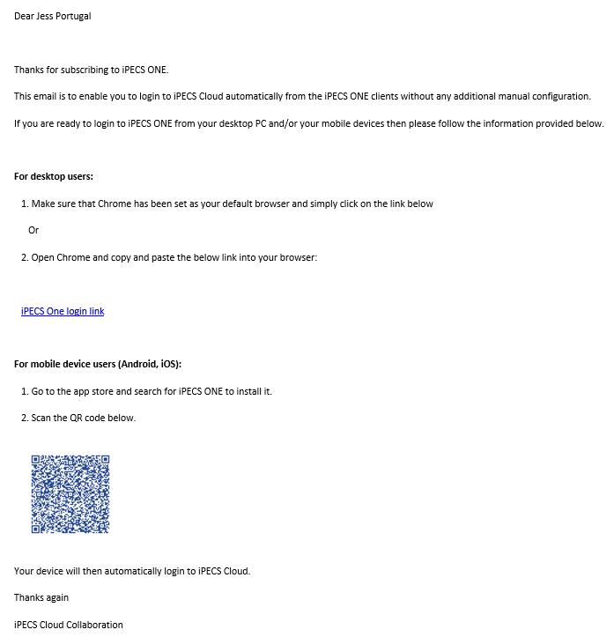
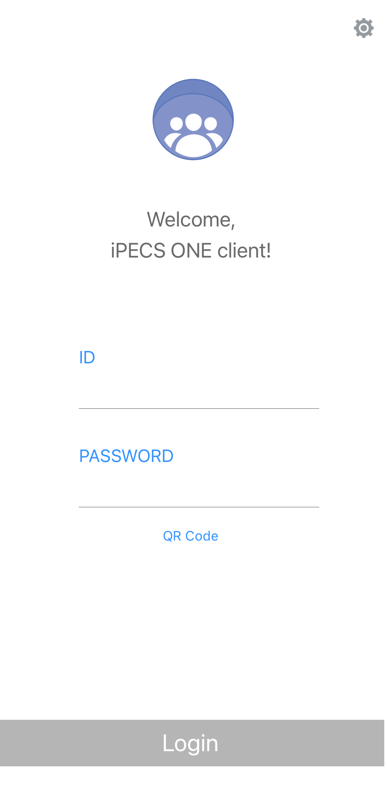
iPECS ONE – Mobile Client
In the iPECS ONE mobile app, to login for the first time, use the QR code provided in the email (slide 9). Use the QR Code button in the iPECS ONE app and aim to the QR code provided in the email and it will log you in automatically.

Slide 31
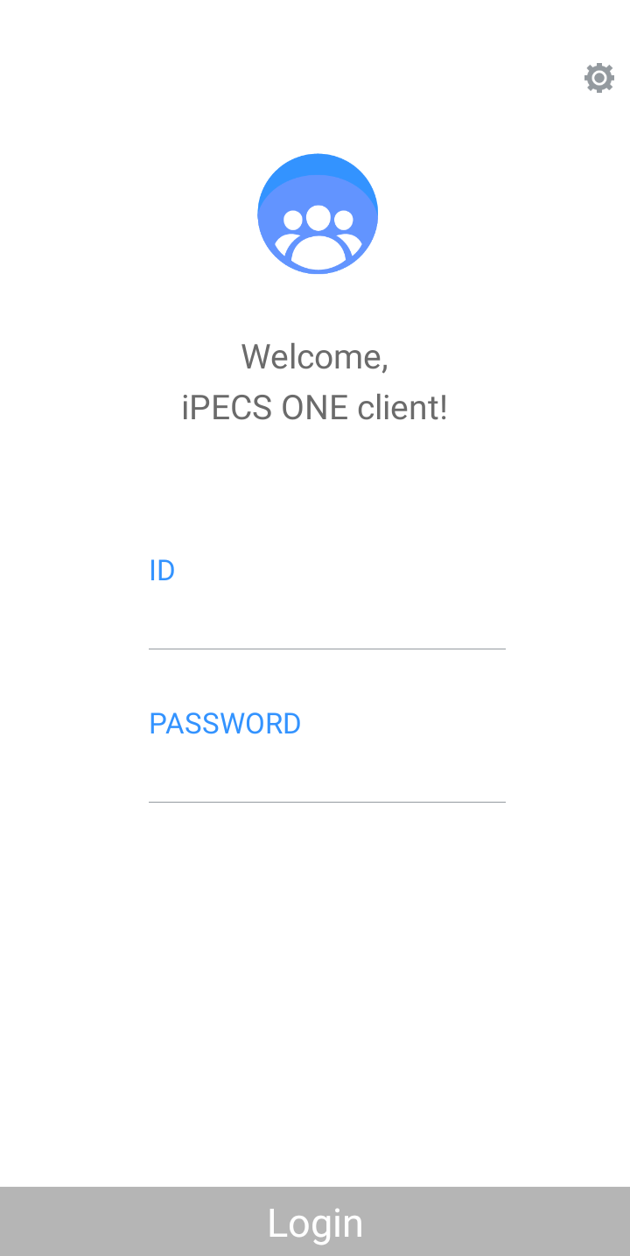
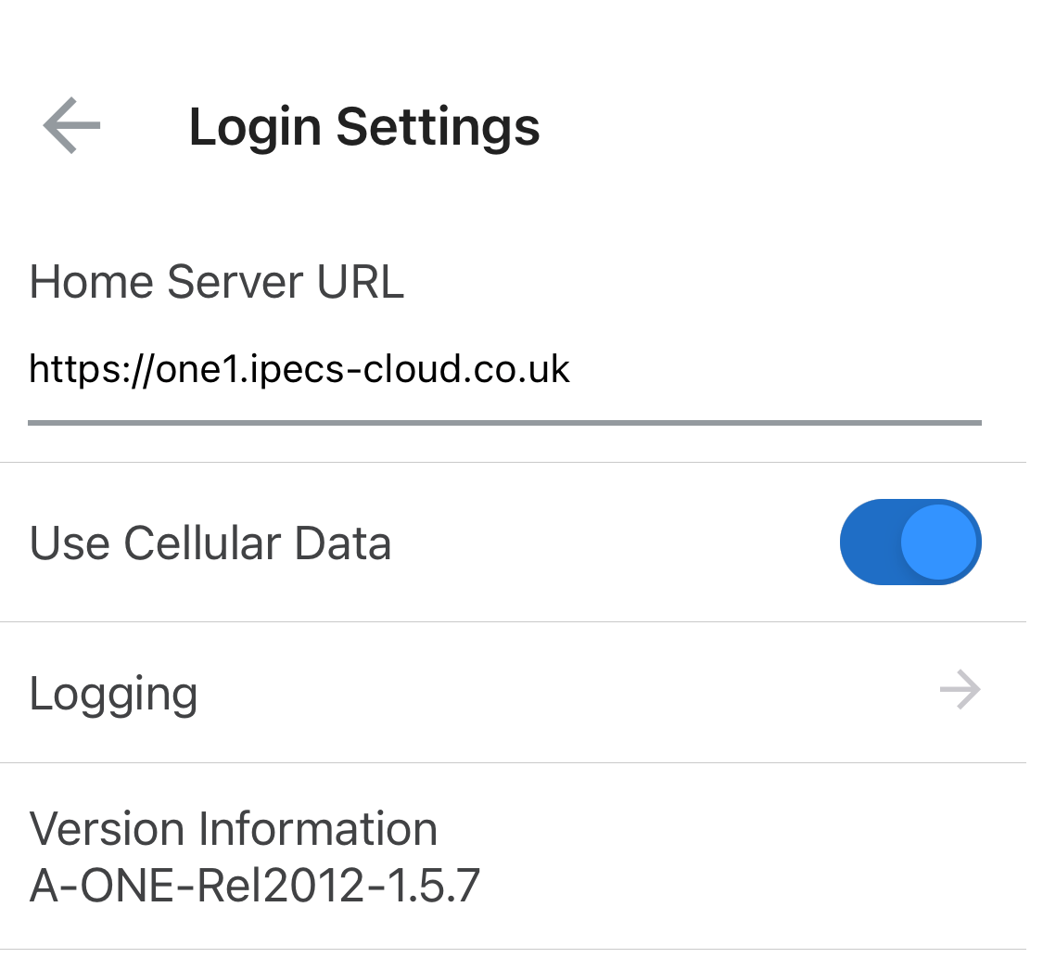
iPECS ONE – Mobile Client
After you logged in for the first time, you can check in the cog the Server URL you need to login as.
To login manually, in the mobile app first click on the (Login Settings) button to open the “Login Settings” screen.
On “Login Settings” screen, enter the Server URL (e.g. https://one1.ipecs-cloud.co.uk) (the Server URL found using the slide before. Please note it could be one of three Servers URL – see slide 11)
Click on (Back) button to update and close the window.
Enter the ID and password as the Portal ID and password created in the User Setup, then click the “Login” button

Slide 32
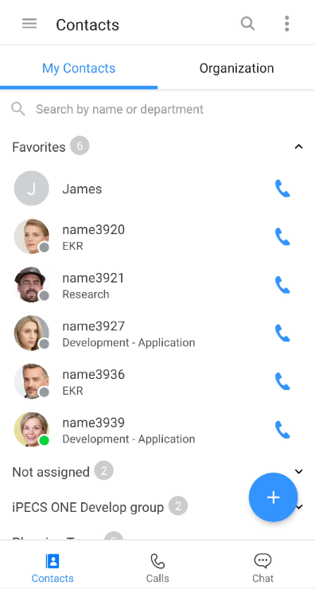
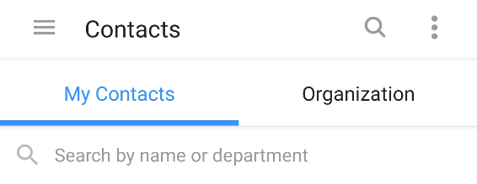
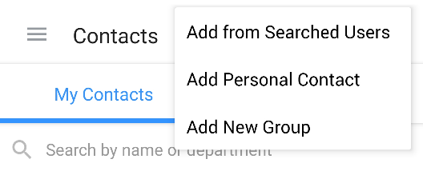
iPECS ONE – Mobile Client: Contact
Groups: Favorites are the frequent users and Not assigned is a grouped users without specific group name.
Clicking in ‘Organization’ will show the organization directory.
Click on (option menu) to show a menu window to add a user to a group, add to personal contact or add to a new group.

Slide 33
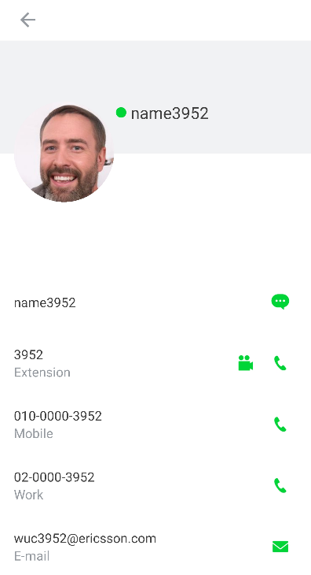
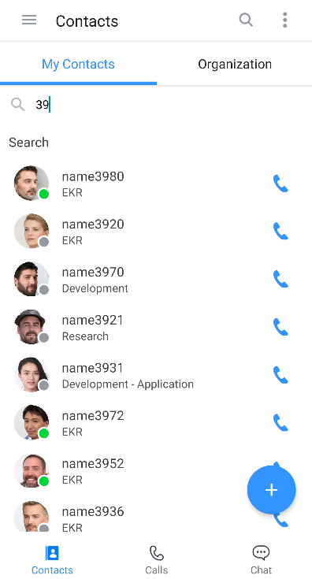
iPECS ONE – Mobile Client: Contact
To make a call to a user, click on (Voice Call) button on Contacts screen.
Select a contact to view contact details such as name, phone numbers, email address and department.
On contact details window, chat, voice/video calls or email can be started using corresponding buttons.
Use the search box to search a user’s name and department, enter at least two letters or numbers in search input box.

Slide 34
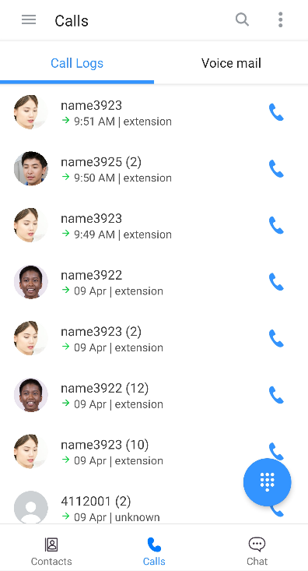
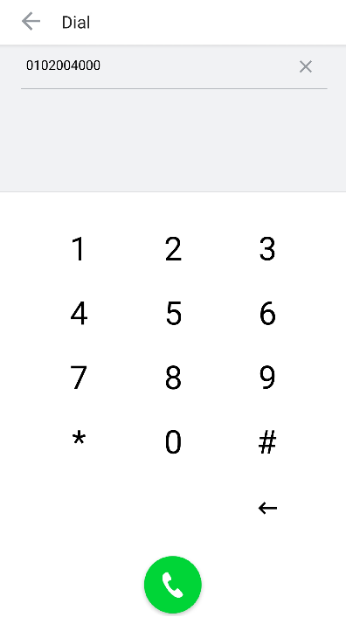
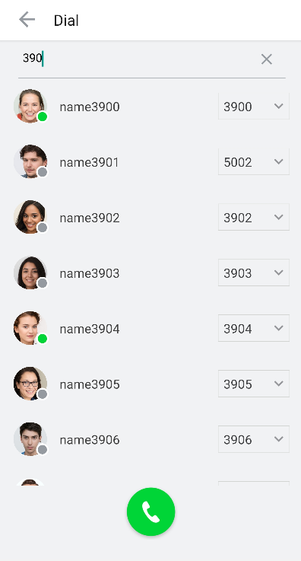
iPECS ONE – Mobile Client: Call
To make a call, click on (Call) button on the “Call Logs” screen.
Or click on the (Keypad) button and enter digits on keypad screen, then click on (Voice Call) button.
Or you can search by name or number on search input box, select a number, then click the (Voice Call ) button.

Slide 35
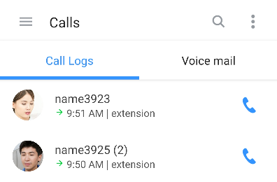
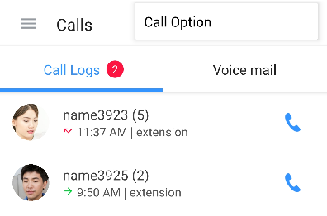
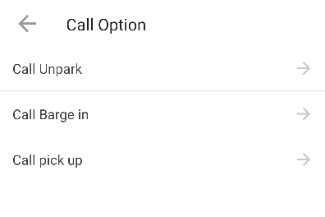
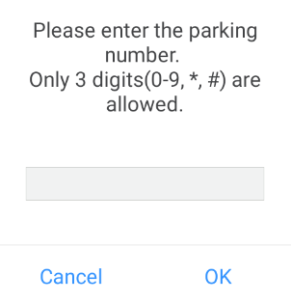
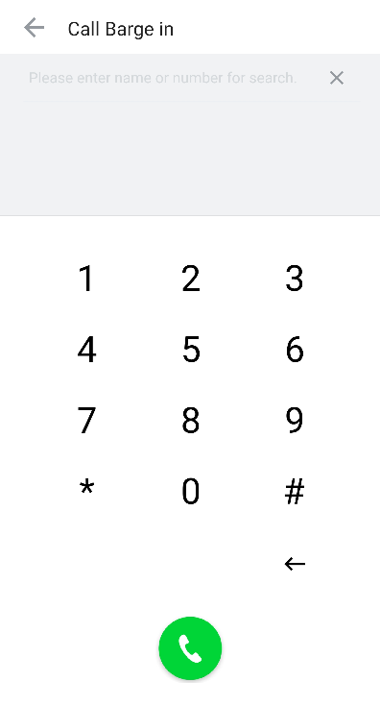
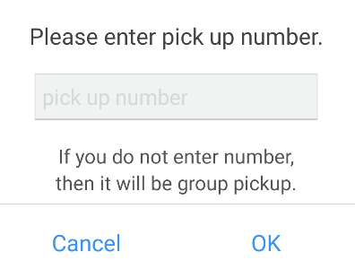
iPECS ONE – Mobile Client: Call
During idle state, several features can be provided by selecting “Call Option” menu.
Unparking a parked call can be performed to continue the call by selecting “Call Unpark”.
You may barge into another existing call by selecting “Call Barge in”.
You can answer a call ringing at another station by selecting “Call Pick up”.

Slide 36
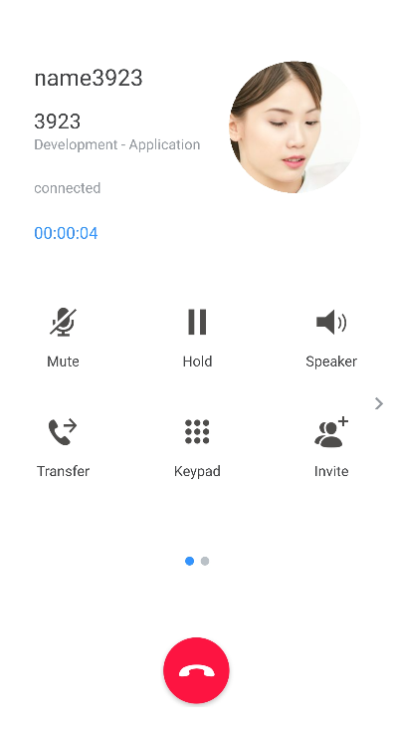
iPECS ONE – Mobile Client: Call
During a call, many features are provided on the call popup screen.
Features while in a call : Mute, Hold/Retrieve, Speaker, Keypad
Voice call features : Transfer, Invite another participant, Switch to Video Call, Call Park, New call, Record, Hide, Participant in the call
Feature when the extension called is busy: Override, Call back

Slide 37
iPECS ONE – Mobile Client: Call
The call log displays the history of outgoing, incoming and missed calls.
The call log of a user can be listed and deleted on “Call Log Details” that appears by clicking the call log row.
In “Voice mail” you can check detailed counts for urgent, new and saved voicemails.
Click (Call voicemail) button to make call to the voice mail service number.

Slide 38
iPECS ONE – Mobile Client: Chat
To create a new chat, click on (Create Chat) button, the search for an user, then click the “OK” button.
You can filter the chat list by All, Unread or Favorites by clicking the (Filter) at the top left.
You may leave the chat room, turn on/off notification for the that chat and add/remove to favorites.

Slide 39
iPECS ONE – Mobile Client: Chat
To send a text message, type the text in message box and click the (Send) button.
To include an emoji in a message, select emoji input on soft keyboard of the smartphone, then select an emoji.
You can attach an image file by selecting it on the phone or taking a picture using (Attach) button.

Slide 40
iPECS ONE – Mobile: Presence
You can set your presence status as Online, Other task or DND on the user settings screen that is shown by clicking in the (drawer) menu.
Online : Indicates you are online and available for contact
Busy : Indicates you are online but busy working on other task, on a call, in a meeting, etc.
DND (Do Not Disturb) : Indicates you don’t want to receive a call or don’t want notifications to pop
Offline : Indicates you are offline
A user’s presence status is displayed if it is added to your contacts or as chat participant.

