Slide 1
iPECS One – ACD Agent Mode
Use normal ACD functionality from iPECS One Web Client
Assign an ACD User license to an iPECS One Single Client user
Select ACD Agent mode before logging in
Gain access to ACD Agent features within Agent tab in iPECS One
Login to one primary and up to ten secondary ACD groups

Slide 2
iPECS One – ACD Agent Mode Features
Multiple ACD queues log on/off 1 Primary queue, 10 secondary queues
Agent States Available, Unavailable, Wrap up
Auto Answer, Automatic wrap up
Help / Whisper coaching request to supervisor
Wrap up countdown timer
RNB Status bar : Agent state, Auto Answer / Automatic wrap up status, Log on queues
Supervisor receiving Help/Whisper coaching requests from an Agent

Slide 3
iPECS One – ACD Agent Mode
Apply an ACD license to any iPECS One Single Client user within the Feature tab in the User Setup menu within the Customer Manager Portal.

Slide 4
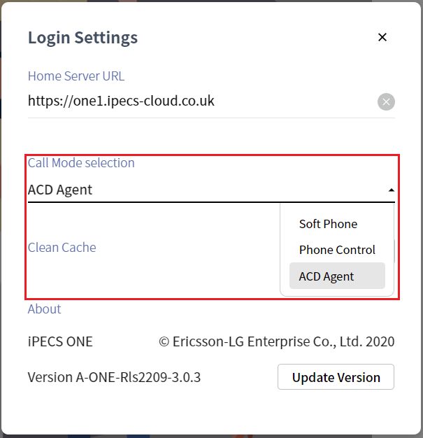
iPECS One – ACD Agent Mode
Before logging into iPECS One, click the cog on the login screen and select ACD Agent from the Call Mode selection dropdown.

Slide 5
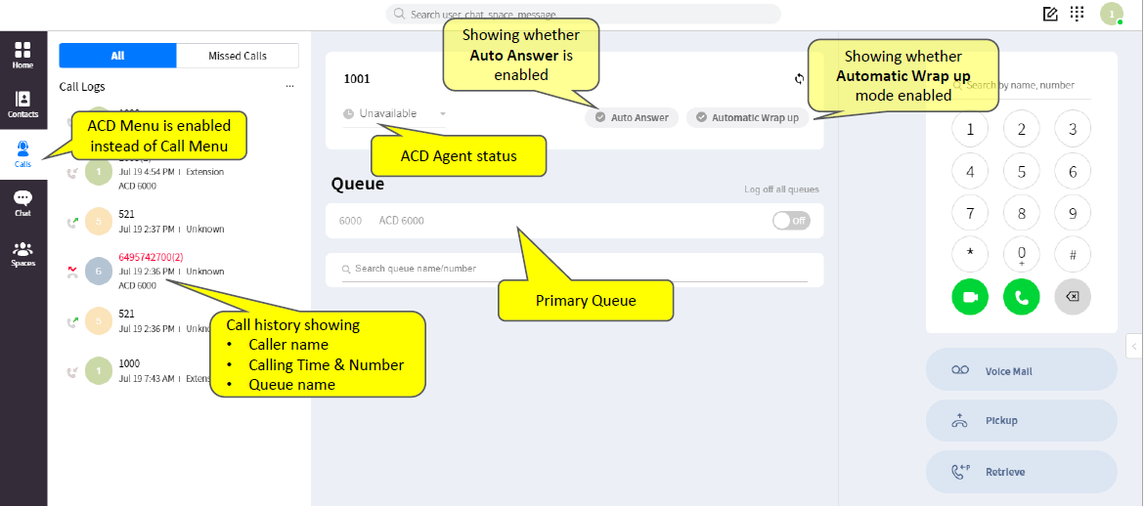
iPECS One – ACD Agent Mode
ACD Agent options will now be available within the Calls tab.

Slide 6
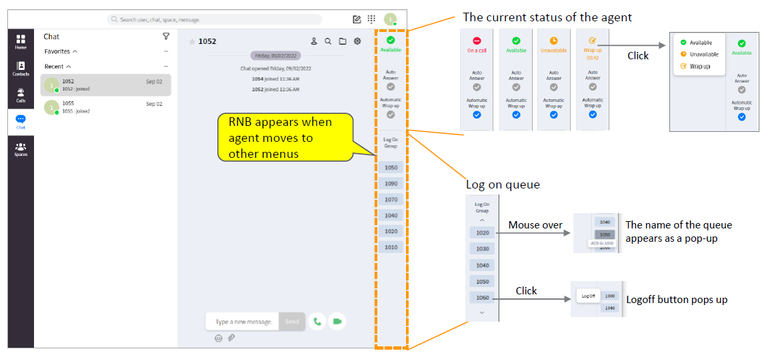
iPECS One – ACD Agent Mode
There is a righthand navigation button (RNB) that has ACD options and follows the agent to whichever iPECS One tab there are in.

Slide 7
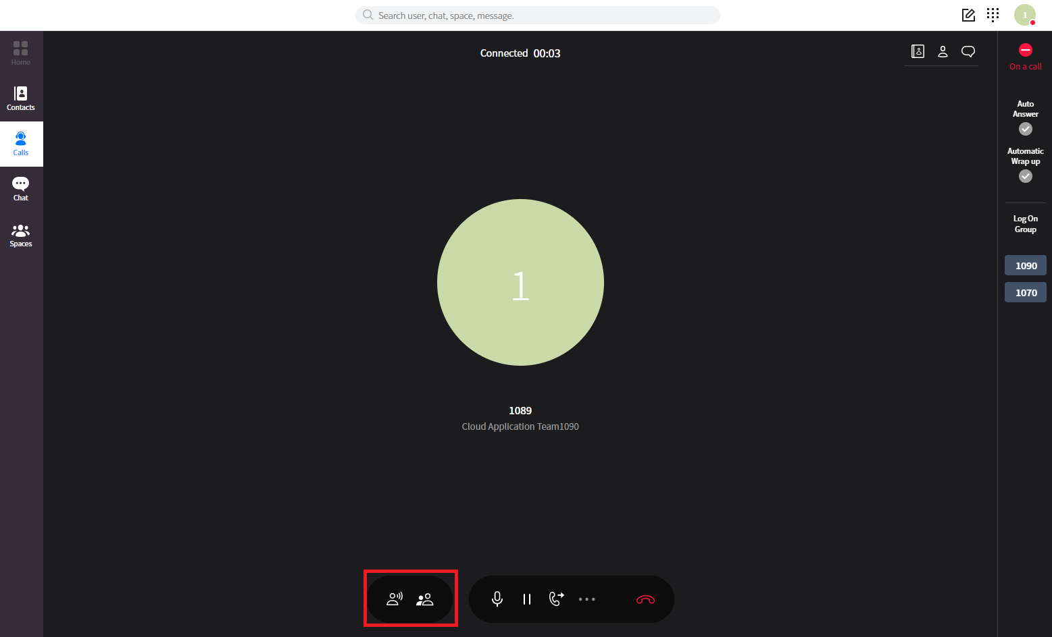
iPECS One – ACD Agent Mode
The agent can also request help and silent monitoring through buttons in the call window

Slide 8
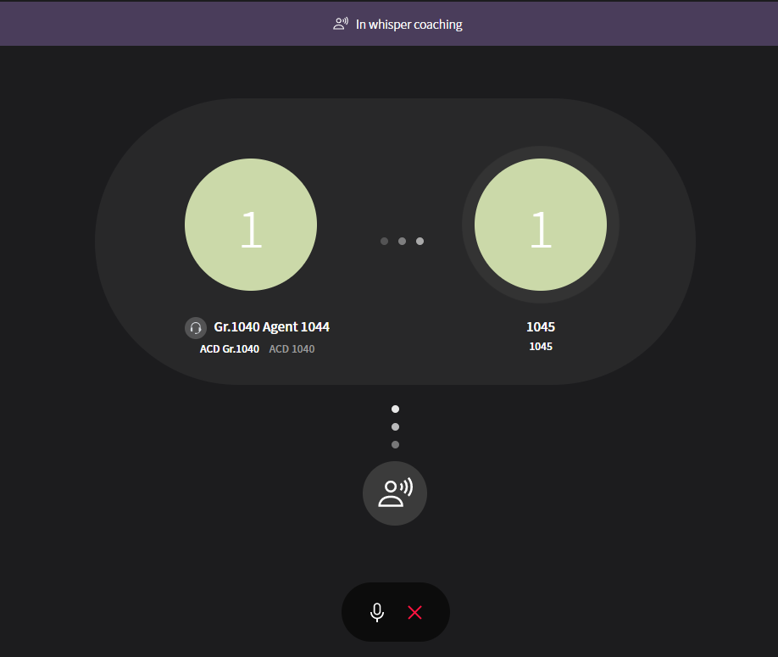
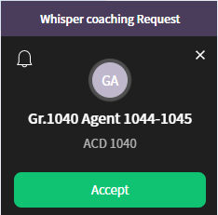
iPECS One – ACD Agent Mode
ACD supervisors using iPECS One will see on screen notifications of Whisper Coaching and silent monitor requests.

Slide 9
iPECS One – ACD Agent Mode
The agent can also see wrap up status once a call has finished.

