Slide 2
iPECS One Collaboration

Slide 3
iPECS One Collaboration
Multi party video conference
Screen sharing
‘Spaces’
Guest invitation

Slide 4
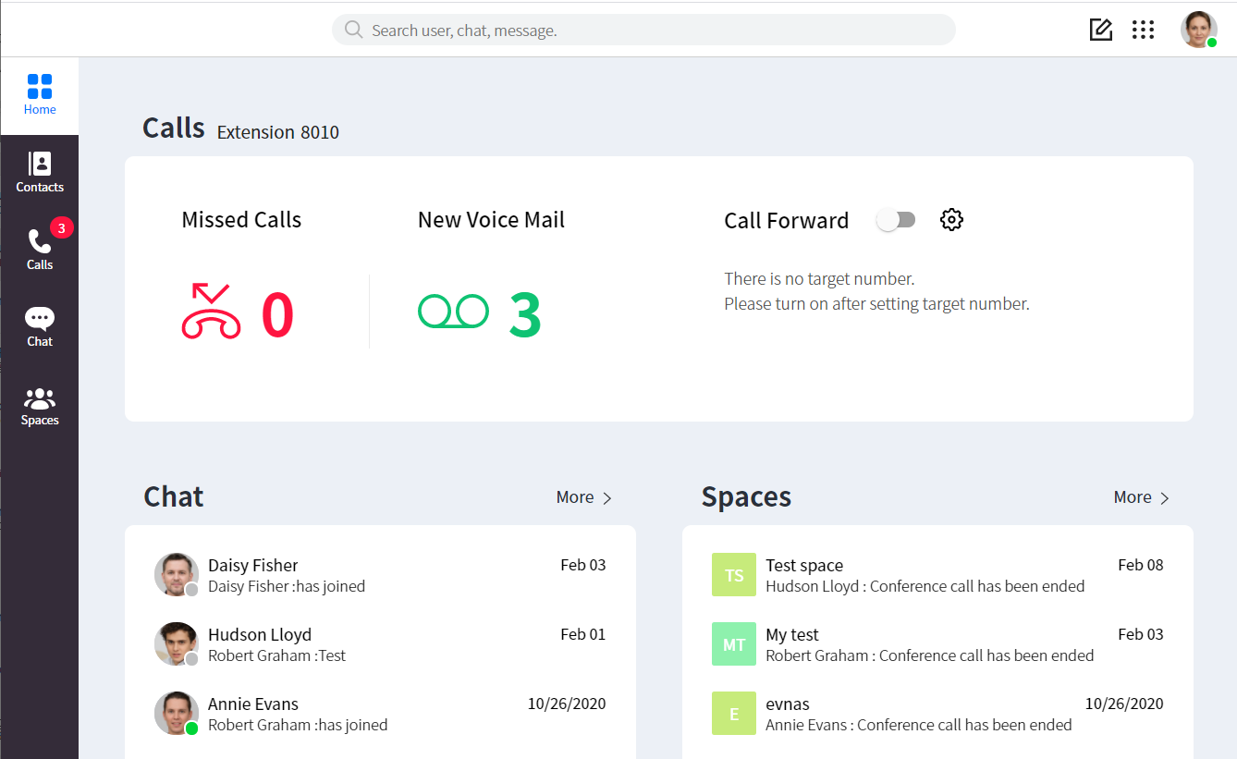
iPECS One Collaboration Web Client
Main Menu Tab
Global Search
New Chat
Keypad
Settings
Call Information Area
Chat Information Area
Collaboration Information Area

Slide 5
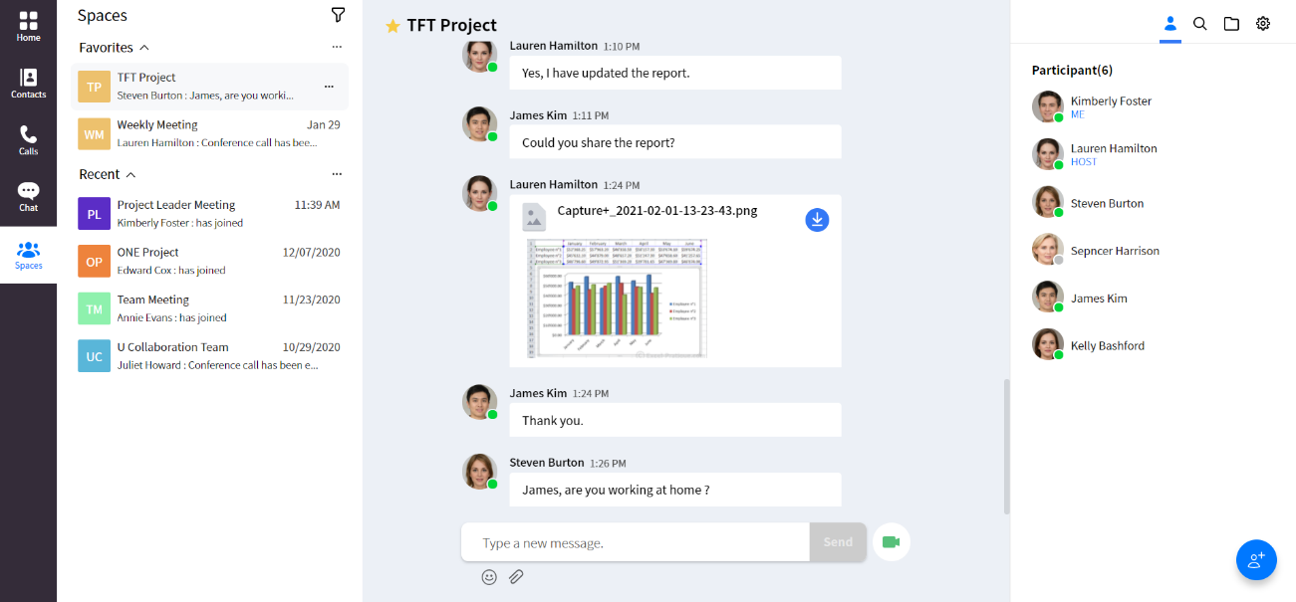
iPECS One Collaboration Web Client: Spaces
The Space room list area shows favourite and recent Spaces
The middle shows the Space content; messages, emojis and files can be exchanged.
The right hand side menu shows participant info, message search, attached files and the session menu.
(1)
(2)
(3)

Slide 6
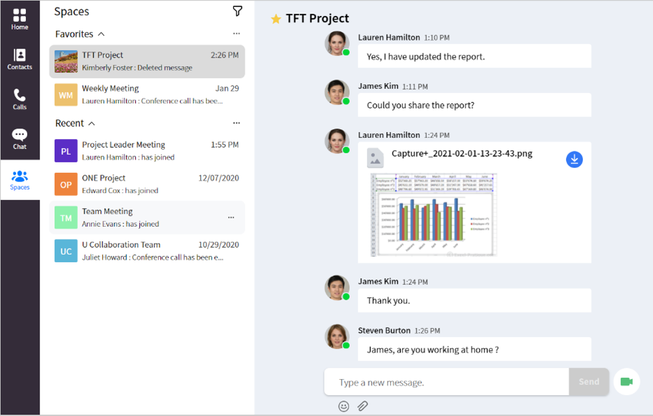
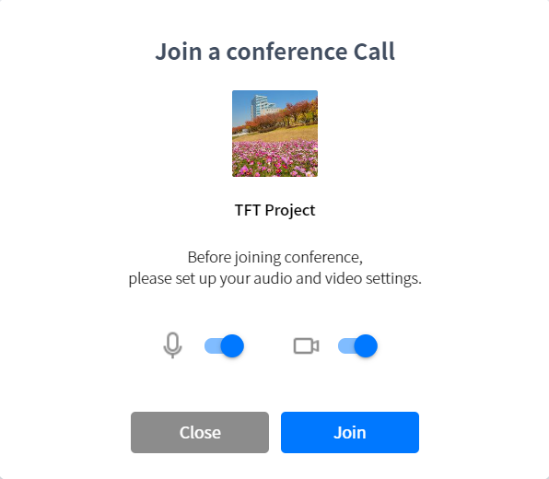
iPECS One Collaboration Web Client: Start a video conference
Select a Space and click the Video Conference button from within the Space .
Choose audio and video option before starting the video conference
Click Join
(1)
(2)
(3)
(1)

Slide 7
iPECS One Collaboration Web Client: Join a video conference
When a host initiates video conference, all other Space members get a video conference notification pop-up.
Click Go to Video Conference on the notification pop-up.
Choose audio and video options before joining the video conference
Click Join
(1)
(2)
(3)

Slide 8
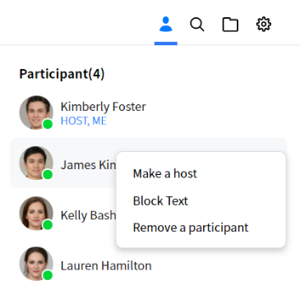
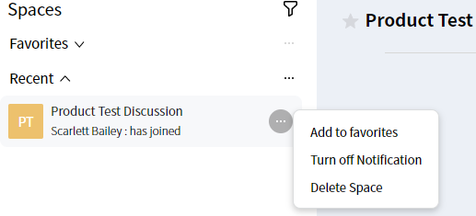
iPECS One Collaboration Web Client: Host options
The host can perform administrative functions from within the space. They can;
Grant host privileges to another participant.
Block other participants from sending chat messages.
Remove participants from the space.
The host can also delete the space.
(1)
(2)

Slide 9
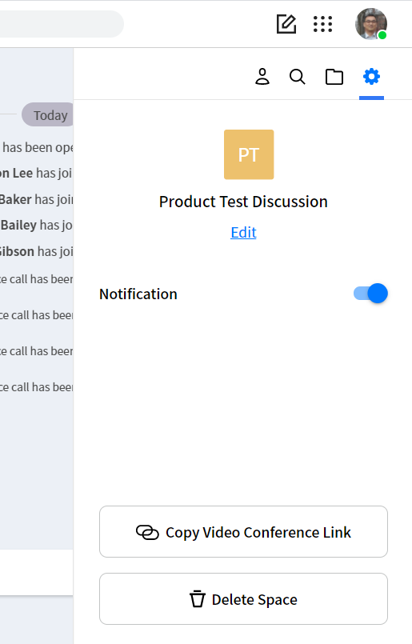
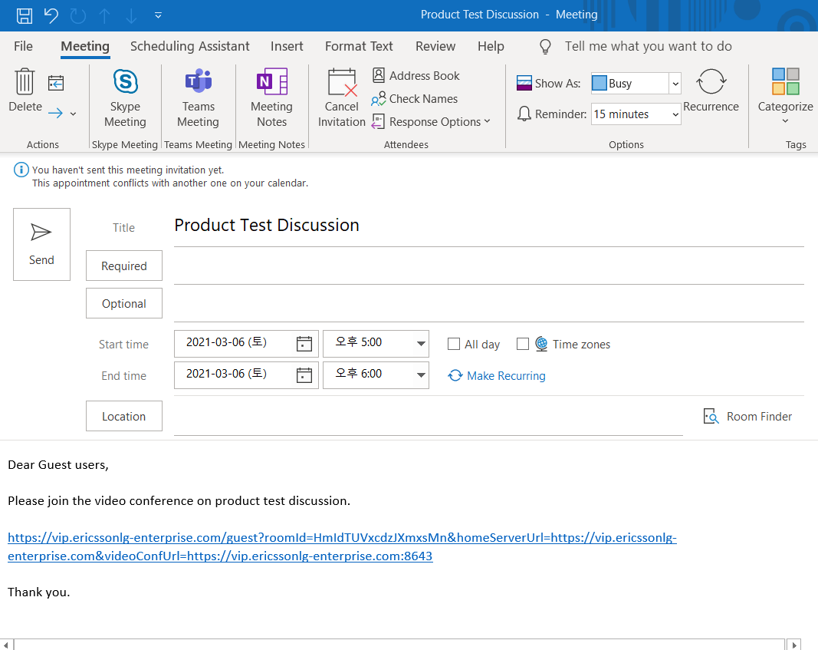
iPECS One Collaboration Web Client: Guest invite
The host or a participant can invite guests (Non-iPECS One Collaboration users) by sharing the Video Conference Link.
In the Spaces menu, click Copy Video Conference Link to copy the guest URL link to clipboard.
Then, send this to the party you would like the to join the conference. They will then need to paste this into their web browser.
(1)
(2)
(1)

Slide 10
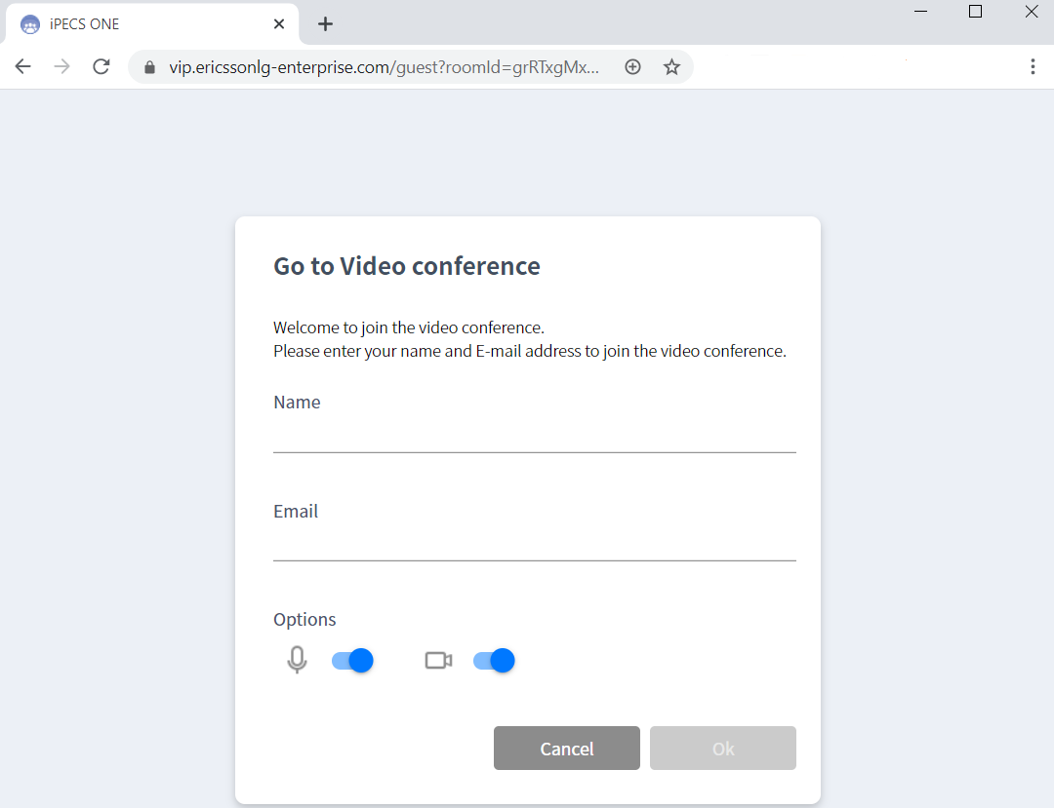
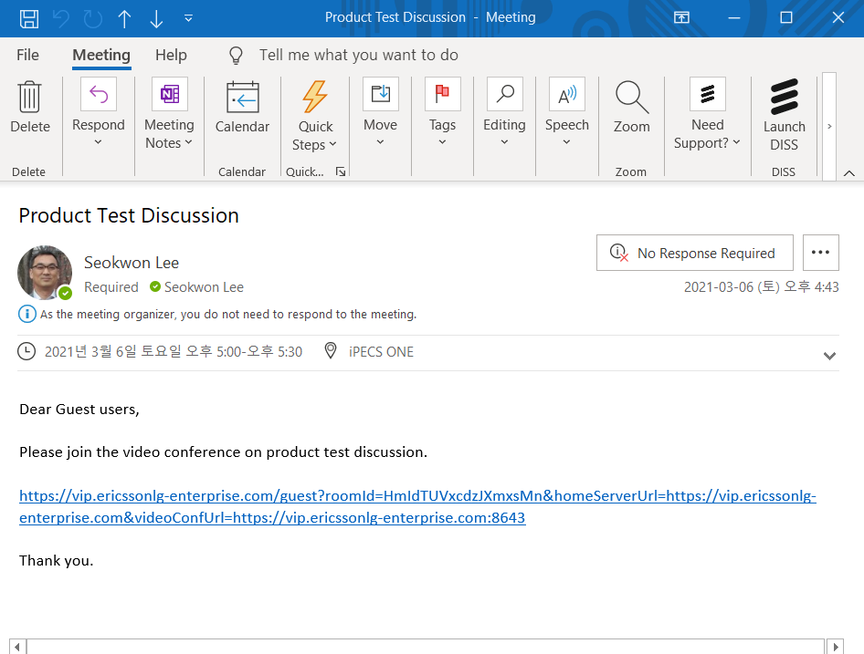
iPECS One Collaboration Web Client: Guest invite
The guest can then join the Video Conference by clicking the guest URL link in the invitation e-mail. (Guest invitation is not supported for mobile users)
Enter their name and e-mail address.
Choose audio and video settings before joining the video conference.
Click OK.
(1)
(2)
(3)

Slide 11
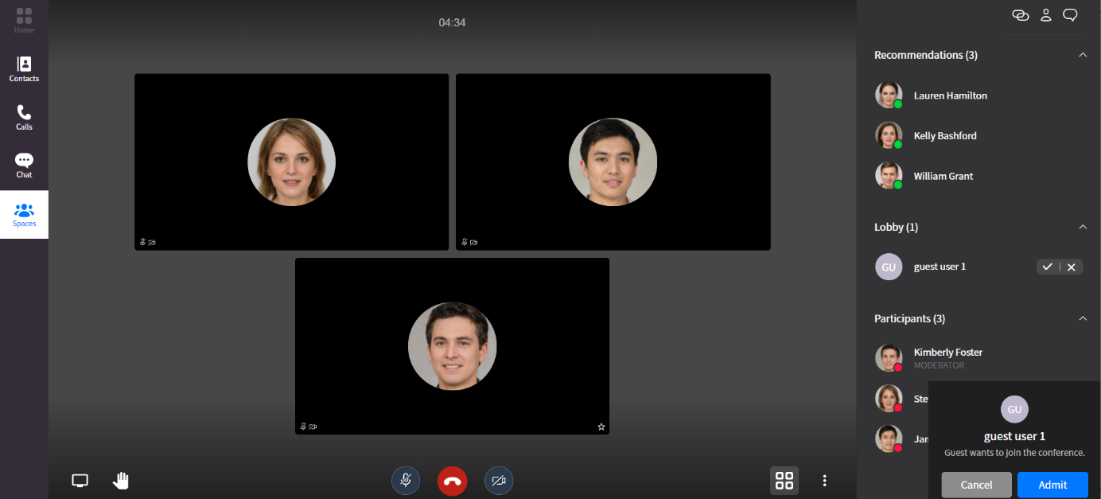
iPECS One Collaboration Web Client: Guest invite
Conference host can admit or reject when the guest requests to join the conference.
Click Admit in the lobby section.
or
Click Admit button in the pop-up
(1)
(2)

Slide 12
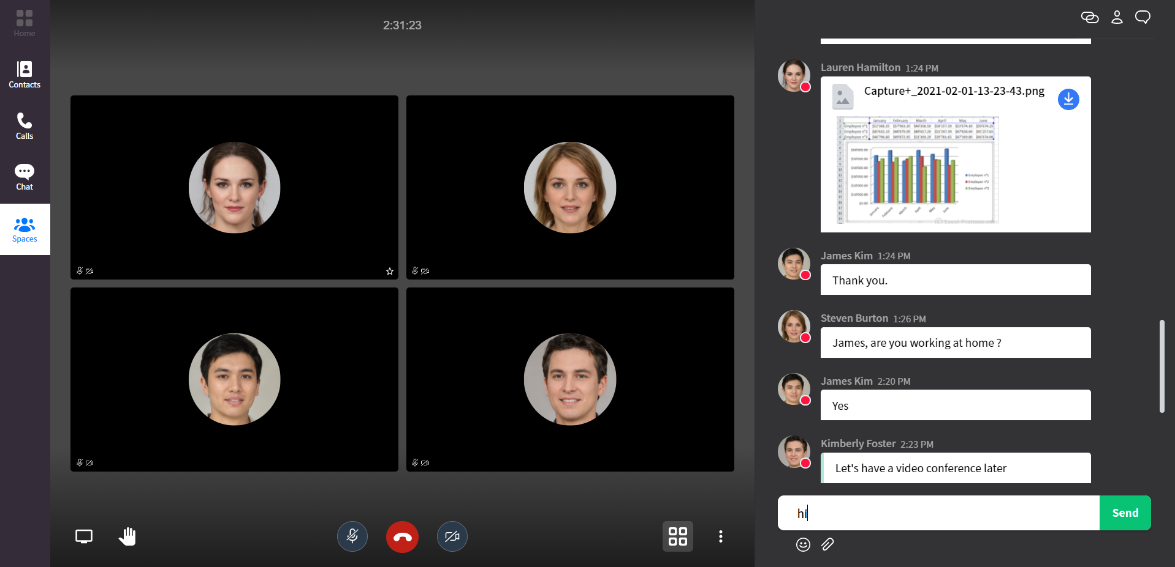
iPECS One Collaboration Web Client: Video conference
Up to 15 parties can join the video conference.
Session Menu
Sharing
Raise hand
Mute
End
Camera
Tile View
More Actions

Slide 13
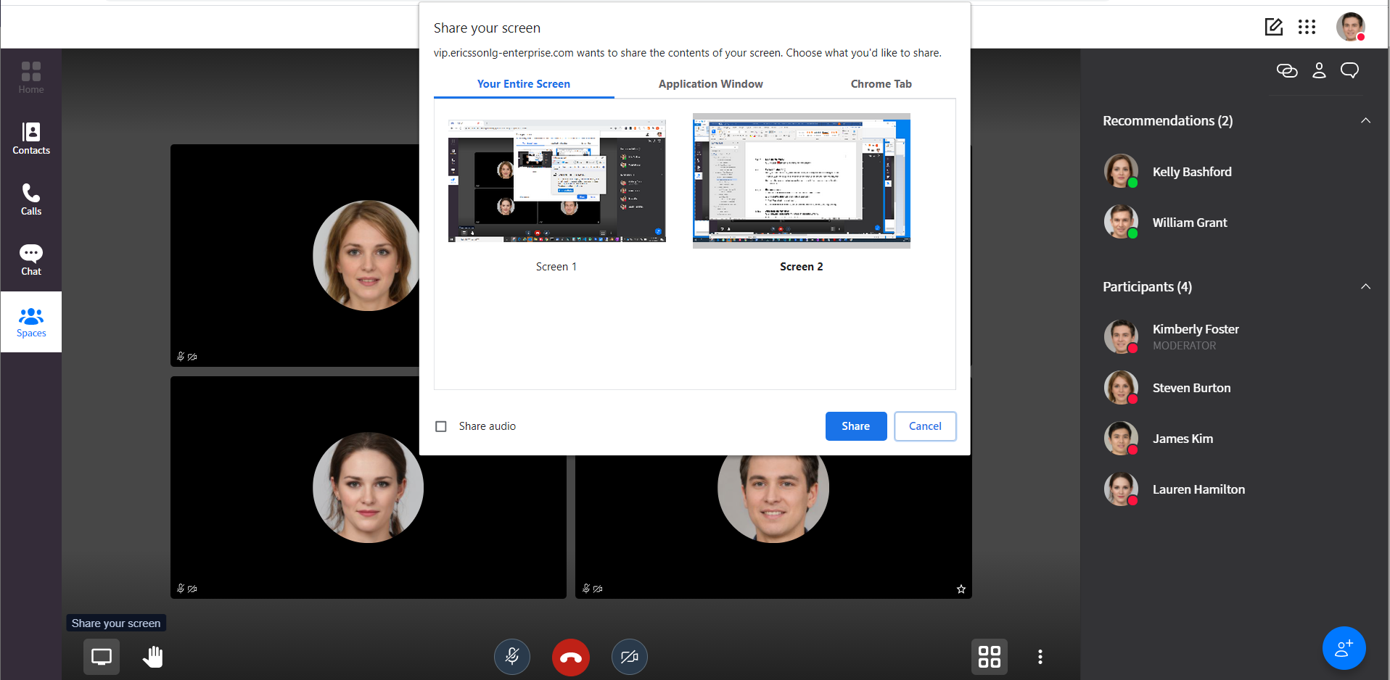
iPECS One Collaboration Web Client: Screen sharing
During a video conference parties are able to share their screen.
Select (screen share) button at the bottom left of video conference screen.
Choose entire screen, application window, or chrome tab to be shared to the video conference.
Select Share audio if you want to share your PC audio to other parties.
Click the Share button.
(2)
(3)
(4)
(1)

Slide 14
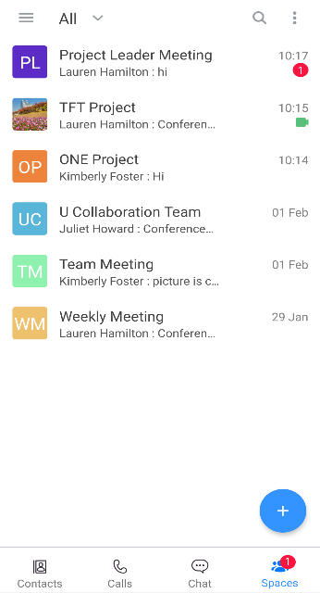
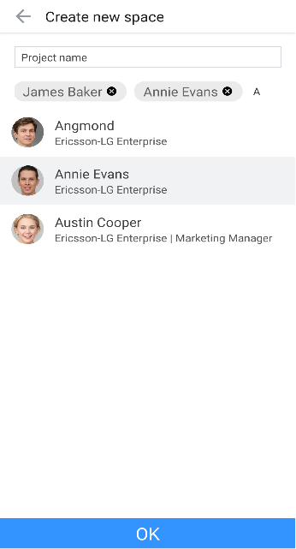
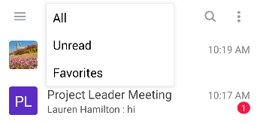
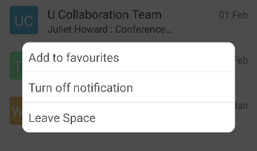
iPECS One Collaboration Mobile Client: Space creation & config
To create new space on the mobile app, tap (Create) button, enter a space name, search for users you would like to add, then tap “OK”.
You can filter the list of Spaces by All, Unread or Favorites by tapping (Filter) at the top left.
You can leave a space, turn on/off notifications for the space and add to/remove from Favorites on the space list menu.
(1)
(2)
(3)
(1)
(1)

Slide 15
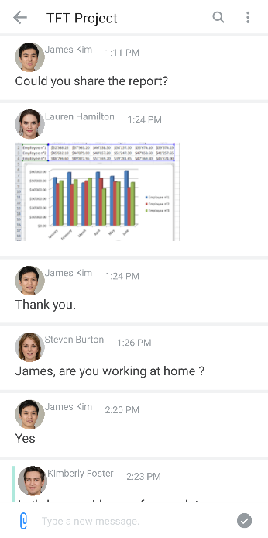
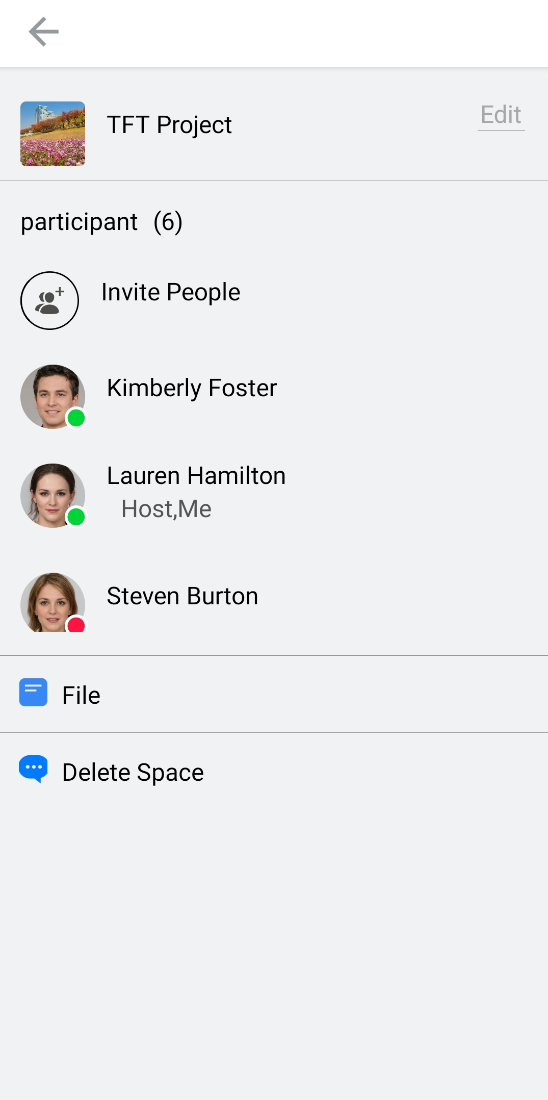
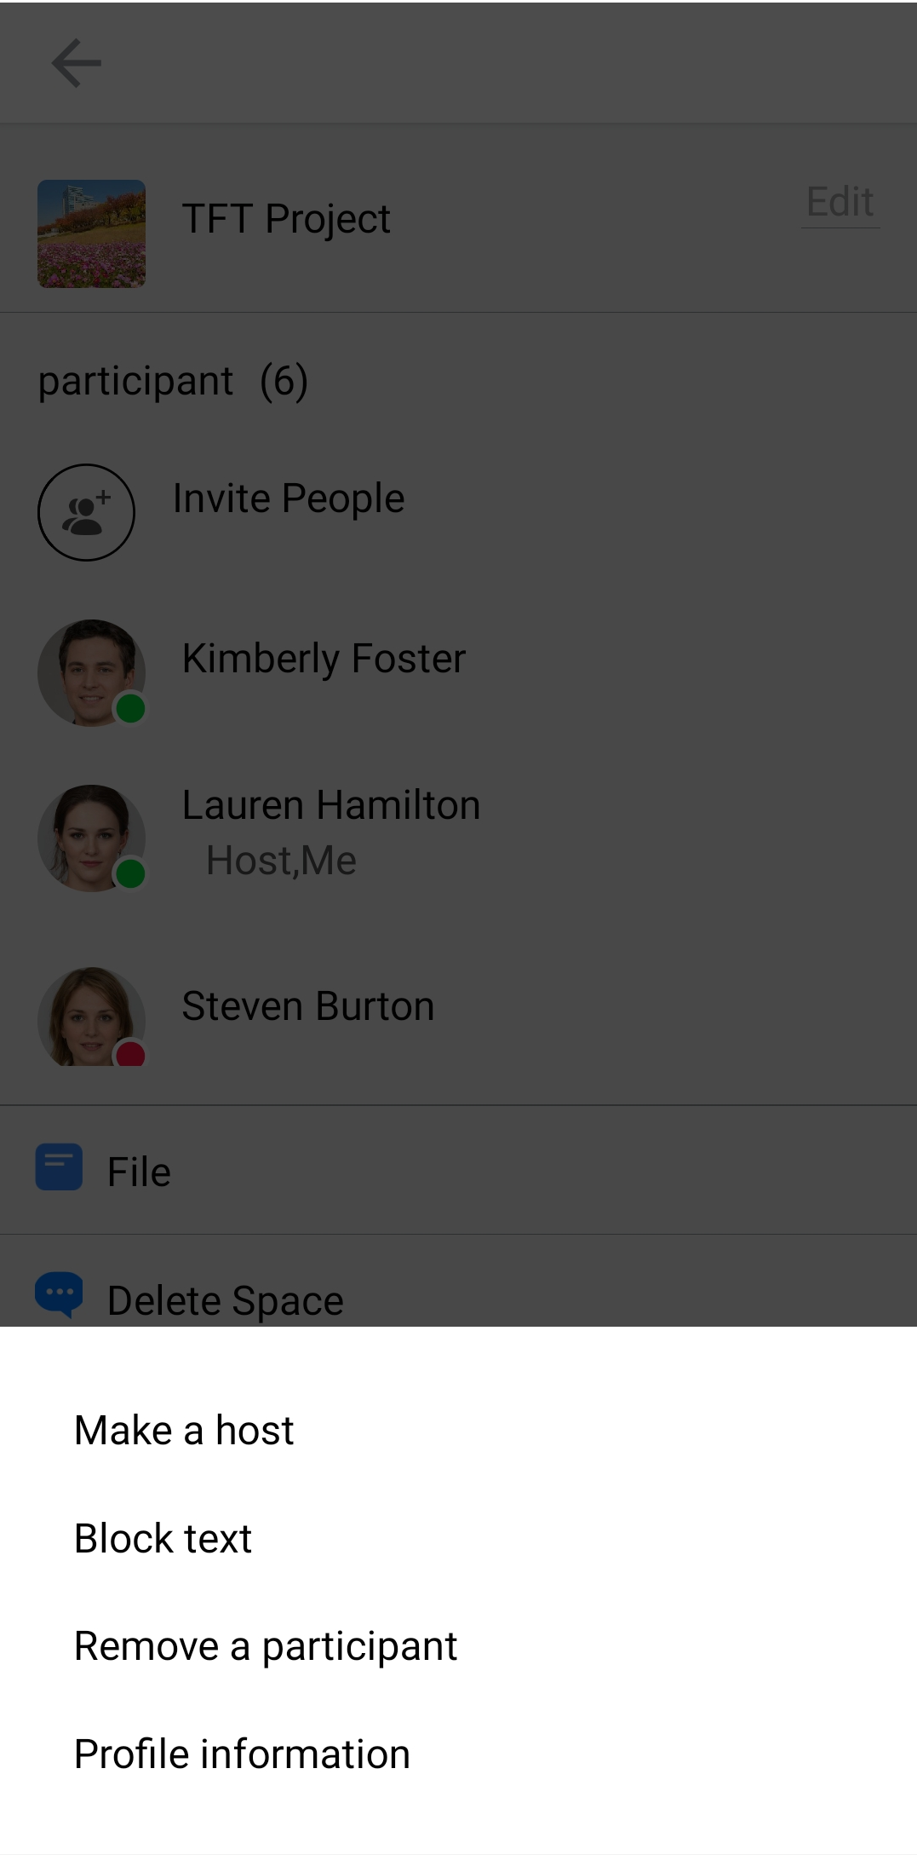
iPECS One Collaboration Mobile Client: Manage a Space
Tap the Option button to display the menu
Tap a participant to display the pop-up menu.
Select an option to manage the participant.
(1)
(2)
(3)

Slide 16
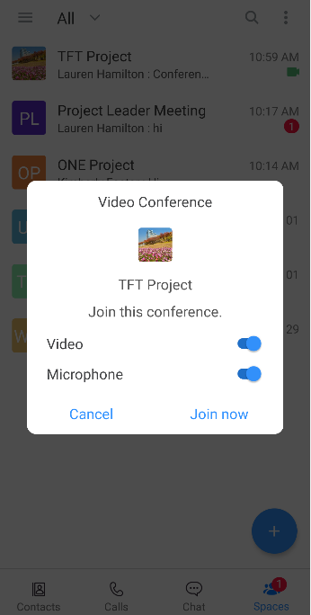
iPECS One Collaboration Mobile Client: Join a video conference
Join from invitation notification
All space room members and invited iPECS ONE users will receive an invitation notification when the video conference begins.
(Mobile client can only join a conference)
Set up your audio and video before starting a video conference.
Tap Join now.
Join the video conference in progress
You can join the video conference in progress from the space list.
Select the space that has the video conference status icon displayed on the right of the space list.
Click Video Conference in the space.
(1)
(2)
(II)
(I)

Slide 17
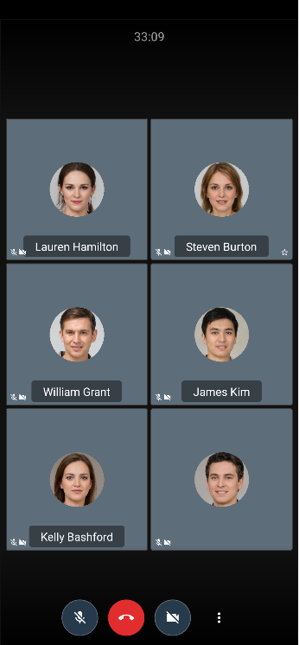
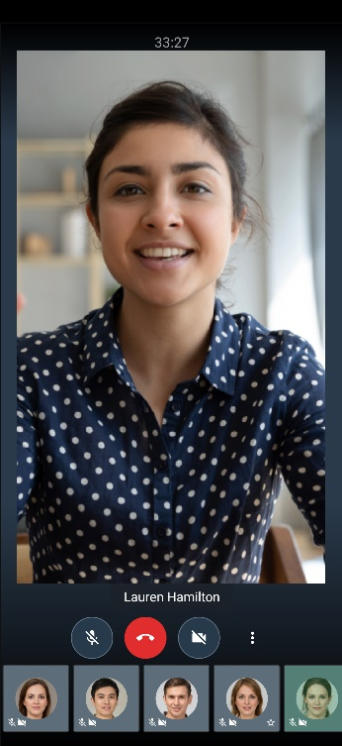
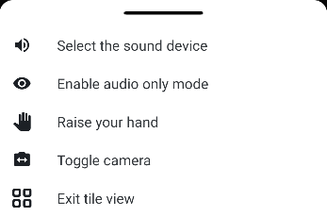
iPECS One Collaboration Mobile Client: Video conference menu
Mute
End
Stop Camera

